Slide 3
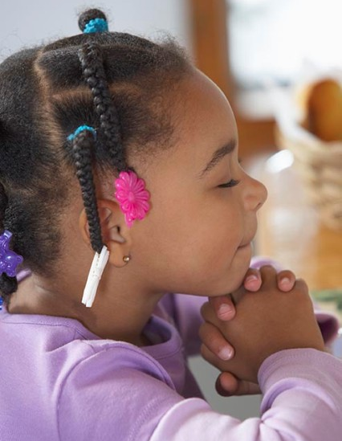
Thank You
Prayers
Please
Prayers

Slide 5
Memory Verse

Slide 6
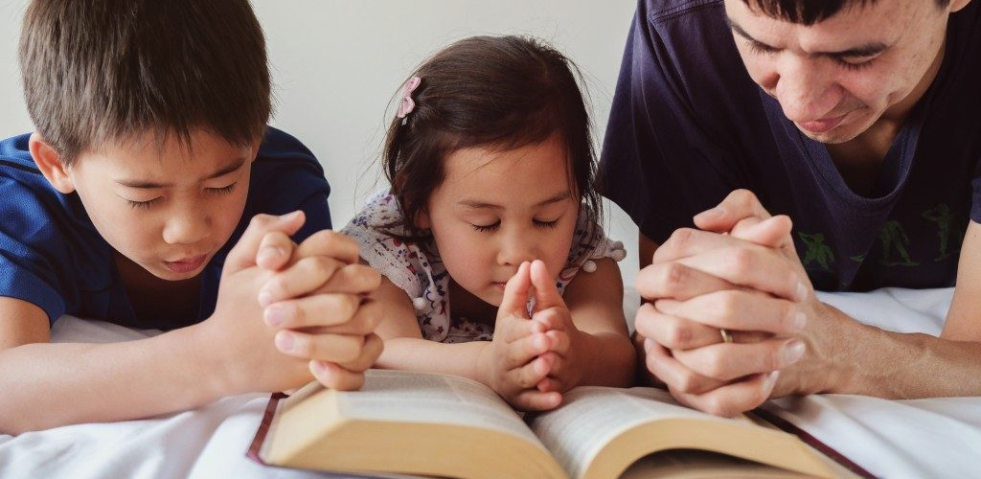
1 Cor. 15:58
“…Be ye steadfast, unmovable, always abounding in the work of the Lord….”

Slide 7
Notes:
Song: “I Have Decided to Follow Jesus”

Slide 9
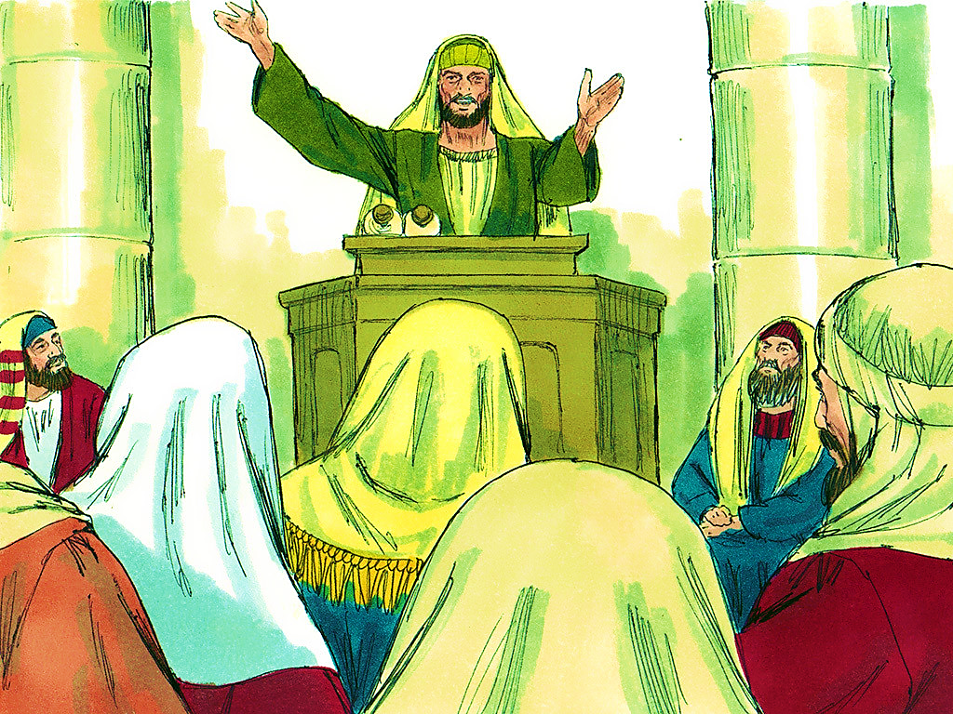
5-1
Notes:
5-1

Slide 10
1 John 1:7b
“… the blood of Jesus Christ
His Son cleanseth us from all sin.”

Slide 11
5-1
Notes:
5-1

Slide 13
5-1
Notes:
5-1

Slide 14
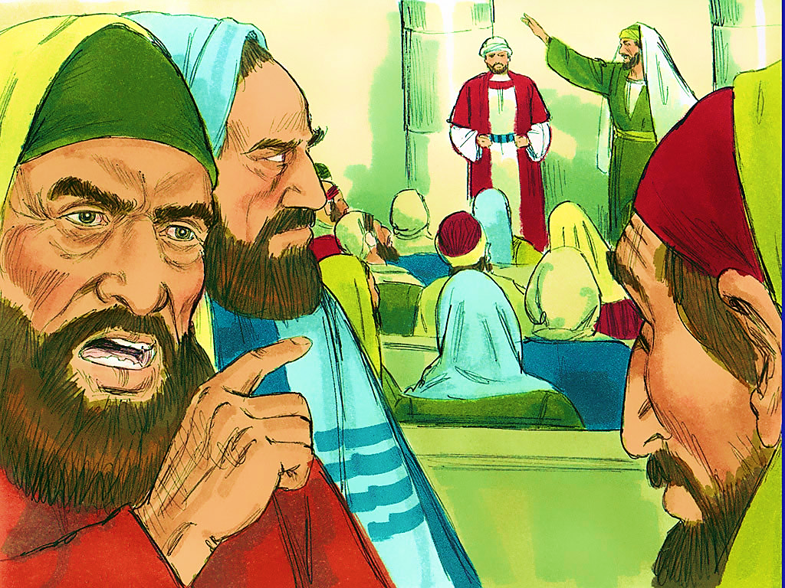
5-2
Notes:
5-2

Slide 15
Ecc. 7:20
“For there is not a just man upon earth, that… doeth good, and sinneth not.”

Slide 16
5-2
Notes:
5-2

Slide 17
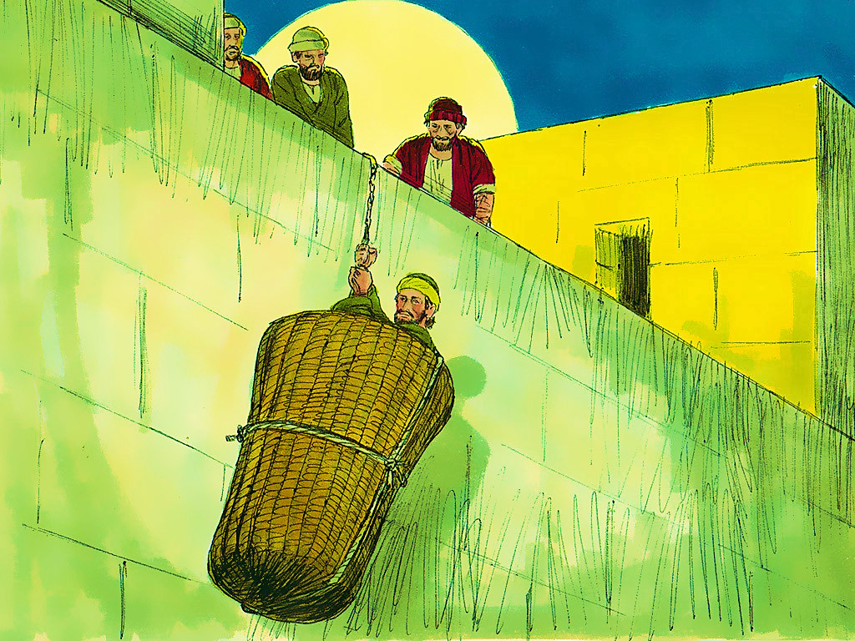
5-3
Notes:
5-3

Slide 18
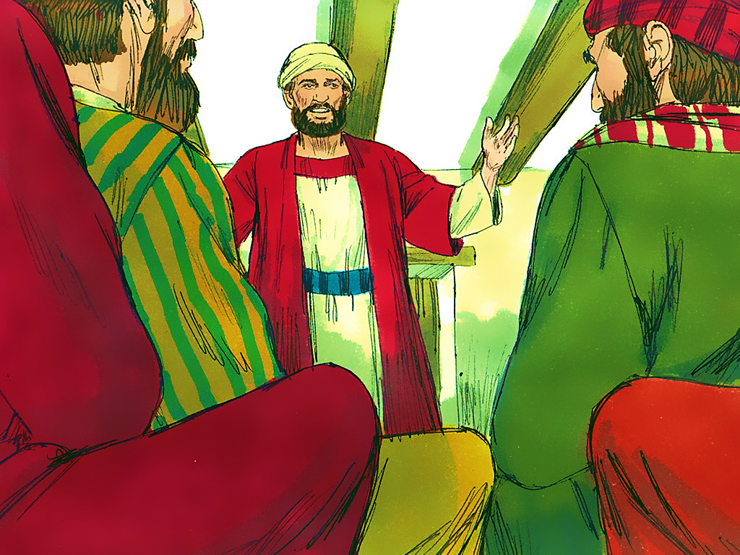
5-4
Notes:
5-4

Slide 20
1 Cor. 15:58
“…Be ye steadfast, unmovable, always abounding in the work of the Lord….”

Slide 21
5-4
Notes:
5-4

Slide 22
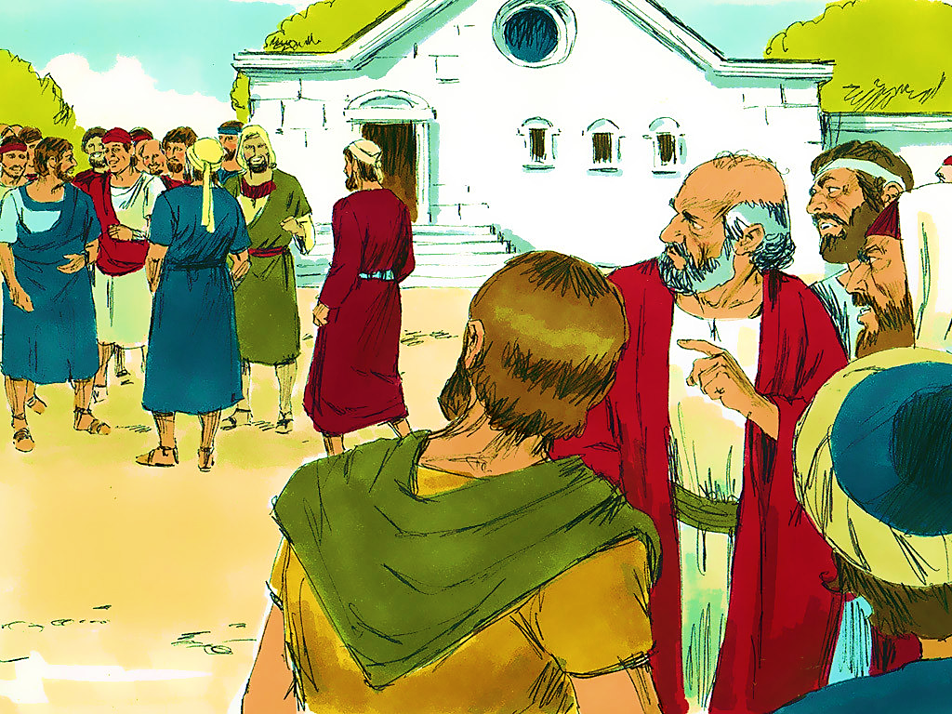
5-5
Notes:
5-5

Slide 23
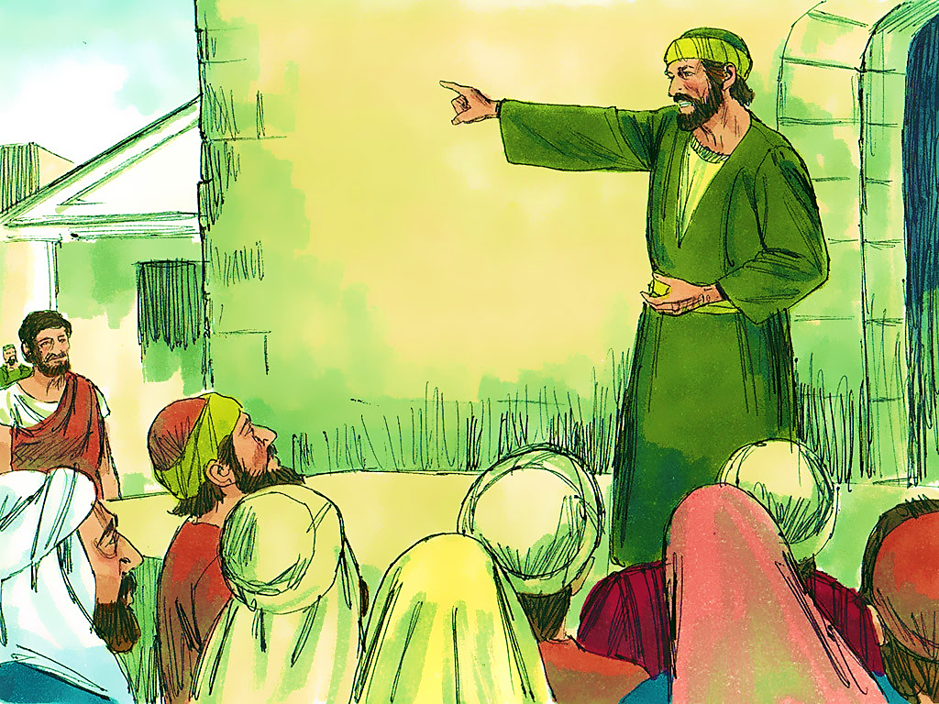
5-6
Notes:
5-6

Slide 24
John 3:16
“For God so loved the world,
that He gave His only begotten Son,
that whosoever believeth in Him
should not perish but have everlasting life.”

Slide 26
1 Cor. 15:58
“…Be ye steadfast, unmovable, always abounding in the work of the Lord….”

Slide 30
Review
G
A
M
E

Slide 32
Thank you for
joining our

Slide 33
Notes:
You can Screen Share these Counseling Card slides to go through as you normally would.

