Slide 1
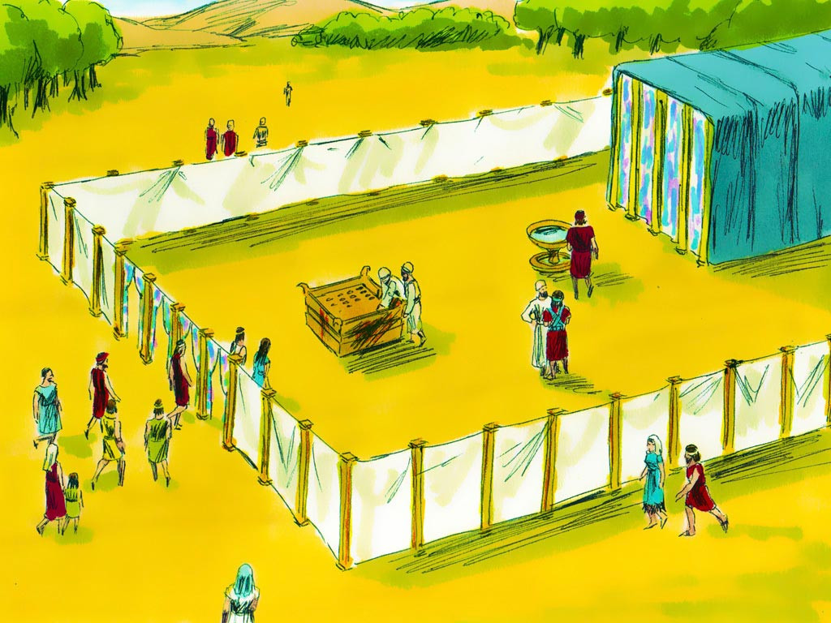
Tabernacle #1
“The Way of Approach to God”

Slide 2
Notes:
Rule Chart

Slide 3
Notes:
Prayer

Slide 4
Notes:
Song: “All that is Good”

Slide 8
Notes:
Bible Lesson

Slide 9
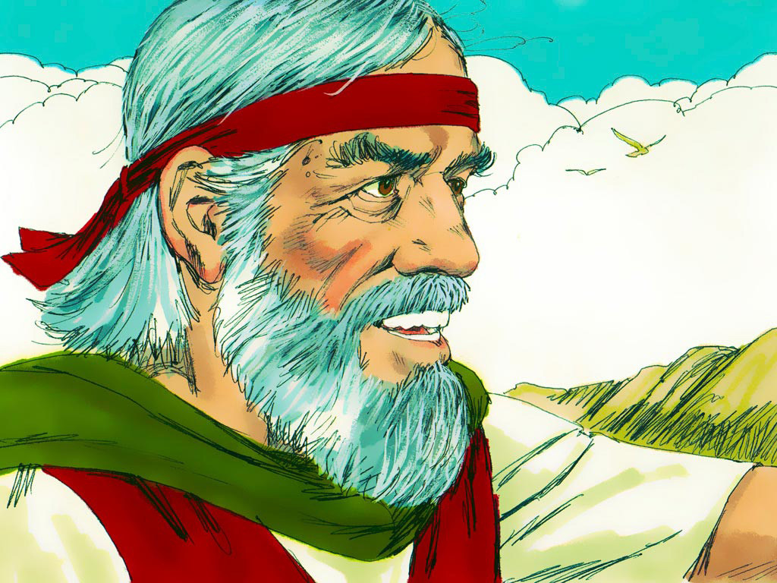

Slide 12
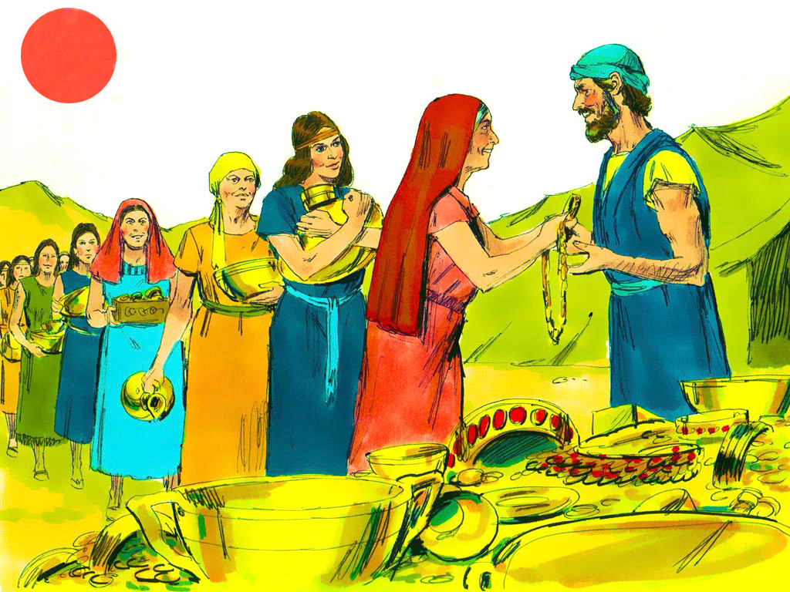

Slide 24
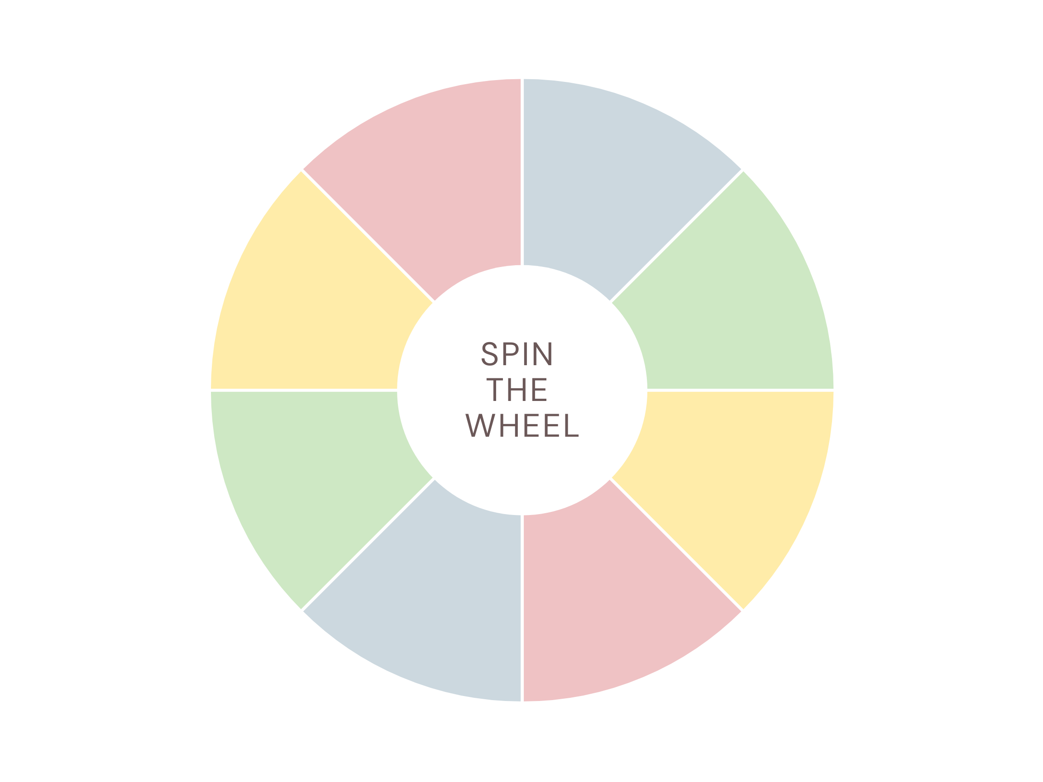

Slide 25
T
A
B
E
R
N
A
C
L
E
E
T
C
B
SPIN!
N
R
E
A
A
L
TABERNACLE

