Slide 1
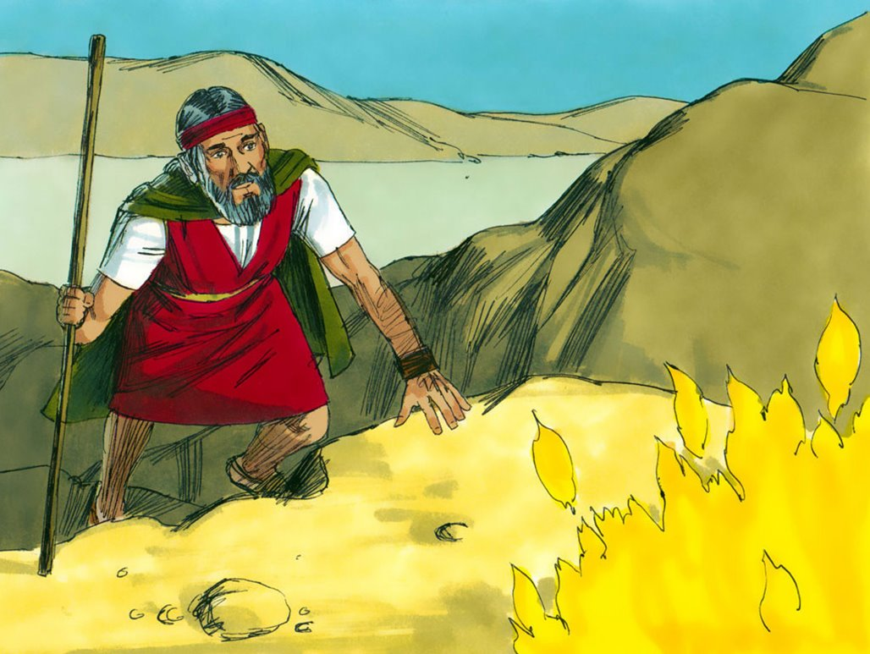
MOSES
“Review”

Slide 2
Notes:
Rule Chart

Slide 3
Notes:
Prayer

Slide 4
Notes:
Song: “All that is Good”

Slide 6
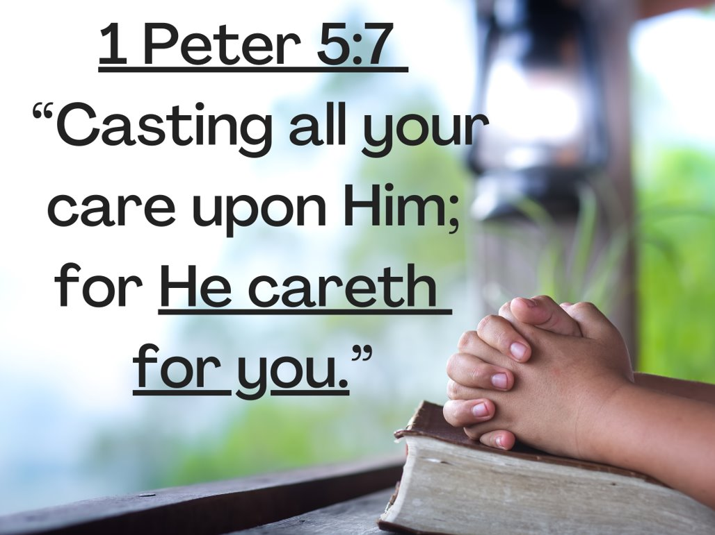
Notes:
MV #1

Slide 7
Notes:
MV #2

Slide 8
Notes:
MV #3

Slide 9
Notes:
MV #4

Slide 10
Notes:
MV #5

Slide 11
Notes:
MV #6

Slide 12
Notes:
MV #7

Slide 13
Notes:
MV #8

Slide 14
Notes:
MV #9

Slide 15
Notes:
MV #10

Slide 16
Notes:
MV #11

Slide 17
Notes:
MV #12

Slide 18
Notes:
Song: “My God is Powerful”

Slide 19
Notes:
Bible Lesson

Slide 20
Rock, Paper, Scissors
If a child answers a question correctly, he may play “Rock, Paper, Scissors” against the GNC friends on this slide. Once he chooses either rock, paper, or scissors you may click the screen to reveal one of the friends and their choice.
Rock (closed fist), scissors (fist with two fingers extended like scissors blades), or paper (hand opened flat, palm down) .
The winner of the round is determined as follows: rock beats scissors, scissors beats paper, and paper beats rock. Because this is a well-known game, the children are already enthusiastic about playing it. Have fun!

Slide 22
THE GOSPEL “MEMORY GAME”
- Play like “Concentration.”

Slide 23
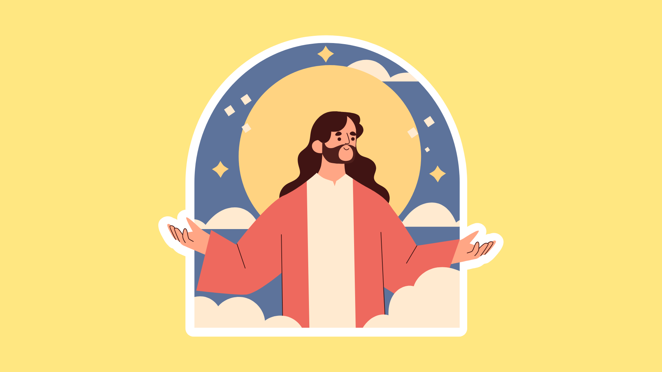
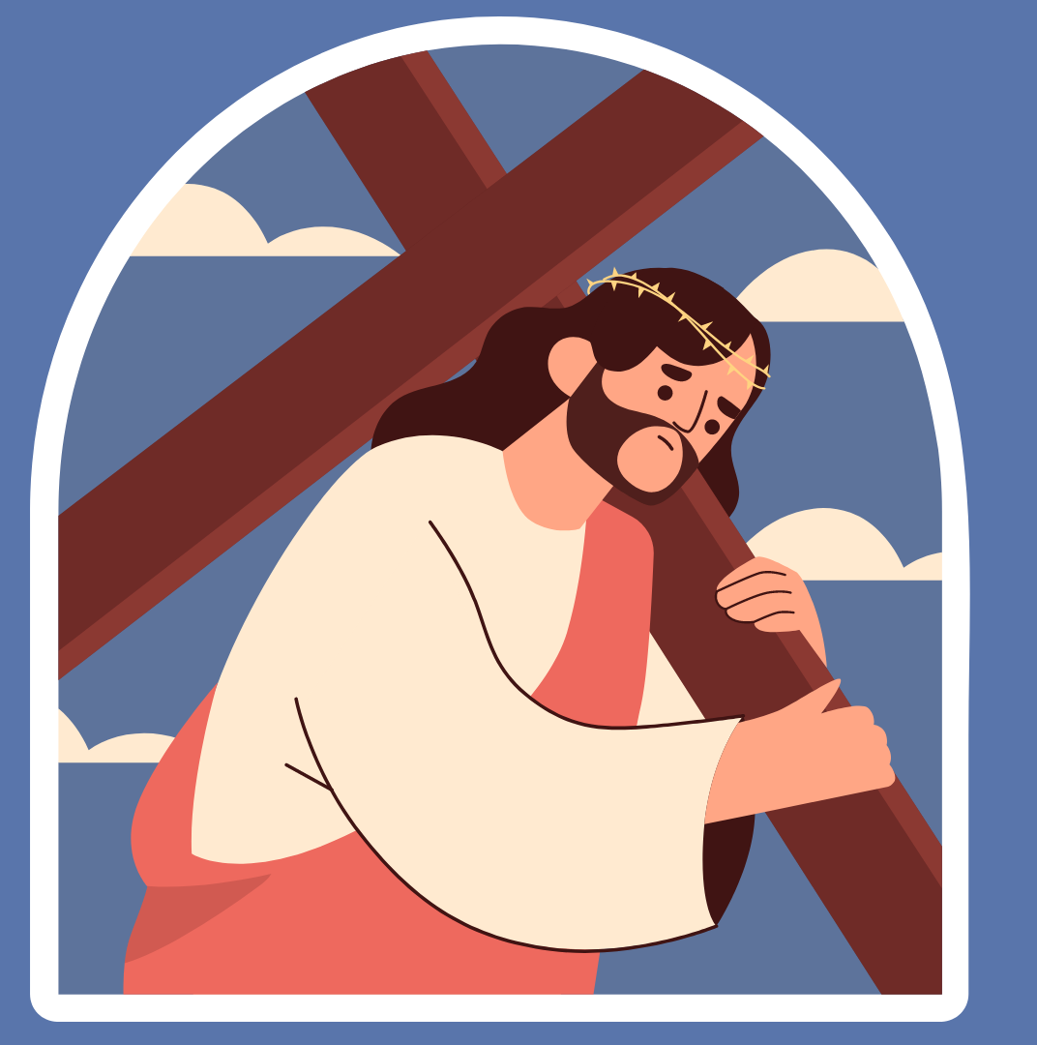
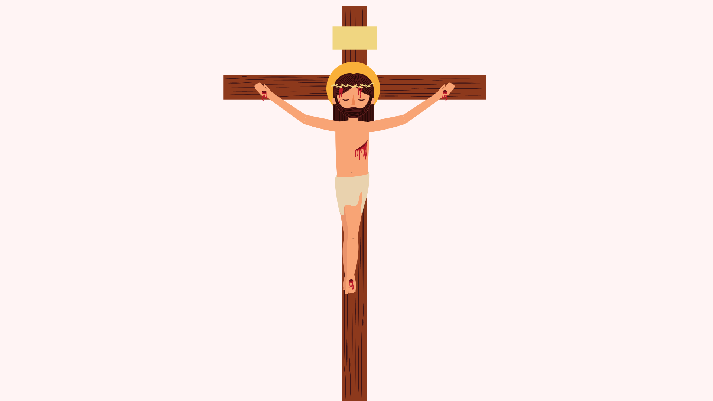
1
2
3
4
5
6
7
8
9
10
11
12

Slide 24
Zonk
Divide the children into 2 teams.
Once a child answers correctly, click on the wheel to spin for points for his team.
Child can spin for points as many times as he wants.
But if he gets Zonk, he loses all points earned for that turn.
If the PowerPoint doesn’t work, you may use "Wheel of Names."

Slide 25
100
Zonk
100
200
200
300
300
SPIN!
400
Zonk
500
400
Zonk
500
600
600
700
1,000
800
Zonk
900
tekhnologic

Slide 27
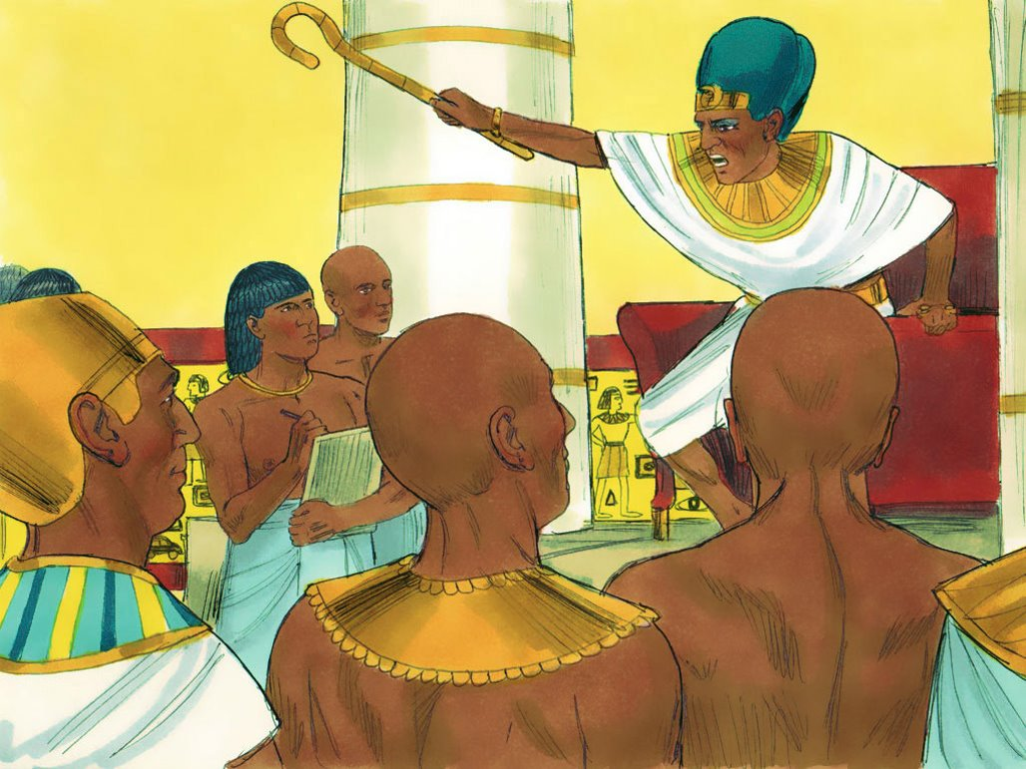
What terrible thing did the Egyptians do to the Israelite people?

Slide 28
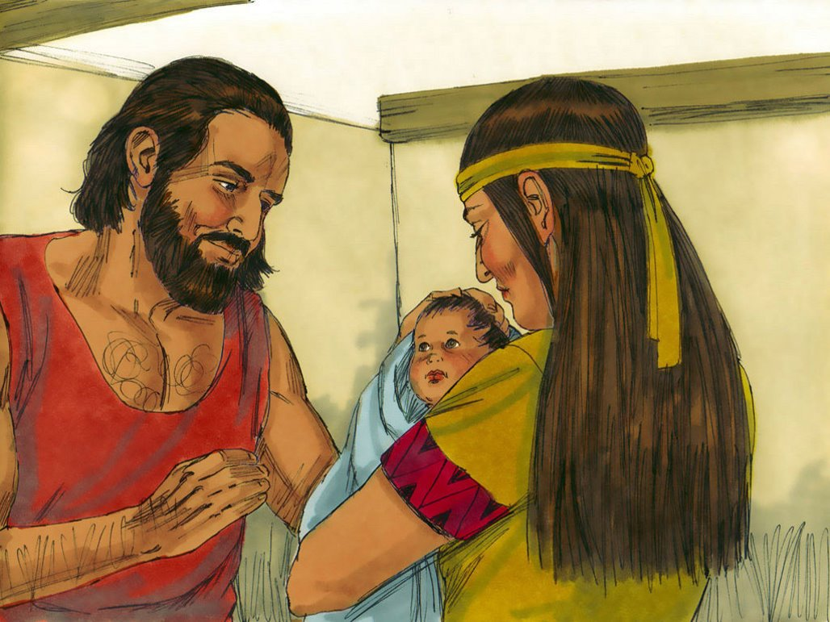
Why did Moses’ mother hide him in a
basket on the river when he was a baby?

Slide 29
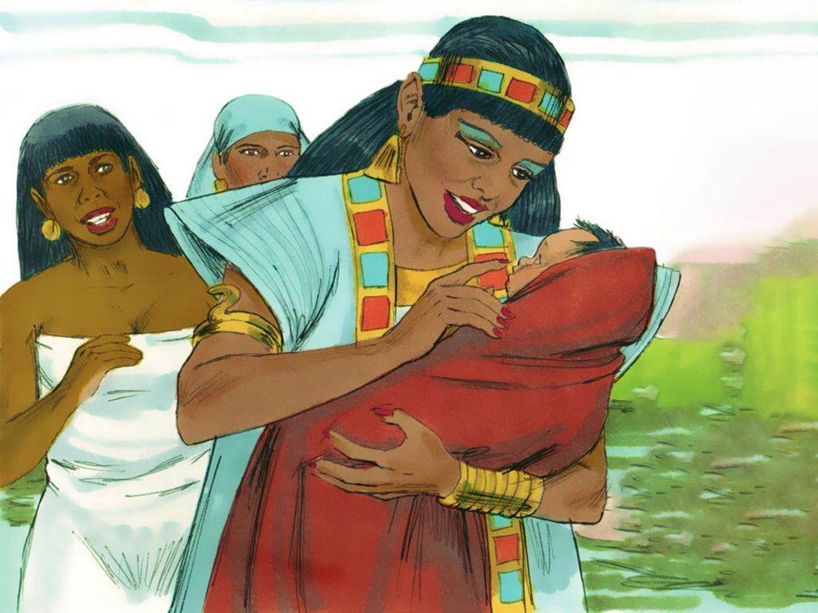
Who found Moses and decided to take
care of him instead of killing him?

Slide 30
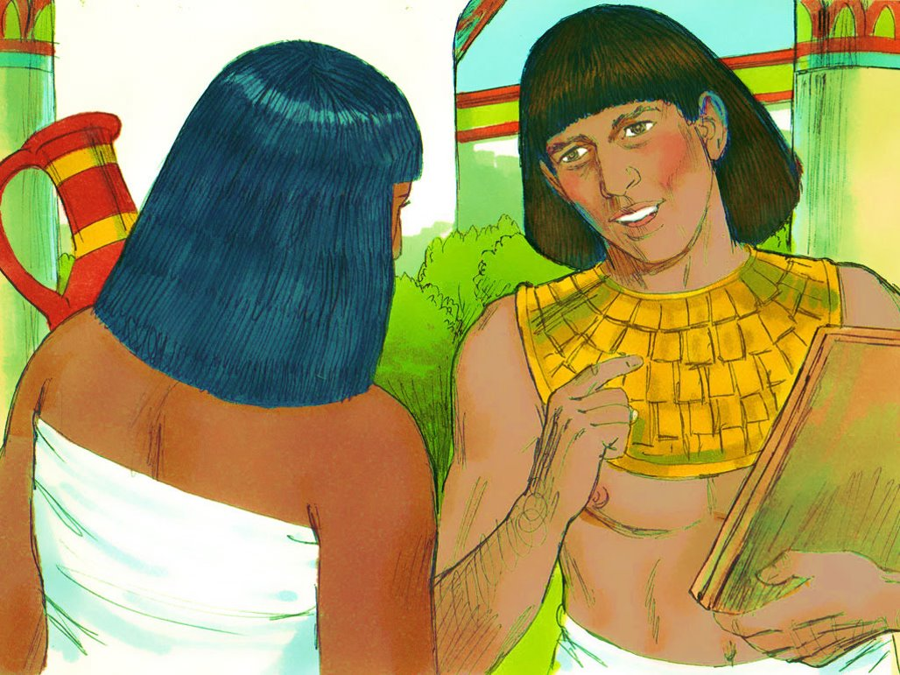
When Moses grew up, saw and Egyptian man beating an Israelite man, what did Moses do?

Slide 31
True/False
Moses could become the one who would lead the Israelites to freedom from the Egyptians without God’s help.
Notes:
2-2

Slide 32
What did God tell Moses that He was going to help Moses do?

Slide 33
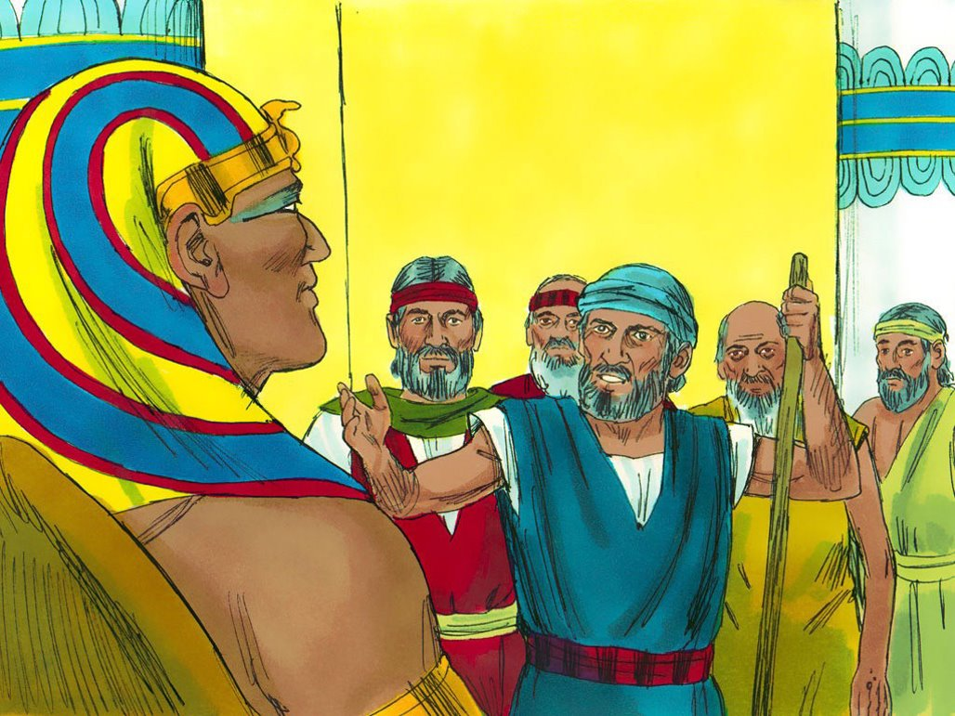
When Moses told Pharaoh to let the Israelites go, Pharaoh said no. What did God do to the Egyptians because of this?

Slide 34
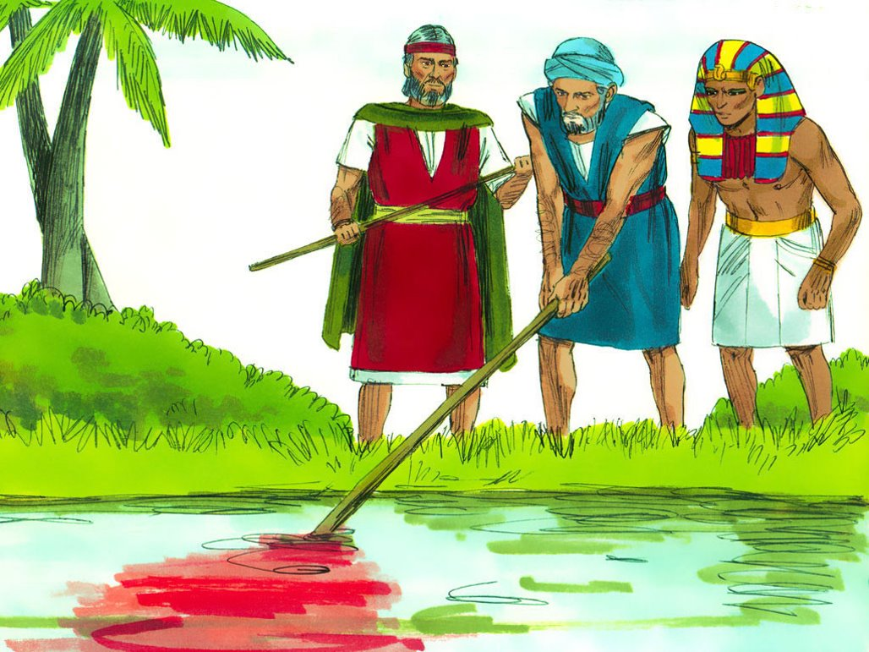
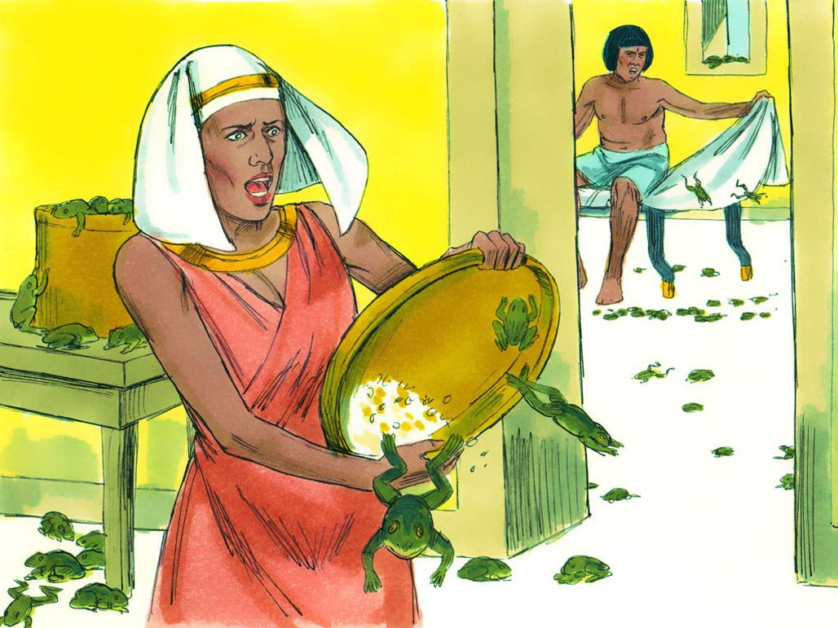
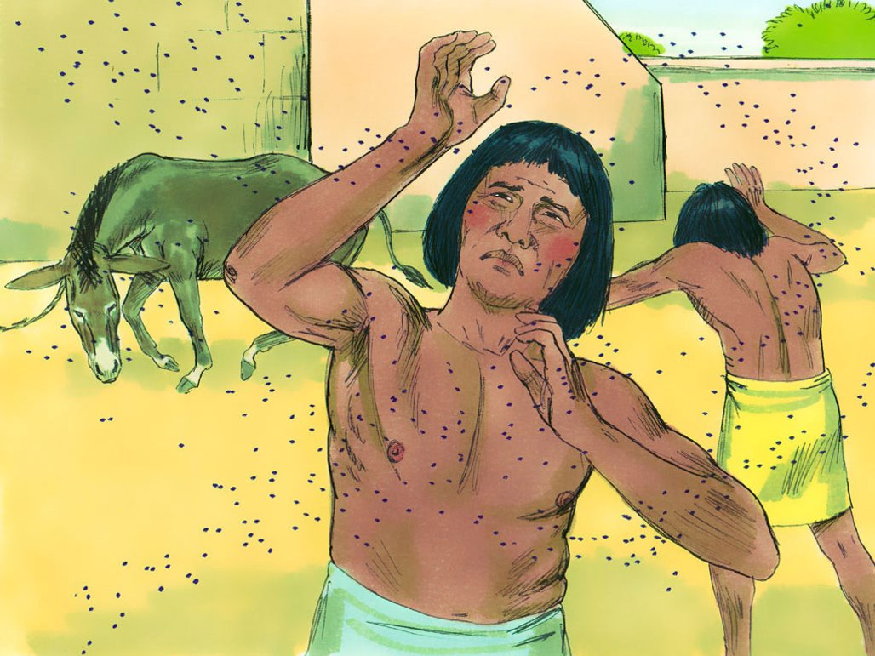
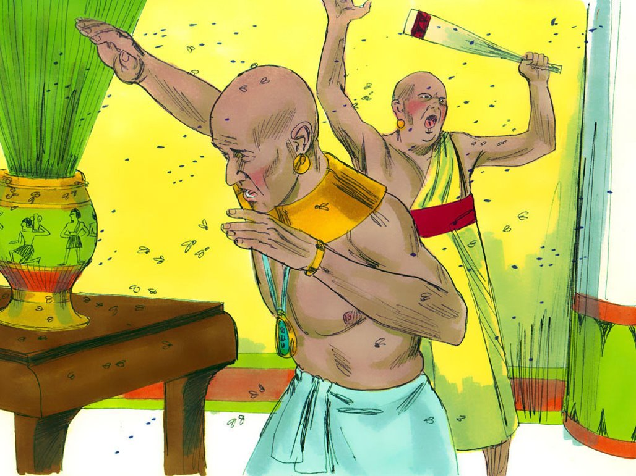
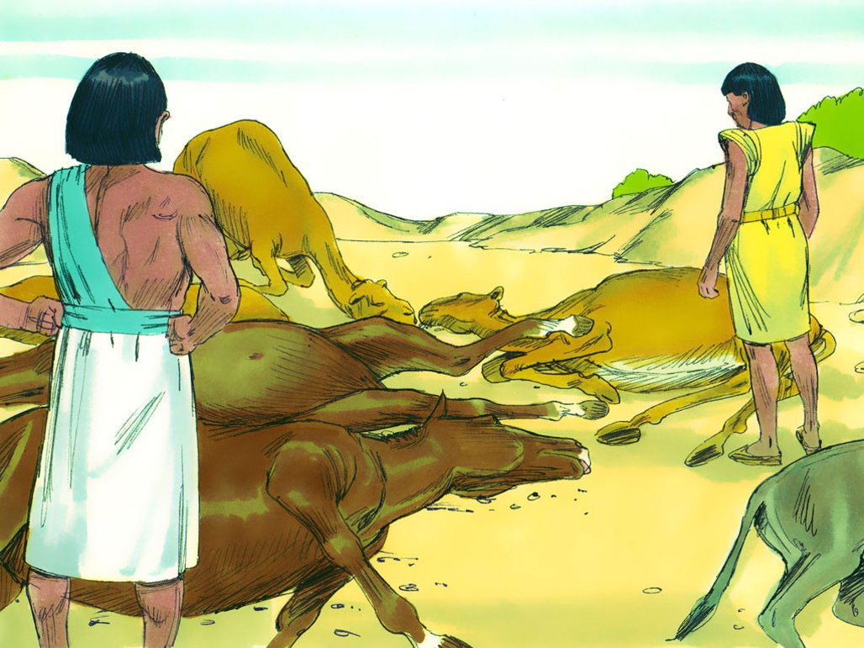
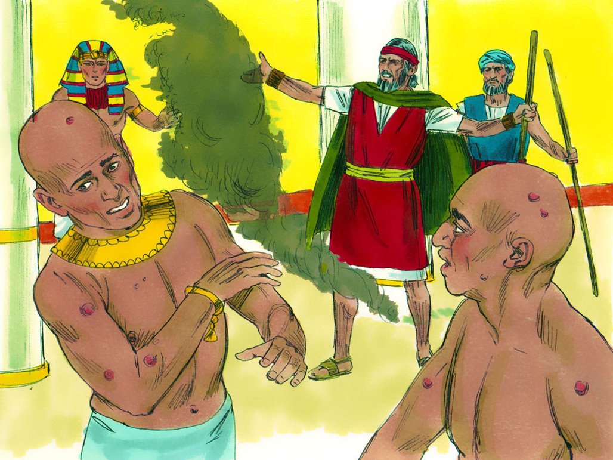
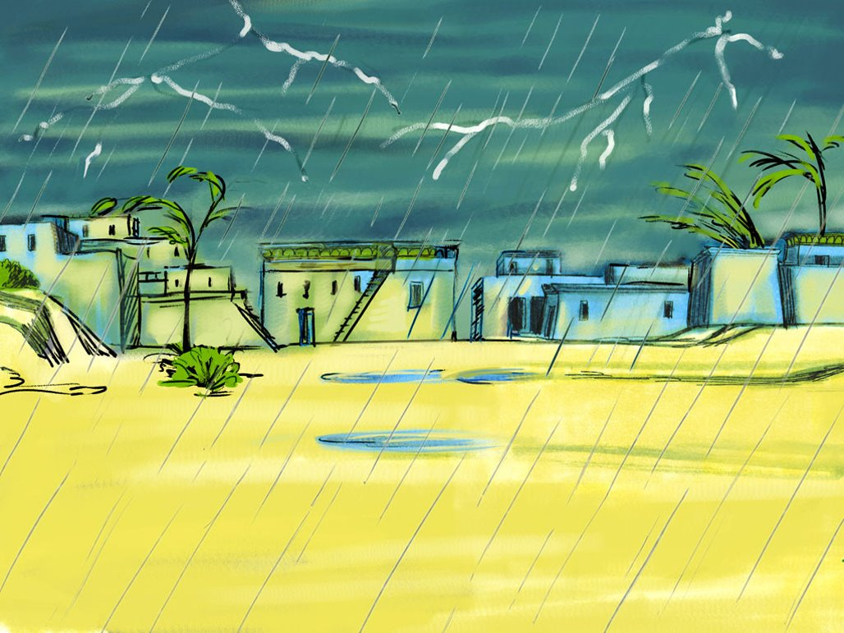
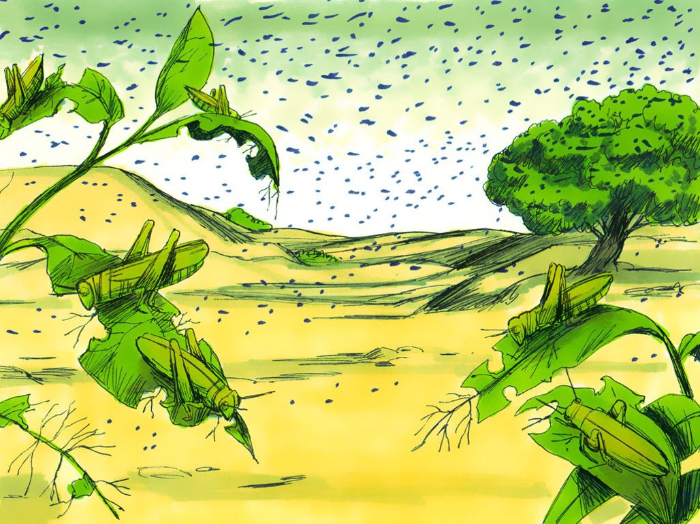
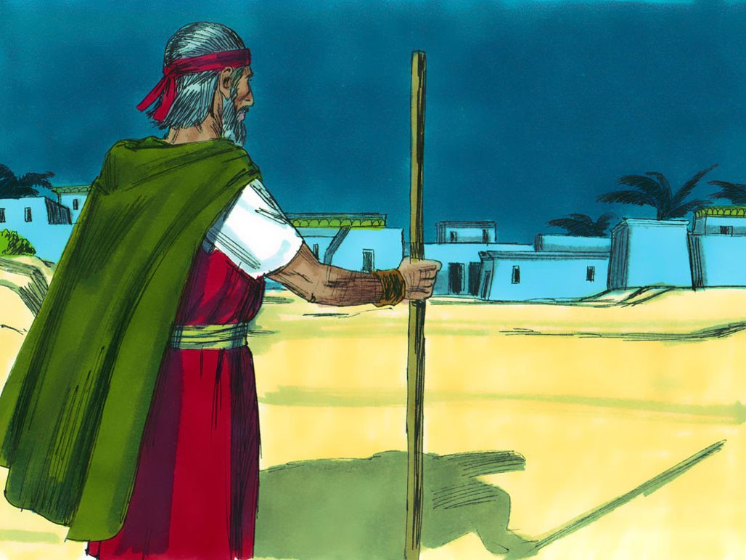
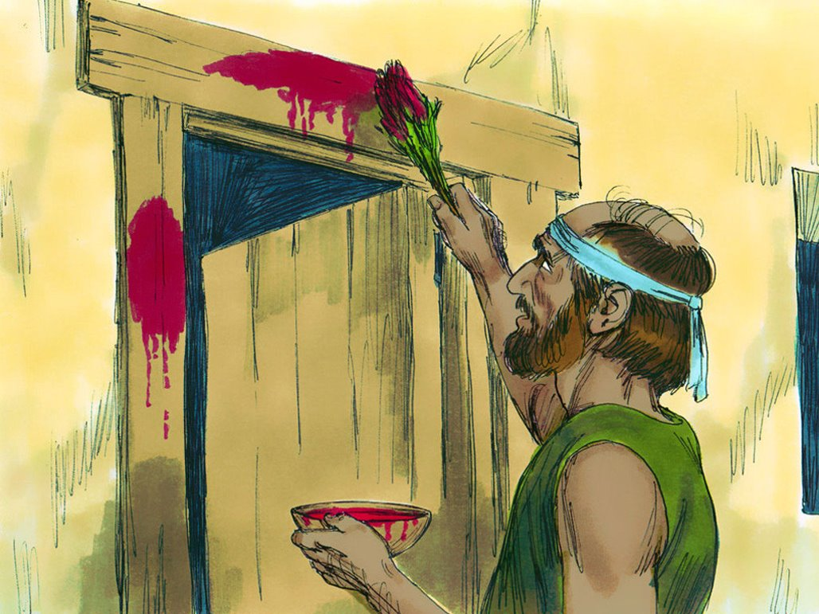
Name one of the plagues (troubles) God
caused to happen to the Egyptians.

Slide 35
Notes:
2-3

Slide 36
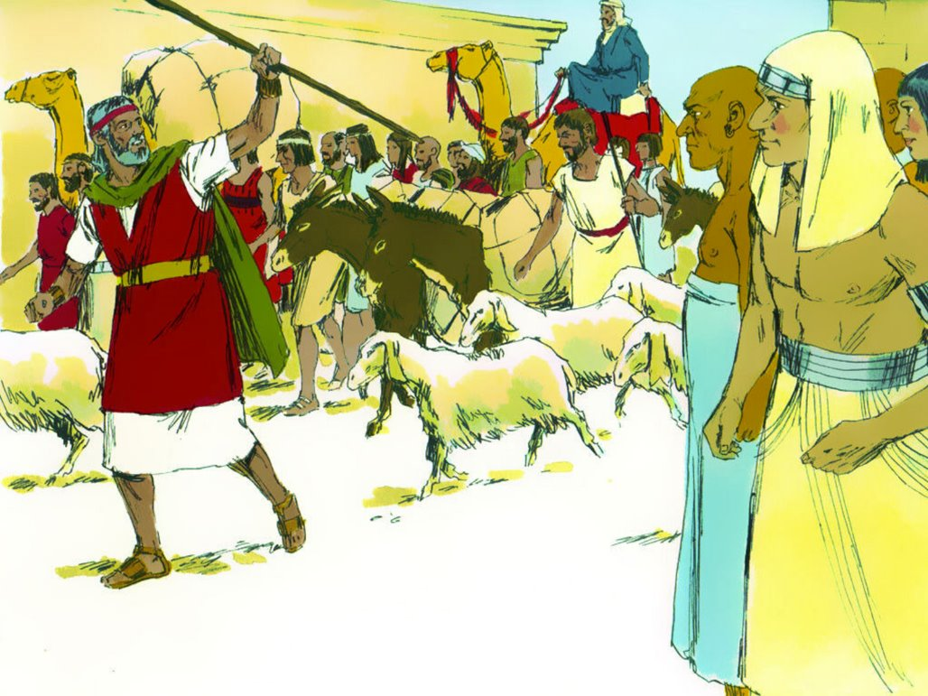
True/False
After the firstborn son died
in each of the Egyptian’s homes,
Pharoah still did not let the Israelites
leave Egypt.

Slide 37
True/False
God told the Israelites to ask
the Egyptians for all kinds of treasure,
and the Egyptians gave it to them.

Slide 38
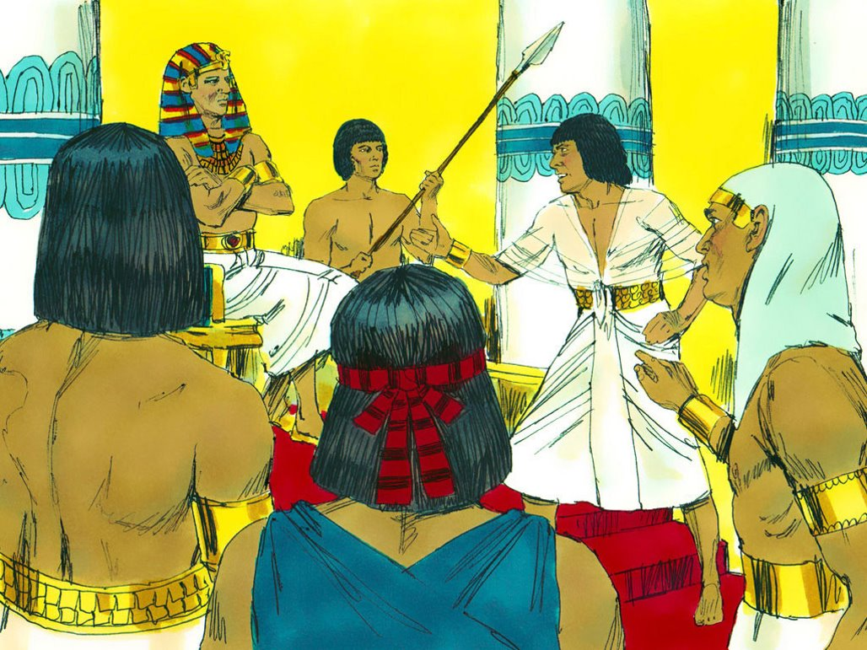
True/False
After the Israelites left
Egypt, Pharaoh changed his mind and
decided to chase after them to bring
them back.
Notes:
2-3

Slide 39
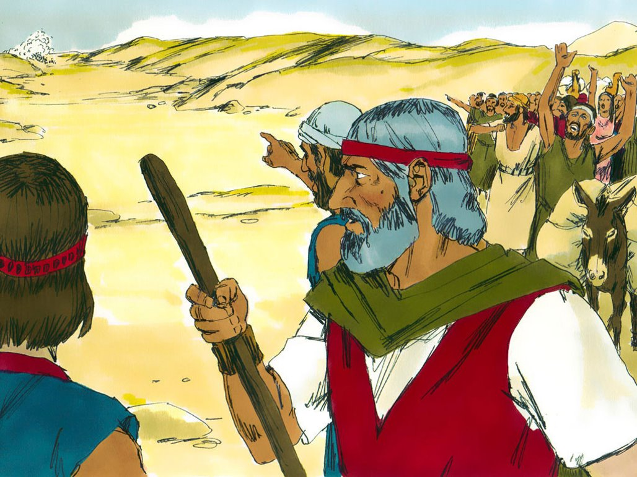
When the Israelites saw the Egyptians chasing after them, what was blocking the Israelites from running any further?

Slide 40
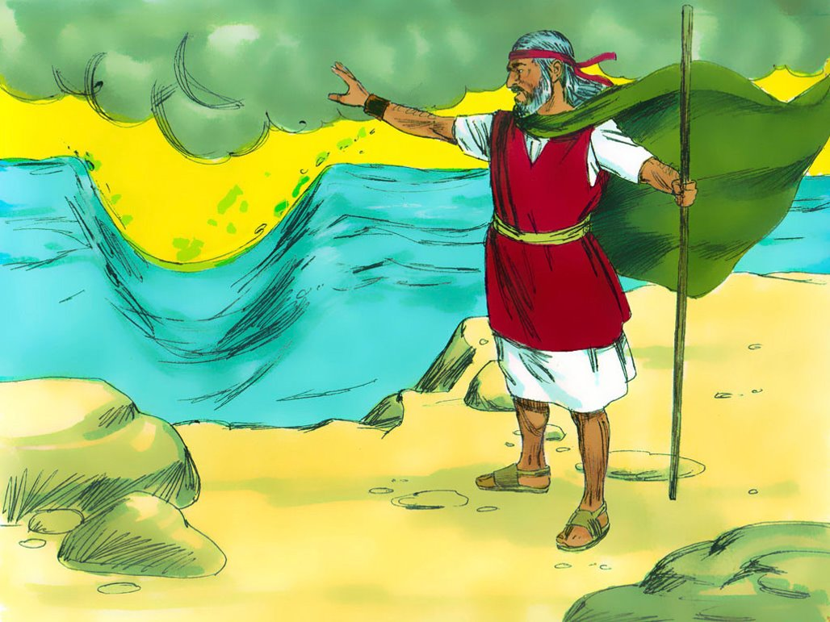
What amazing thing did God do through
Moses so the Israelites could get away
from the Egyptians?

Slide 41
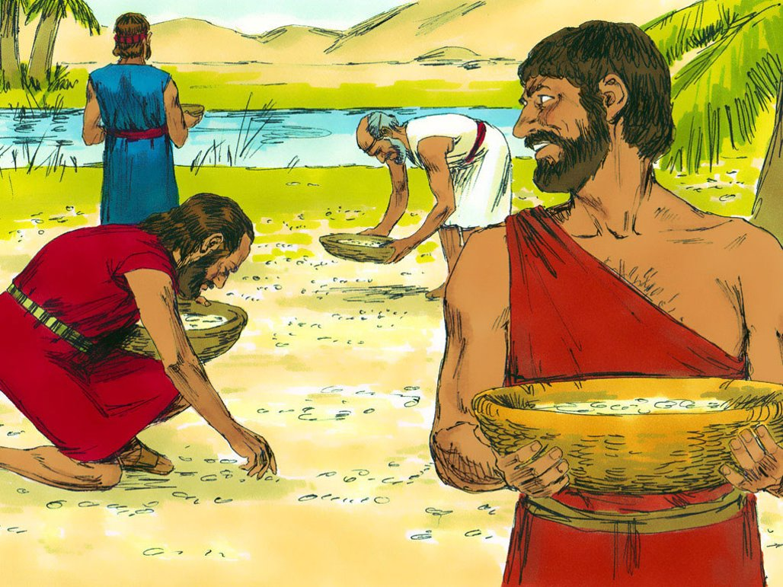
When the Israelites were hungry in the
wilderness, what was 1 of the things God
sent to feed them?

Slide 42
True/False
God wanted the Israelites to
take only enough manna for what they
needed for each day. God wanted them
to trust Him for what they needed each
day.

Slide 43
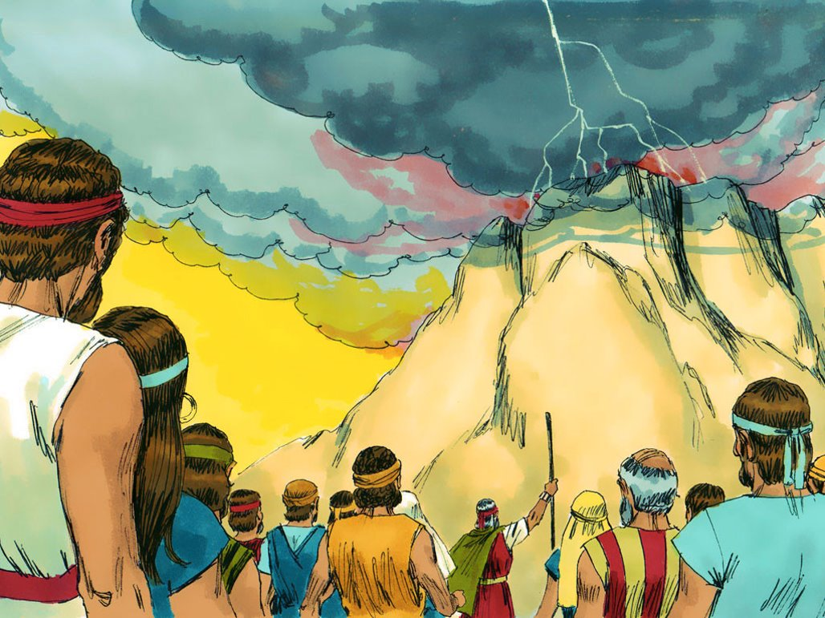
True/False
When Moses went up the
mountain to meet with God, the rest of
the Israelites were allowed to be on the
mountain too.

Slide 45
Why couldn’t the Israelites be on the
mountain or even touch it when Moses
was there meeting with God?

Slide 46
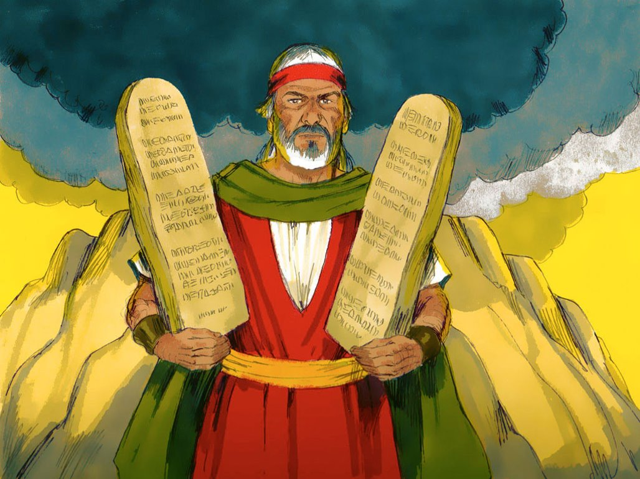
Ture/False
The biggest reason God
gave His 10 Commandments is to show
us how sinful we are.

Slide 47
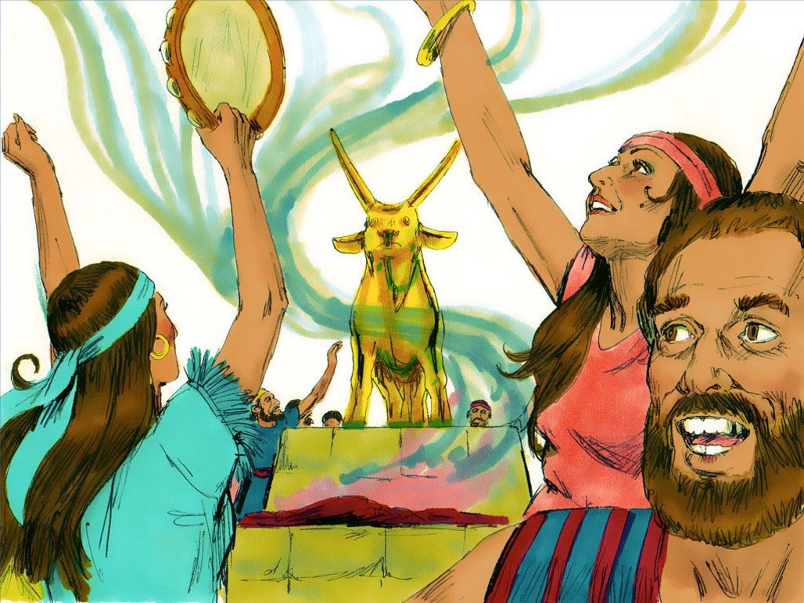
What terrible thing did the Israelites do
while Moses was up on the mountain
meeting with God?

Slide 48
Why was this so serious?

Slide 49
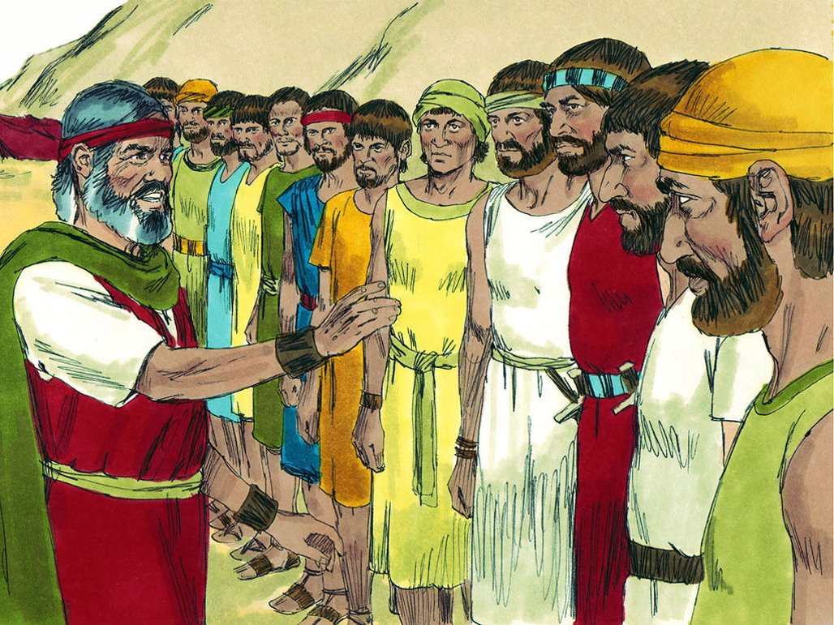
True/False
When the spies went into
the land of Canaan, all the spies came
back believing God would help them take
the land.

Slide 50
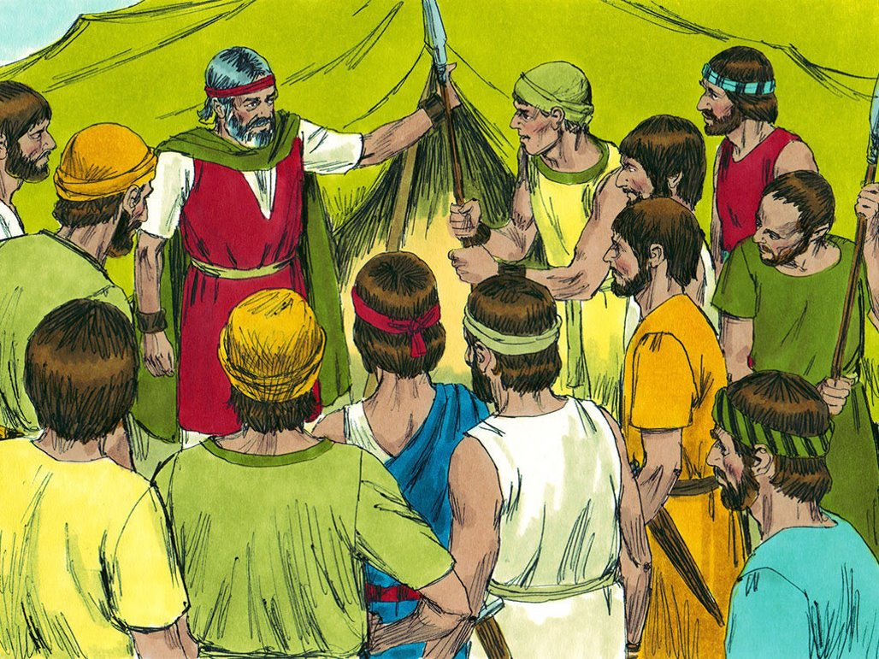
Because the people refused to believe
God would help them take the land, what
did God say they would have to do?

Slide 51
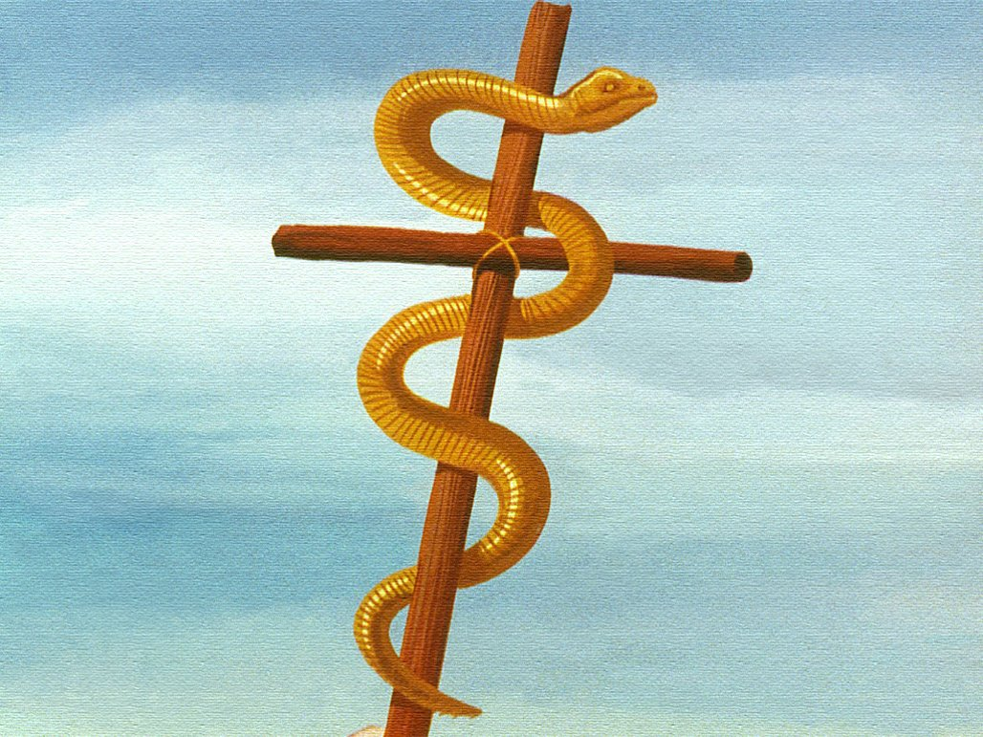
When the Israelites complained again
and God sent the fiery serpents, what
was the one way people could be healed
from the snake bites?

Slide 52
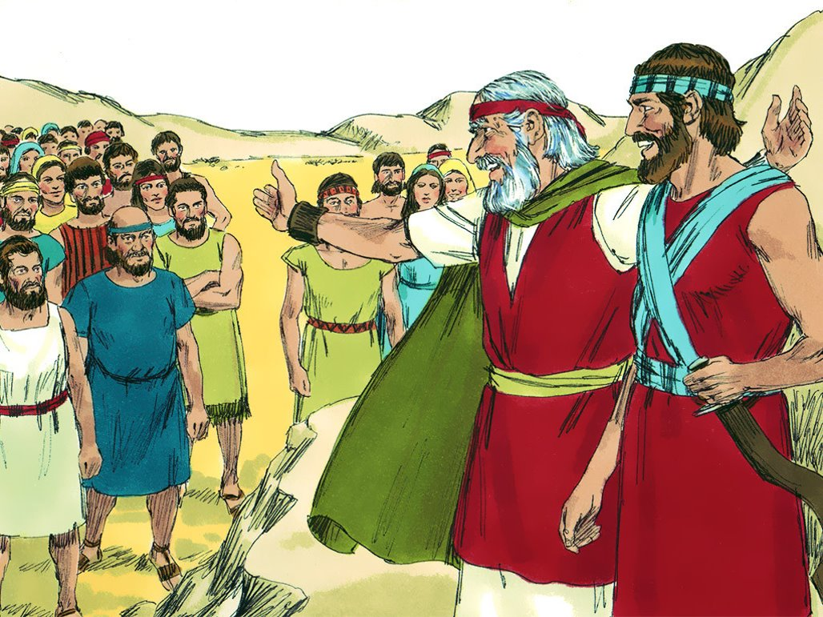
Who did God choose to be the next
leader to lead the Israelites into the land
of Canaan after Moses died?

