Slide 1
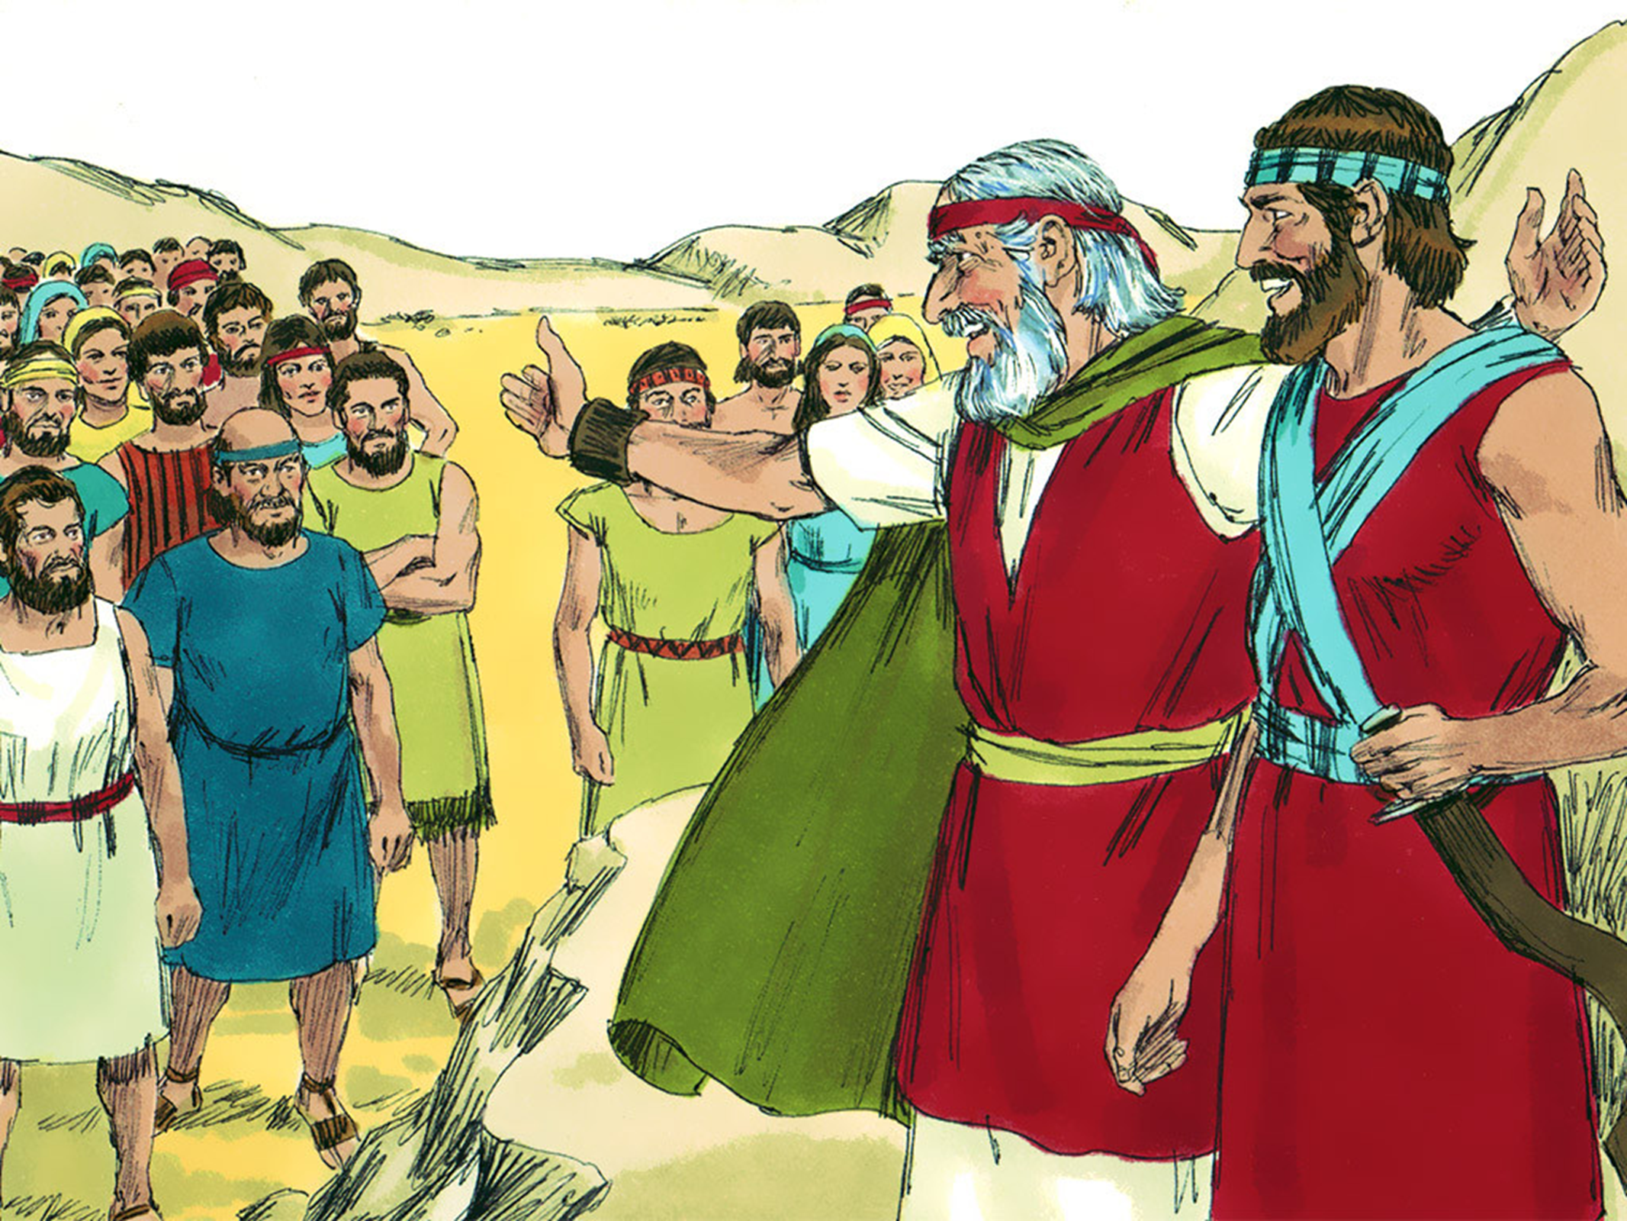
MOSES # 12
“God’s Plan for a New Leader”

Slide 3
Notes:
Rule Chart

Slide 4
Notes:
Prayer

Slide 9
Notes:
Bible Lesson

Slide 10
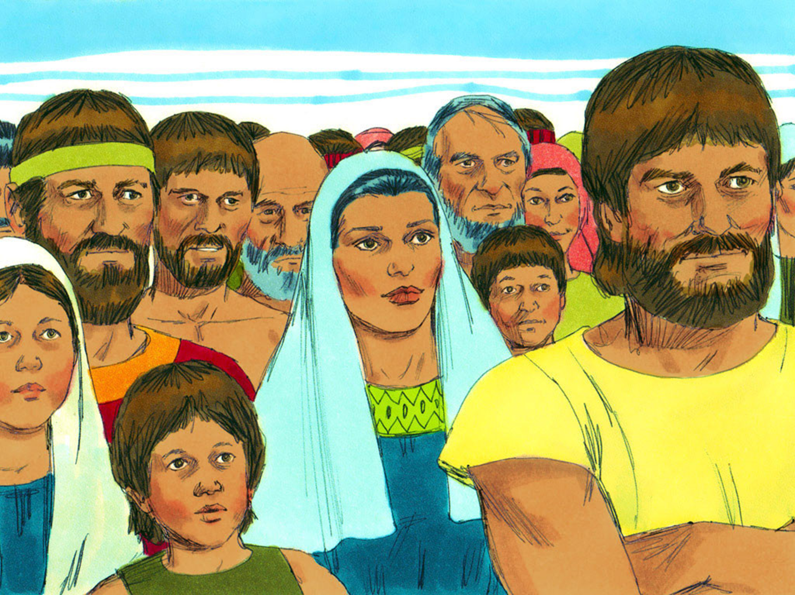

Slide 11
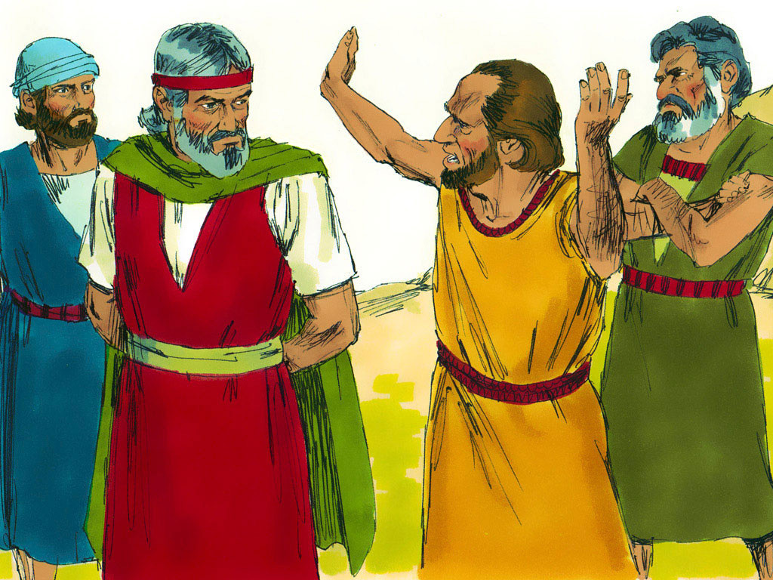

Slide 13
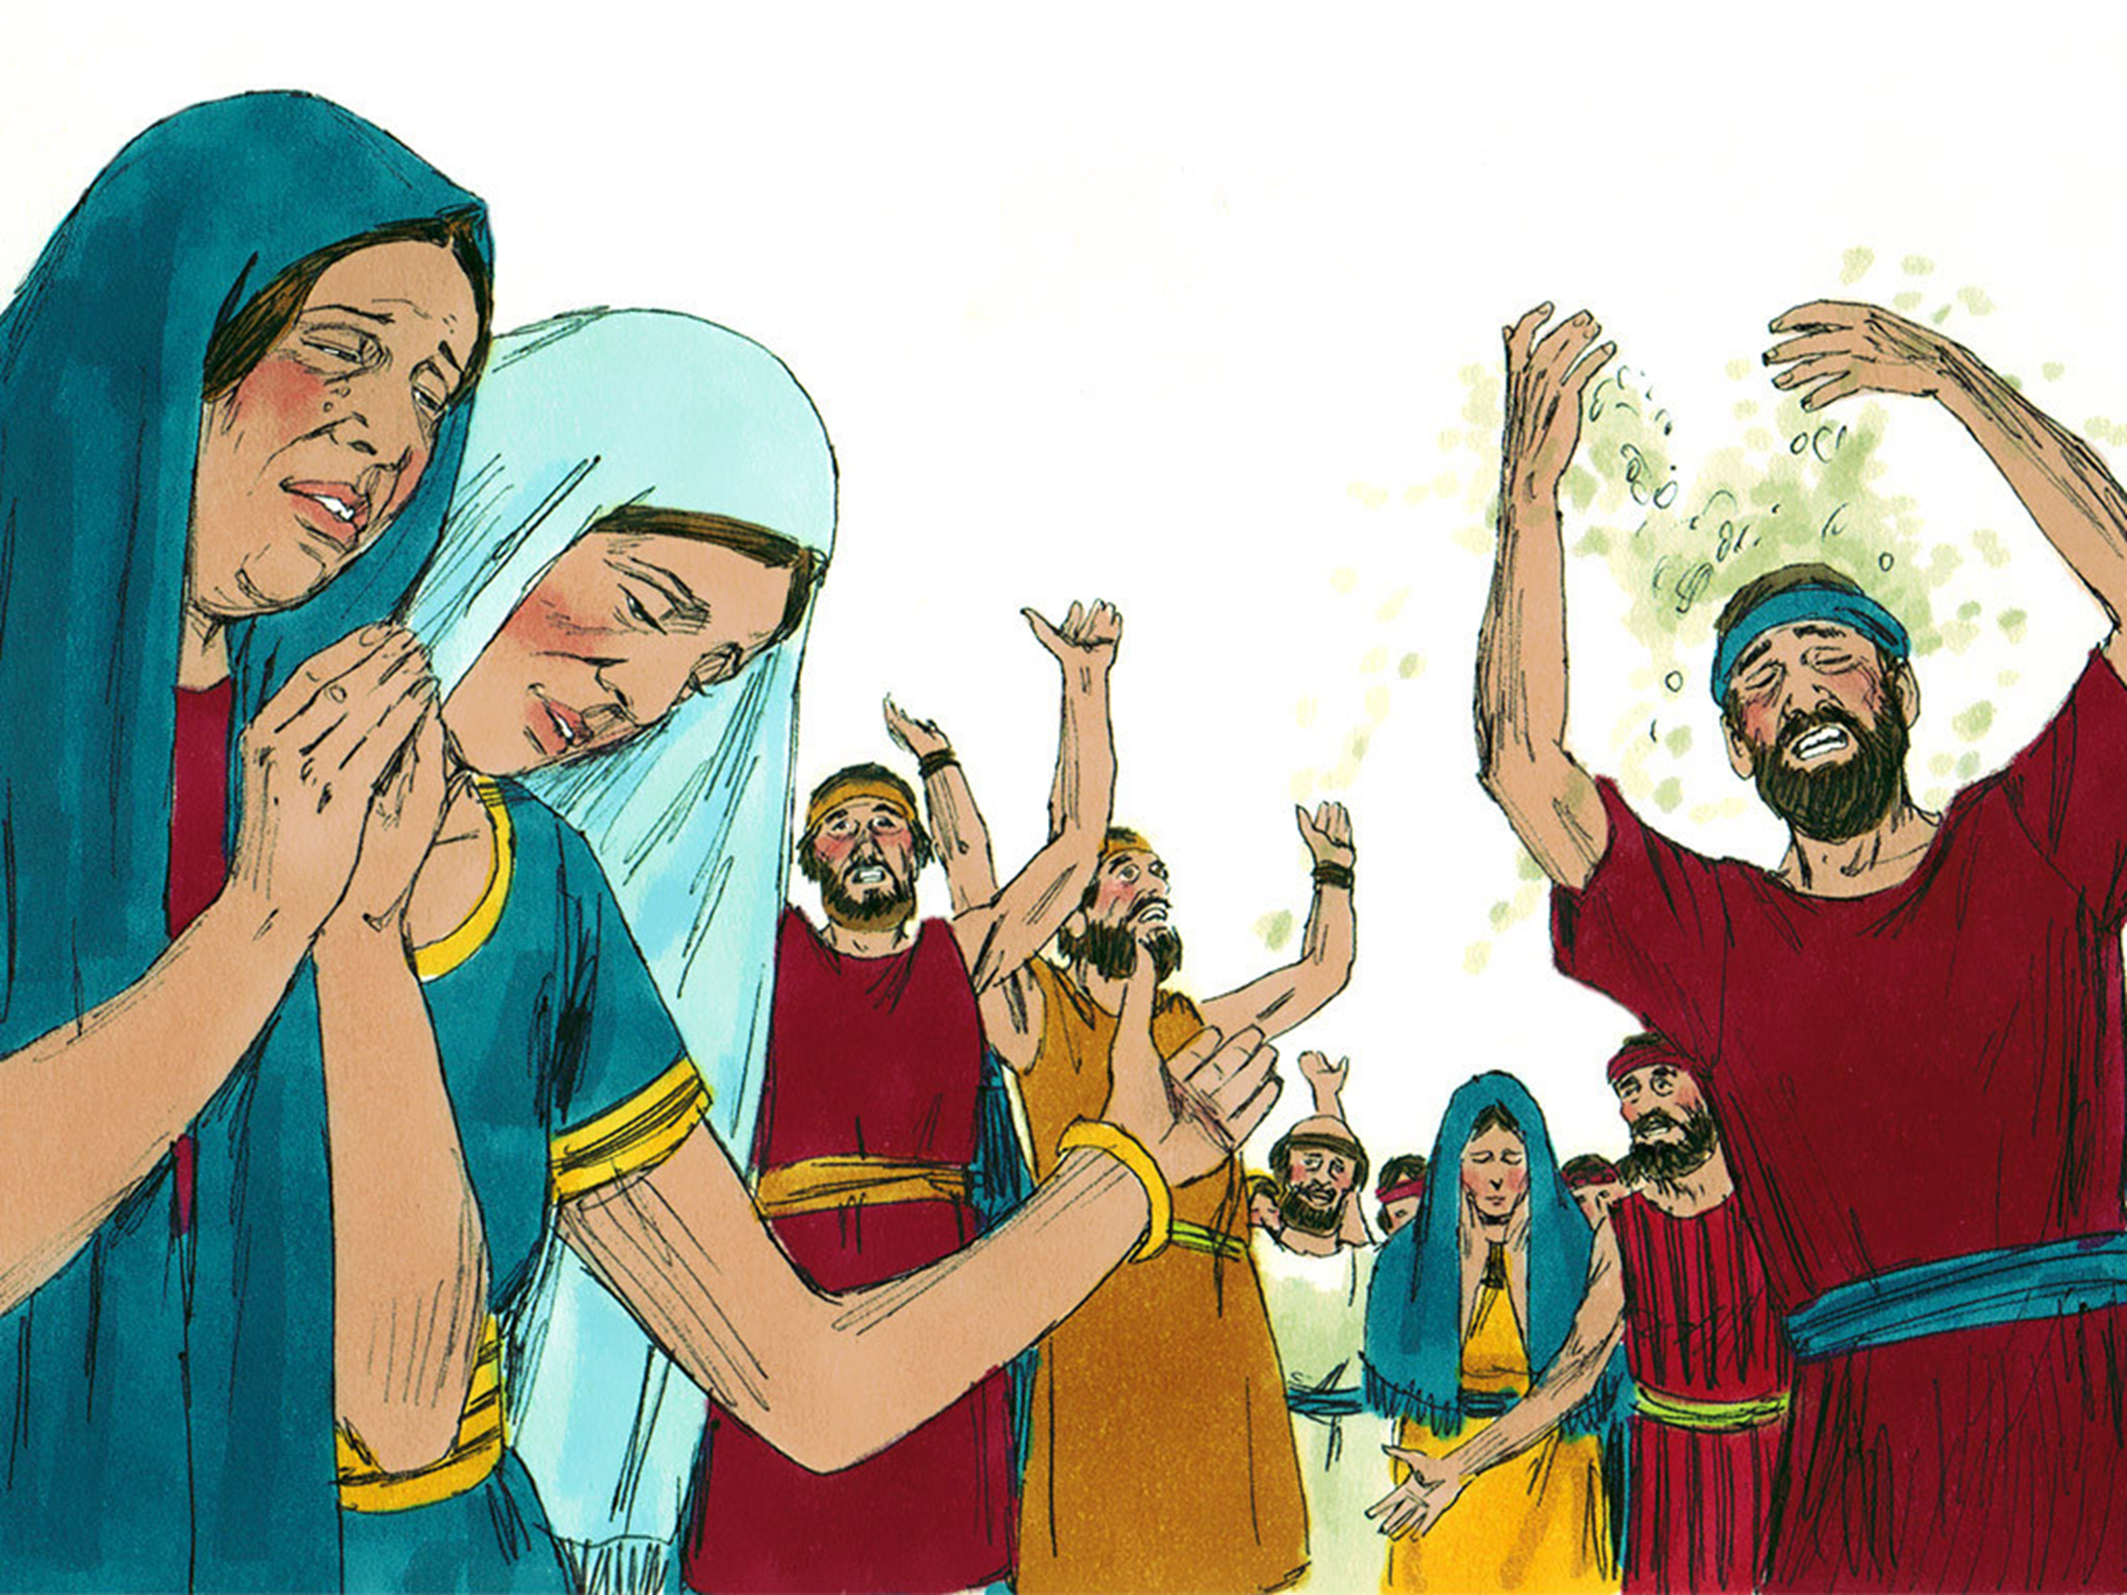

Slide 15
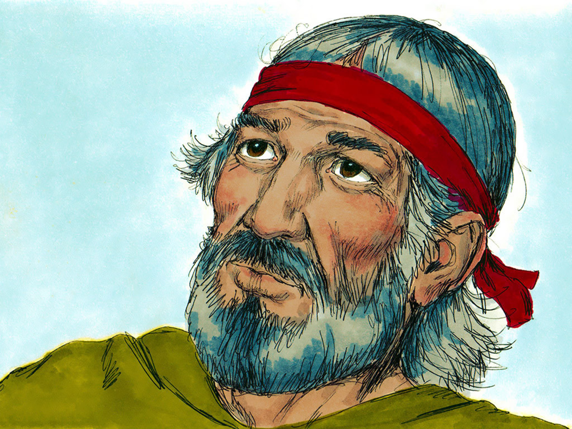

Slide 19
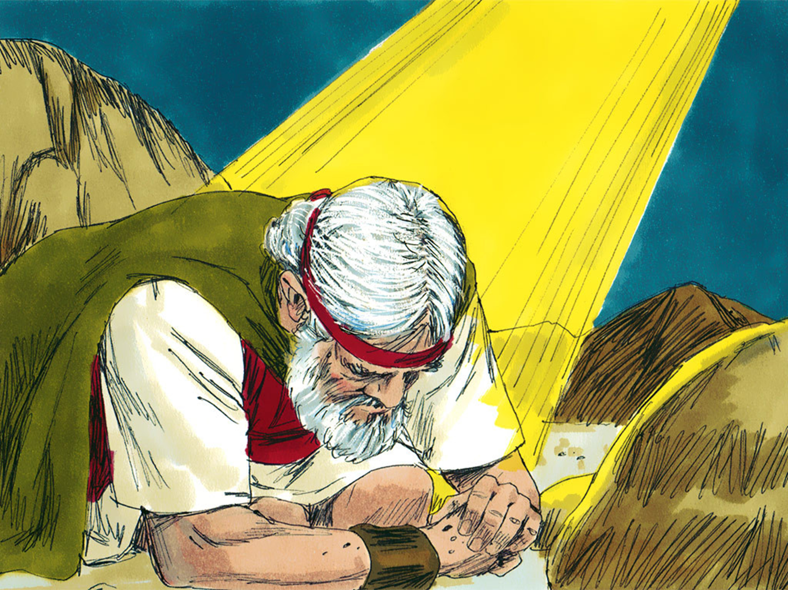

Slide 23
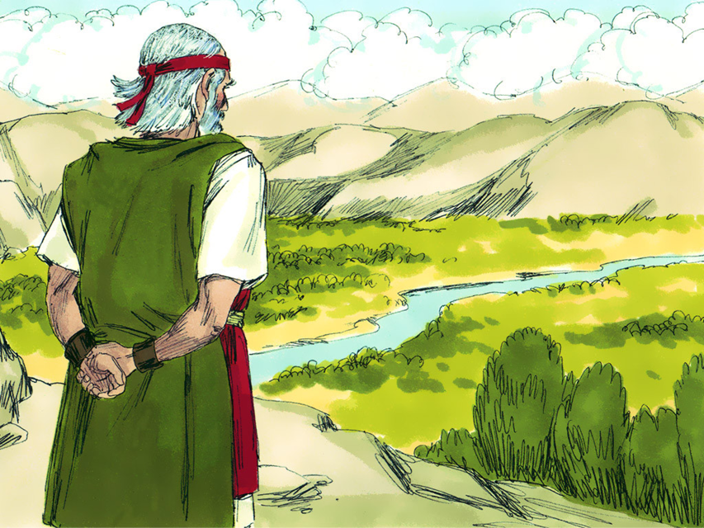

Slide 28
Aa
Bb
Cc
Dd
Ee
Ff
Gg
Hh
Ii
Jj
Kk
Ll
Mm
Nn
Oo
Pp
Qq
Rr
Ss
Tt
Uu
Vv
Ww
Xx
Yy
Zz
…
“
T
h
a
n
k
G
o
d
.”
a
t
a
l
l
t
i
m
e
s

