Slide 1
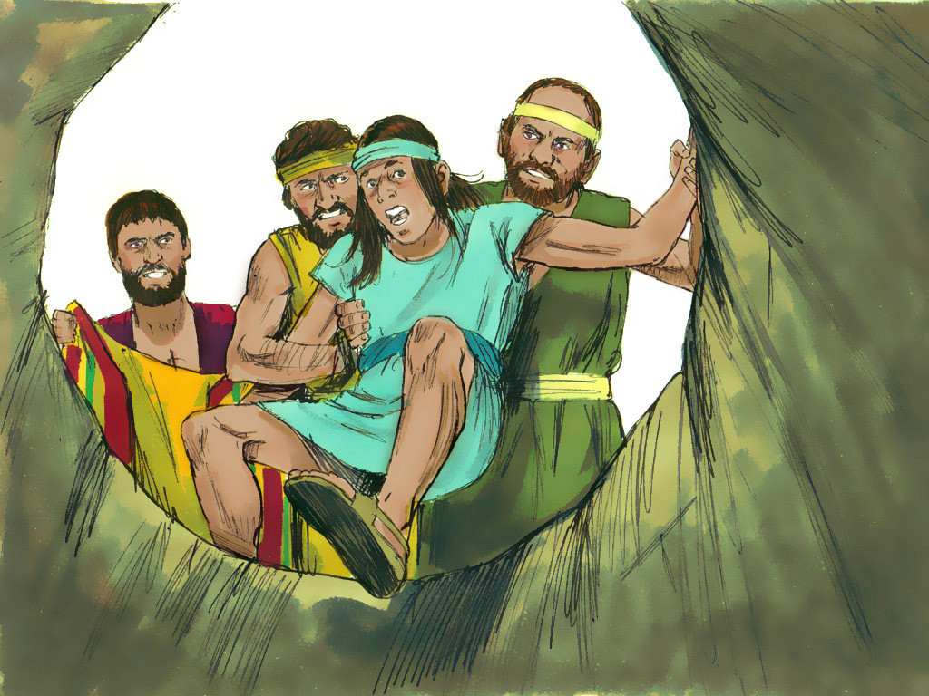
JOSEPH - 2

Slide 2
Notes:
Rule Chart

Slide 3
Notes:
When we get ready to pray…

Slide 5
Notes:
PRAYER:

Slide 6
Notes:
Song:

Slide 12
Notes:
Memory Verse

Slide 13
Notes:
MV game: Solo Word

Slide 16
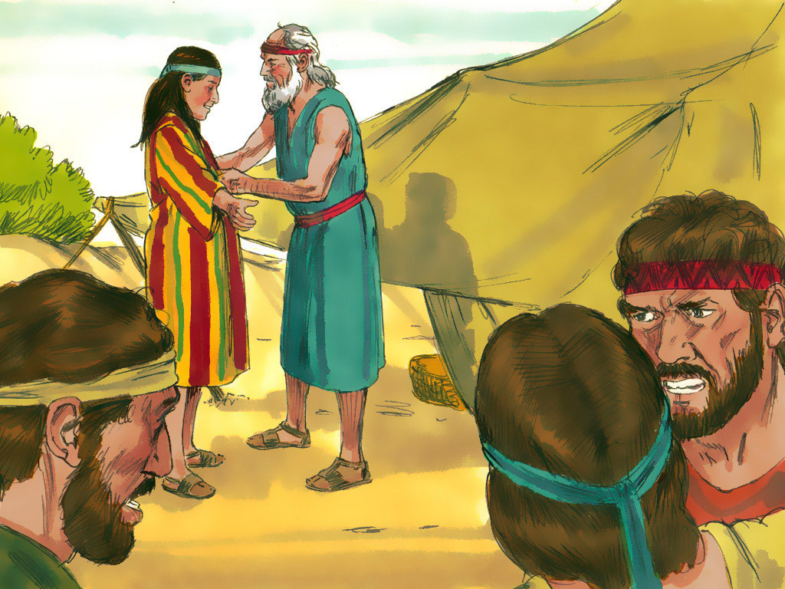

Slide 19
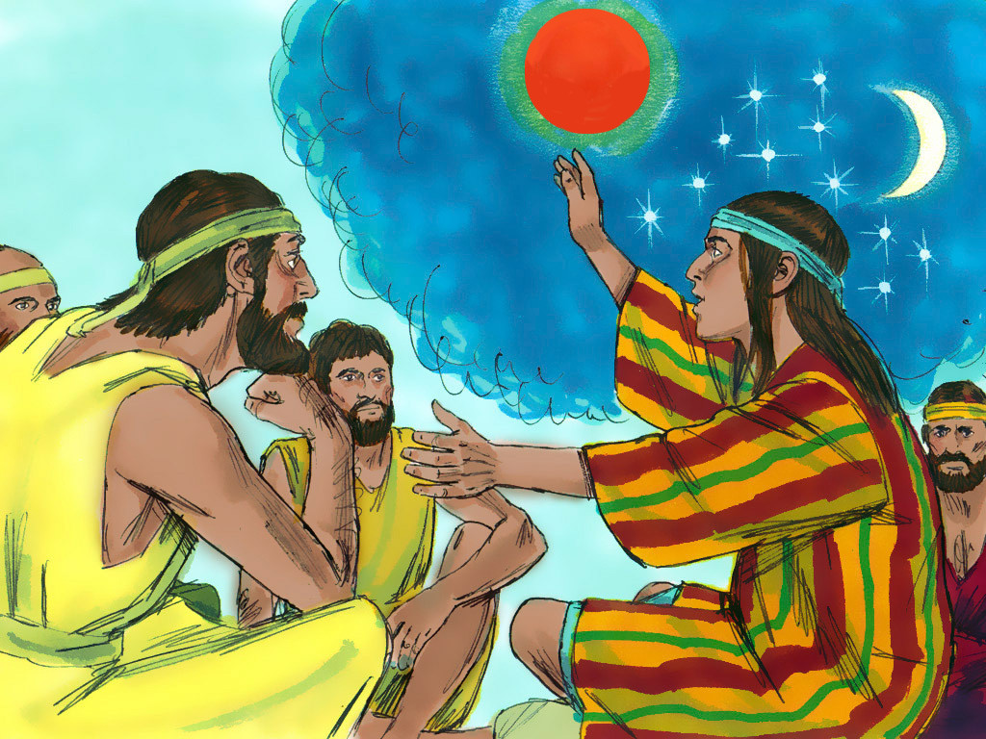

Slide 22
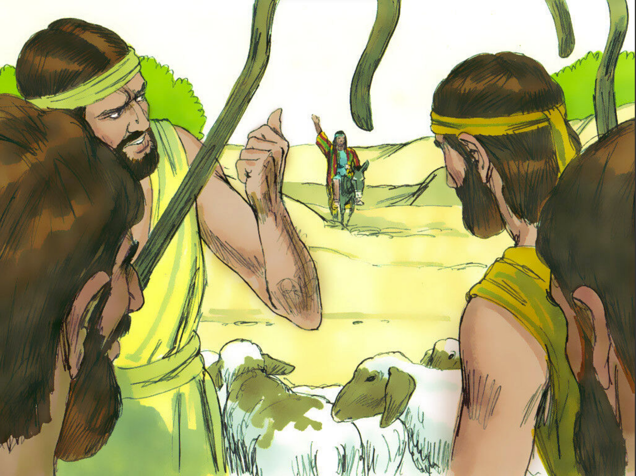

Slide 24
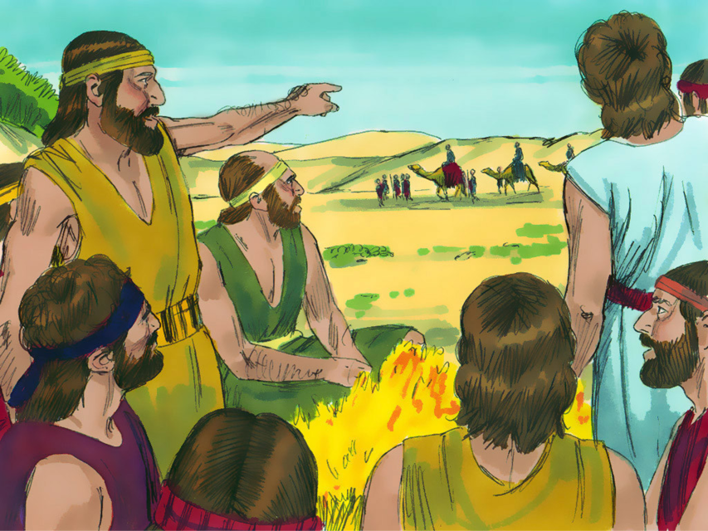

Slide 29
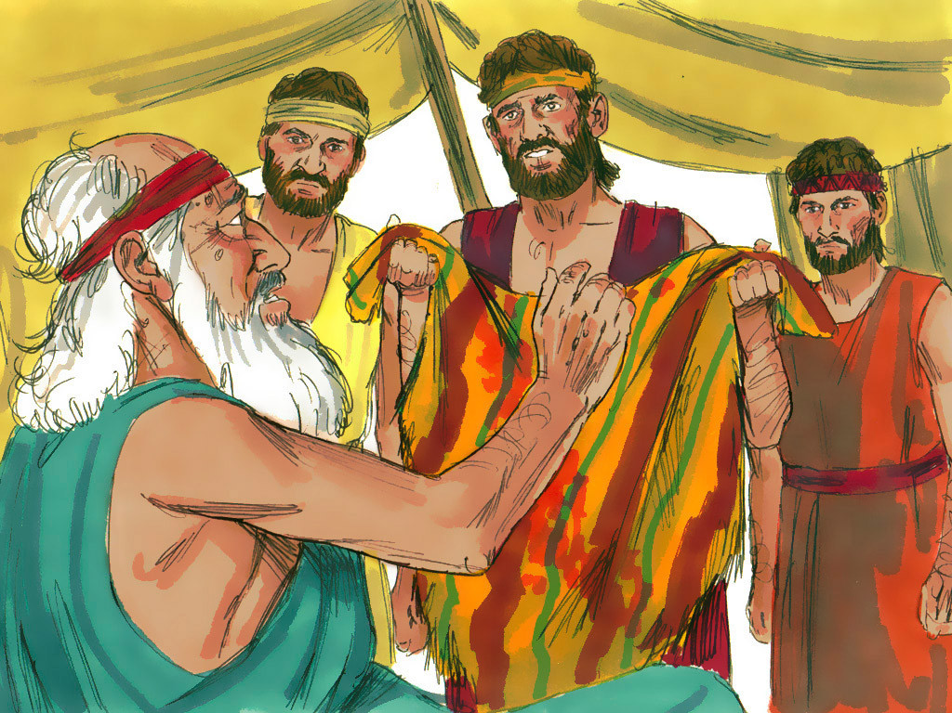

Slide 33
Strike A Pose
Divide the children into 2 teams.
Once a child answers a question correctly, he can try to guess which pose will be revealed next on the screen by striking the pose he thinks it will be.
The poses are “Sleep,” “Eat,” or “Drink.”
After child strikes a pose, click the screen to reveal a pose. If the pose the child made matches the pose revealed on the screen, the child earns 100 points for his team.
Notes:
Review Game: Strike A Pose

Slide 34
Notes:
Review game
Strike a Pose
Once a child answers the question correctly he strikes a pose, either “Sleep,” “Eat,” or “Drink.” Click for next slide to see if it matches the one uncovered.

