Slide 1
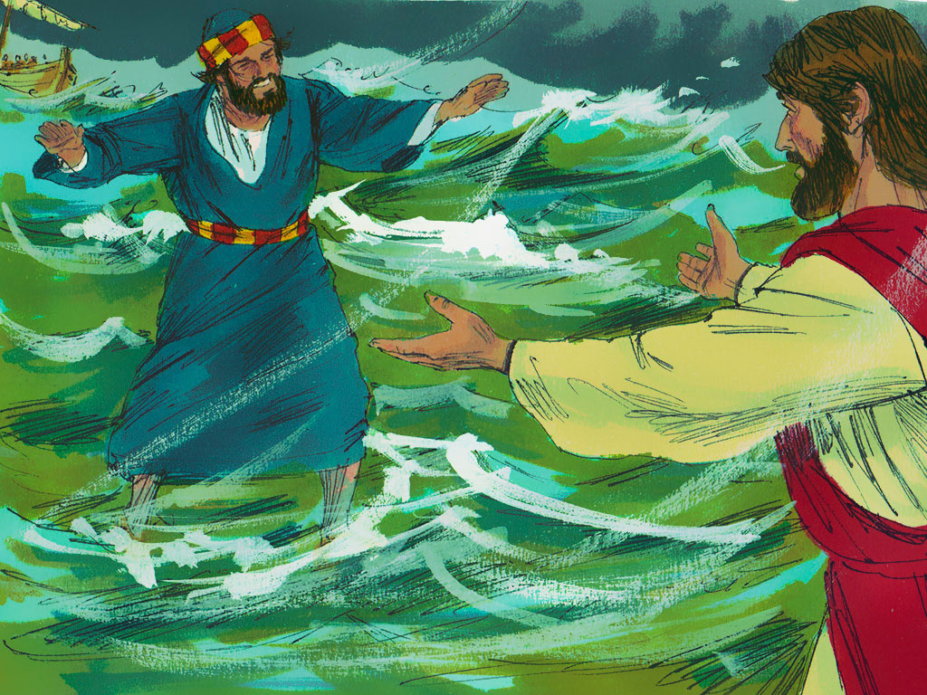
Jesus Calms Our Storm
Mark 6:45-52; John 6:15-21; Matthew 14:22-23

Slide 5
Notes:
“God is Good!”

Slide 6
Jesus Calms Our Storm
Mark 6:45-52; John 6:15-21; Matthew 14:22-23

Slide 7
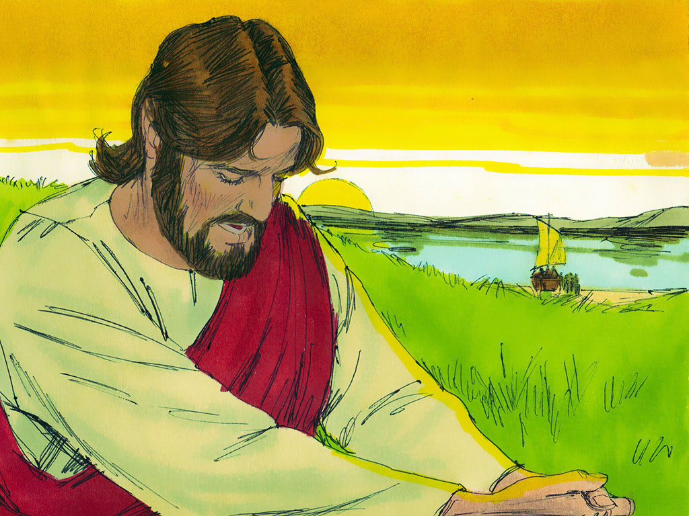

Slide 8
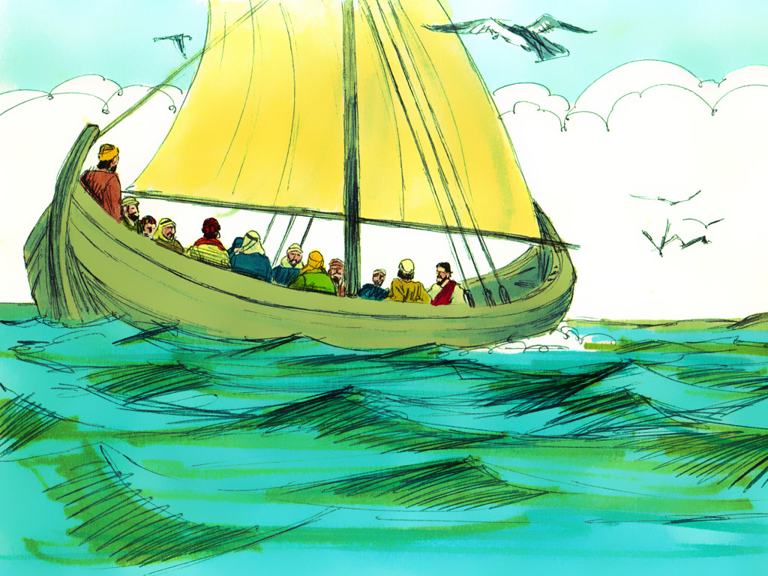

Slide 9
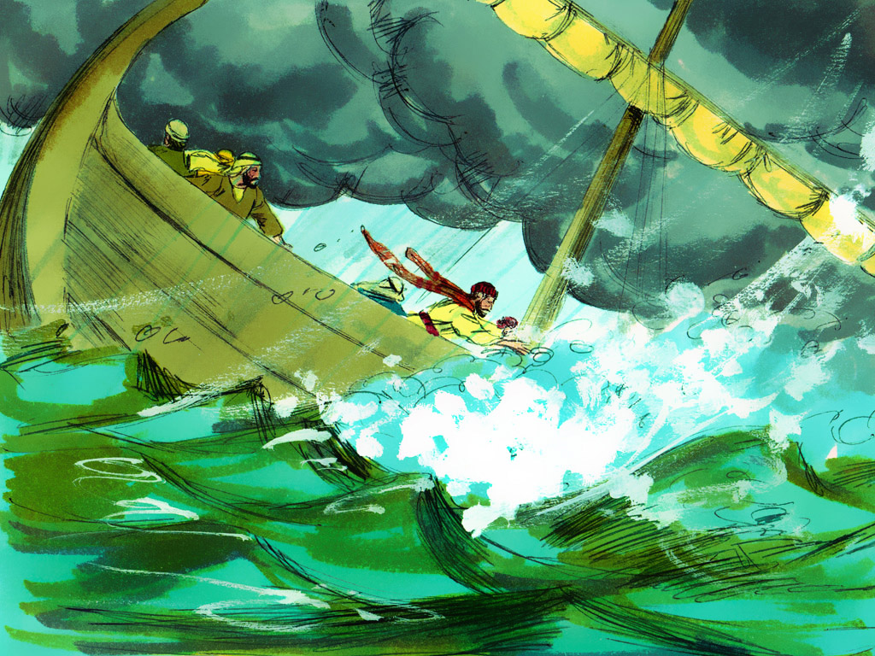

Slide 10
“For the wages
of sin is death….”
Romans 6:23

Slide 12
GOD IS WITH YOU IN TIMES OF TROUBLE

Slide 14
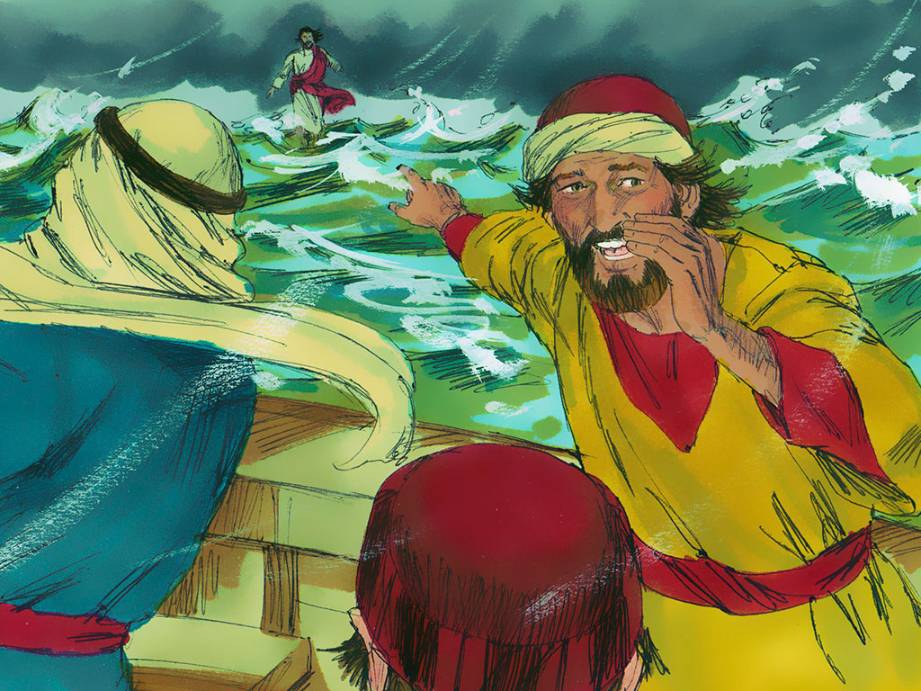

Slide 16
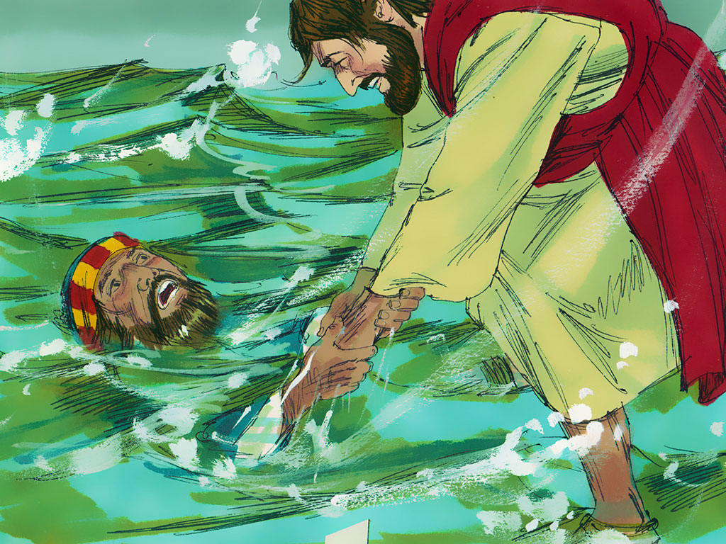

Slide 17
GOD IS WITH YOU IN TIMES OF TROUBLE

Slide 18
Psalm 46:1
“God is our refuge and strength,
a very present help in trouble.”

Slide 20
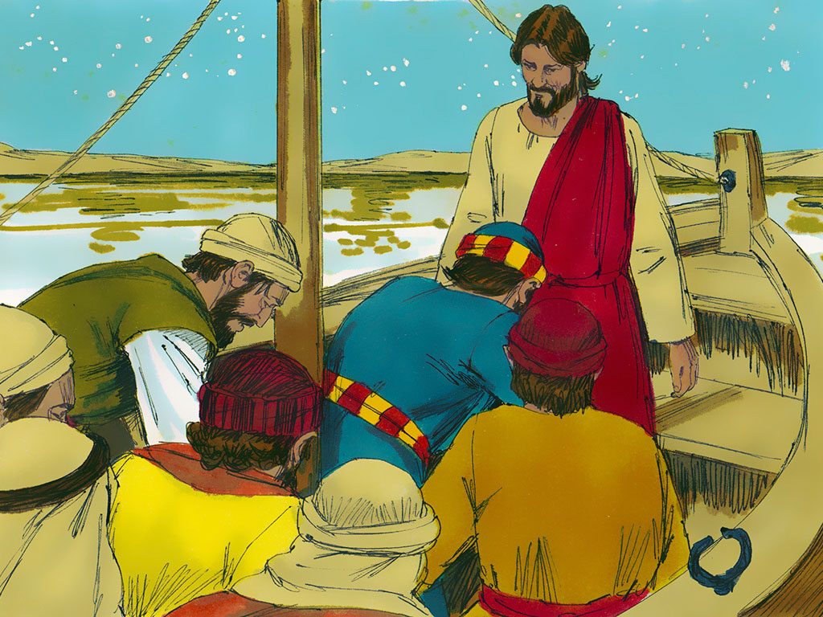

Slide 21
“…Christ died for our sins…
He was buried, and…
rose again the third day….”
1 Corinthians 15:3-4

Slide 22
John 3:15
“…Whosoever believeth in Him (Jesus)
should not perish,
but have everlasting life.”

Slide 23
Psalm 46:1
“God is our refuge and strength,
a very present help in trouble.”

Slide 24
GOD IS WITH YOU IN TIMES OF TROUBLE

Slide 27
Psalm 46:1
“God is our refuge and strength,
a very present help in trouble.”

Slide 28
Notes:
Review game
Strike a Pose
Once a child answers the question correctly he strikes a pose, either “Sleep,” “Eat,” or “Drink.” Click for next slide to see if it matches the one uncovered.

