Slide 2
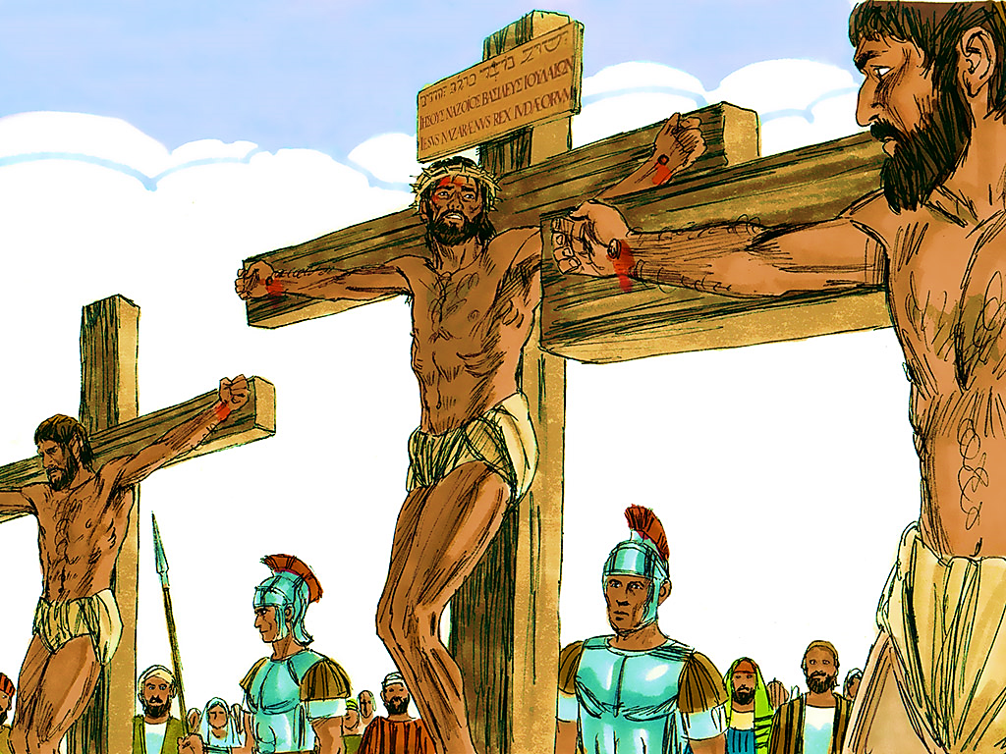
1-1
Notes:
1-1

Slide 3
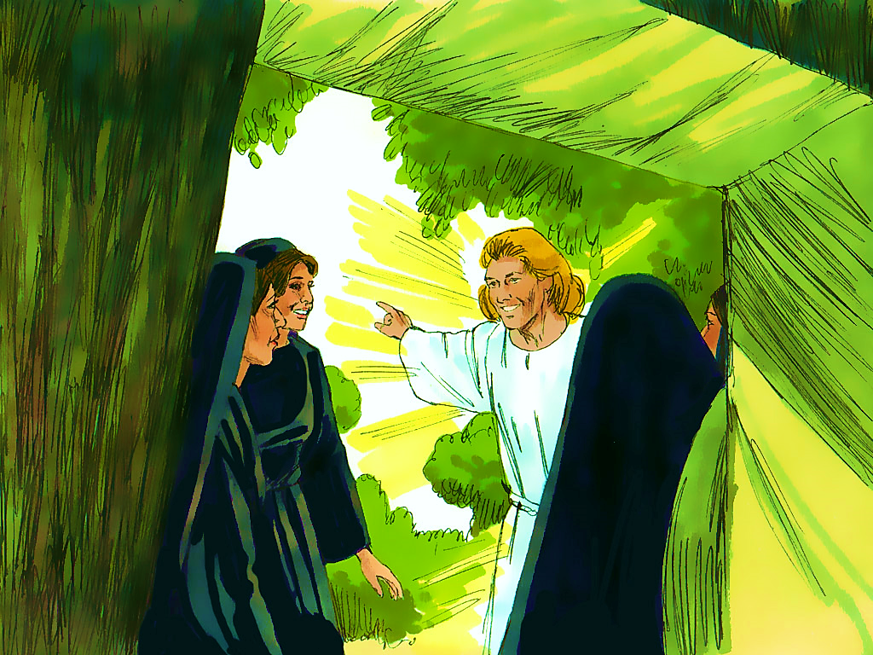
1-2
Notes:
1-2

Slide 5
1-2
Notes:
1-2

Slide 6
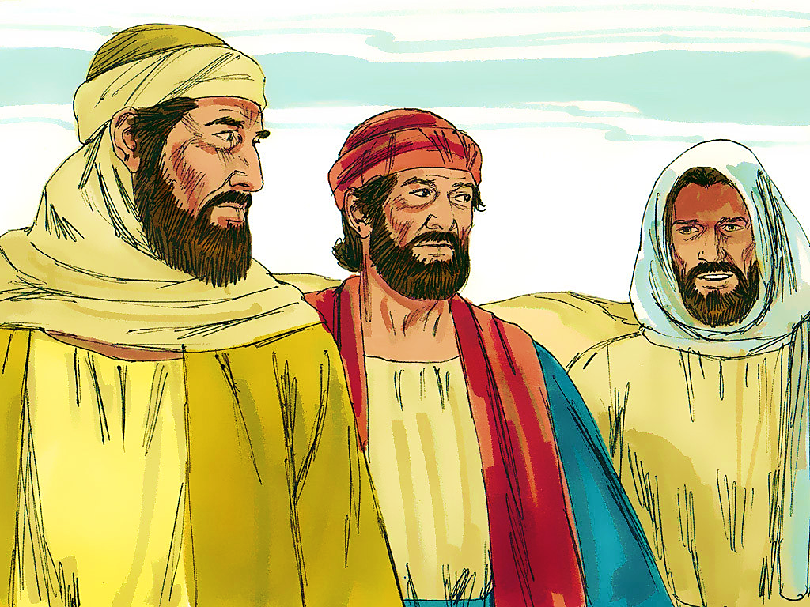
1-3
Notes:
1-3

Slide 8
1-3
Notes:
1-3

Slide 9
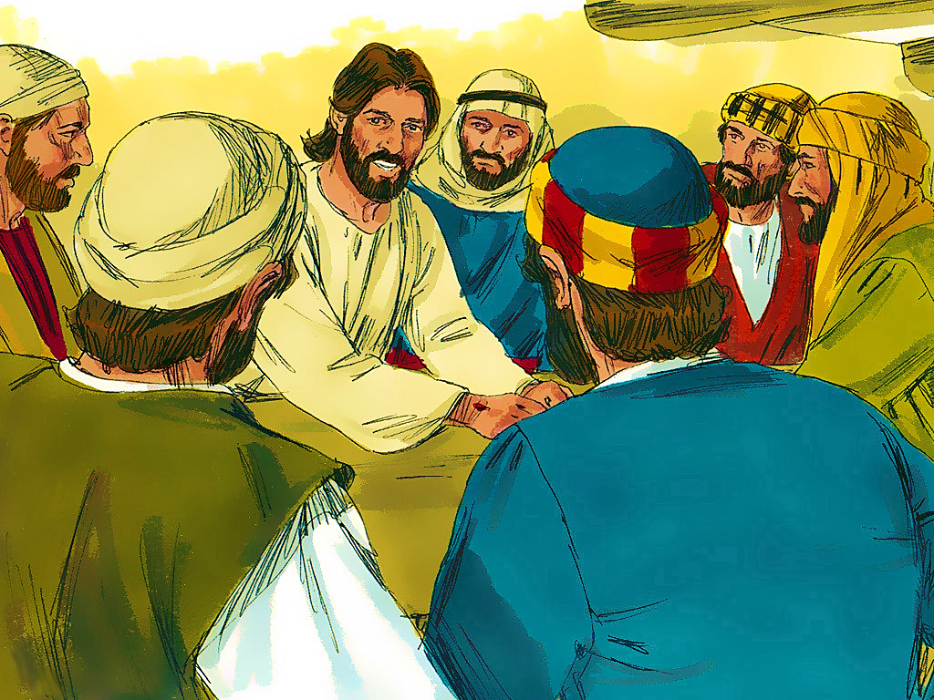
1-4
Notes:
1-4

Slide 10
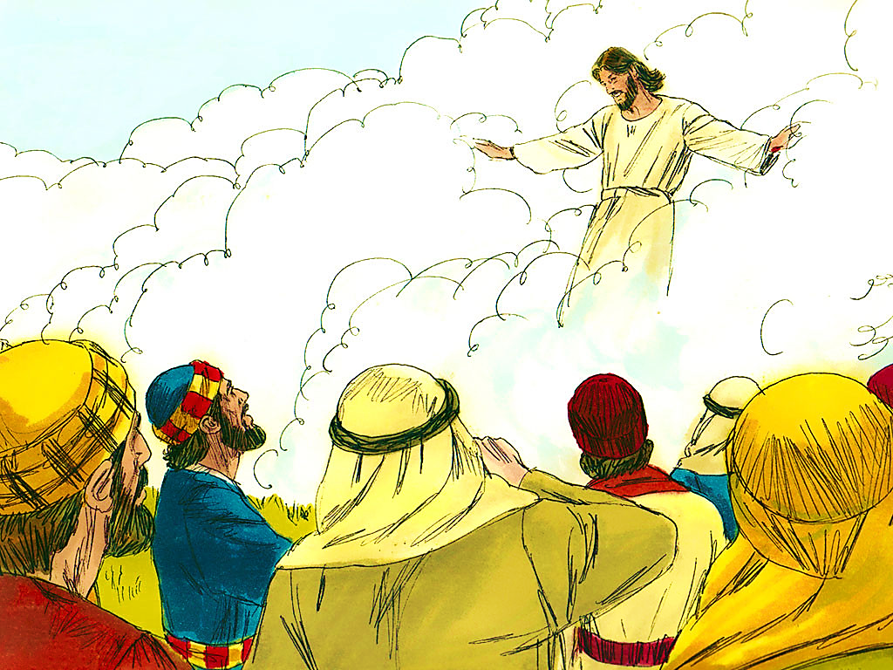
1-5
Notes:
1-5

Slide 11
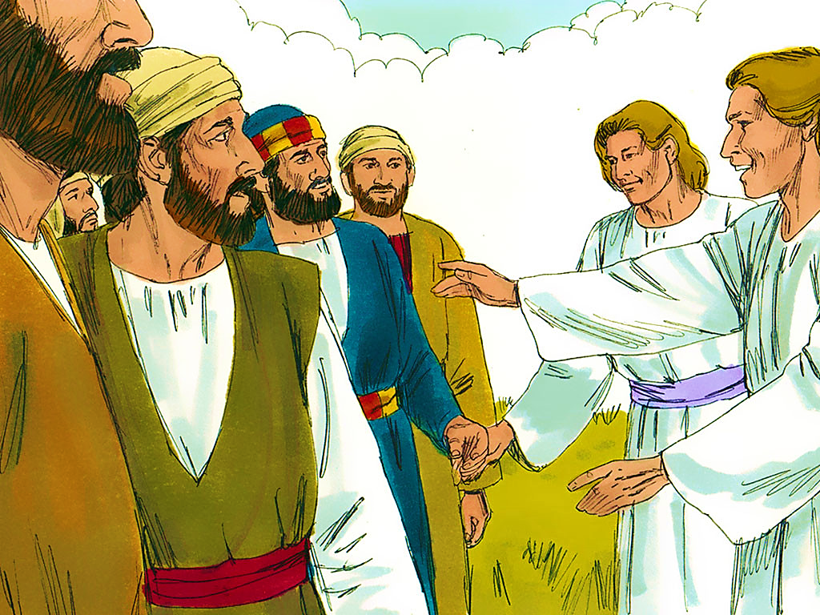
1-6
Notes:
1-6

Slide 13
Notes:
End Lesson

