Slide 1
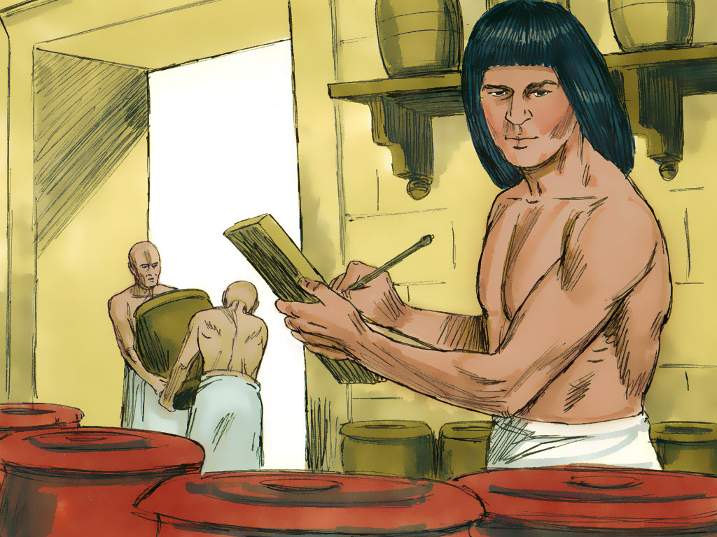
JOSEPH - 3

Slide 2
Notes:
Rule Chart

Slide 3
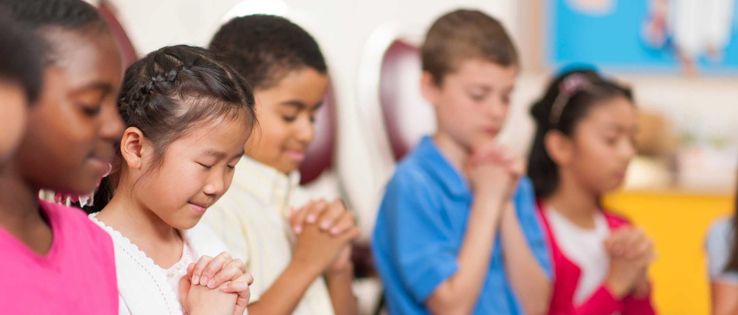
Prayer
Notes:
Prayer

Slide 4
Notes:
When we get ready to pray…

Slide 6
Notes:
Prayer Pattern

Slide 7
Notes:
Song: Obey, Obey the Lord

Slide 8
Notes:
Memory Verse

Slide 9
Notes:
MV game: “Do as I Do”

Slide 10
Notes:
Song

Slide 12
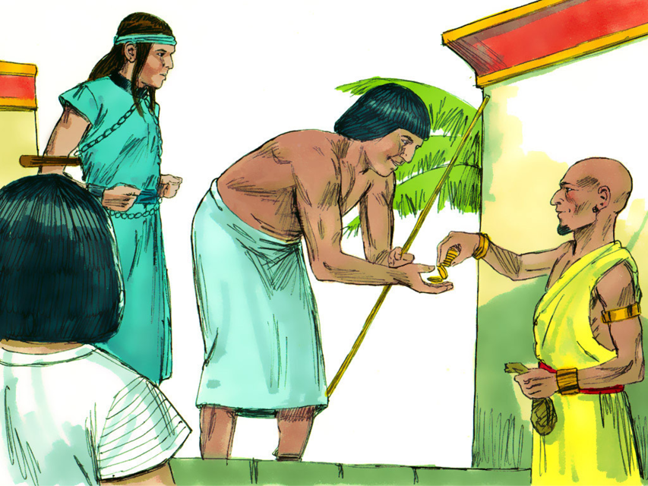

Slide 19
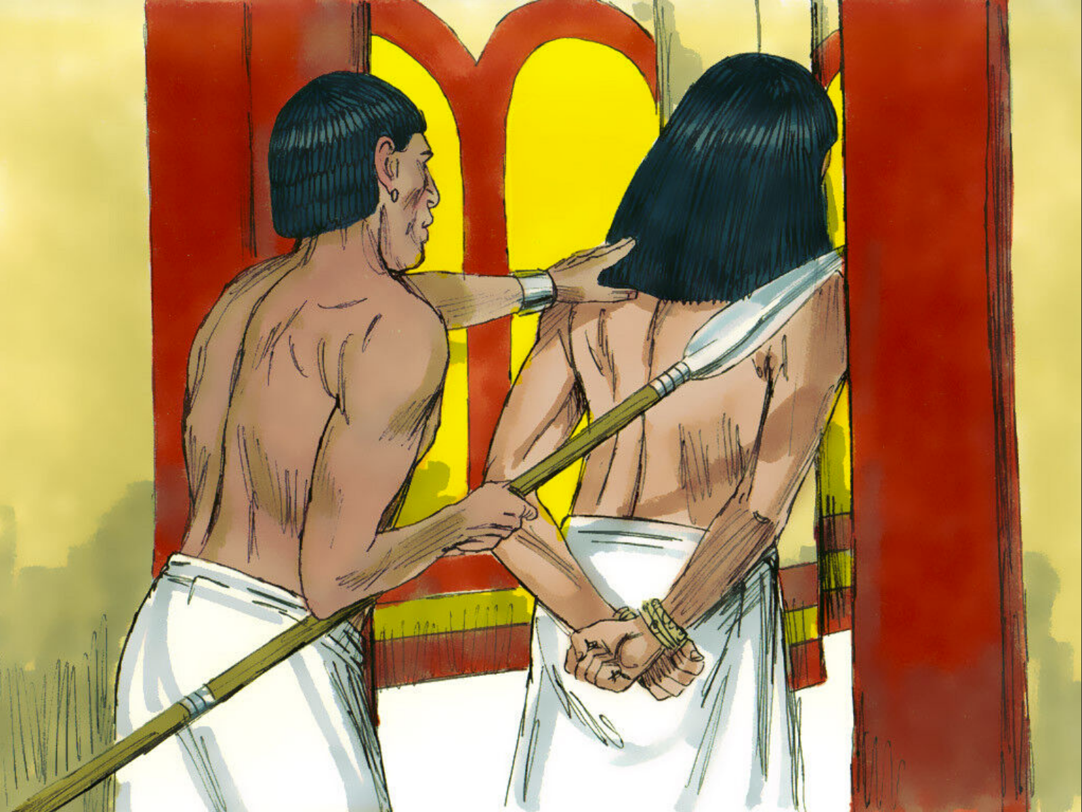

Slide 25
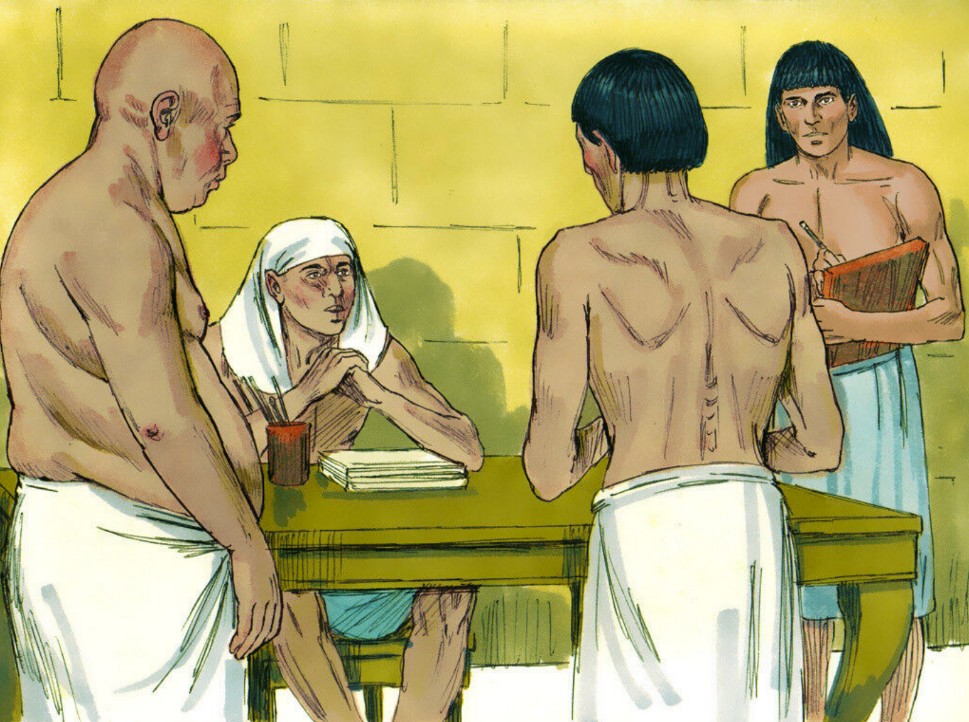

Slide 26
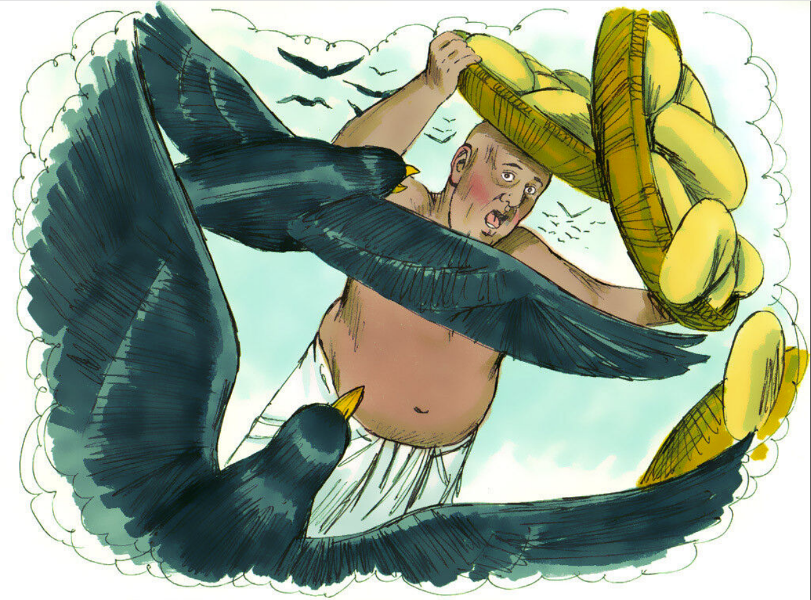

Slide 27
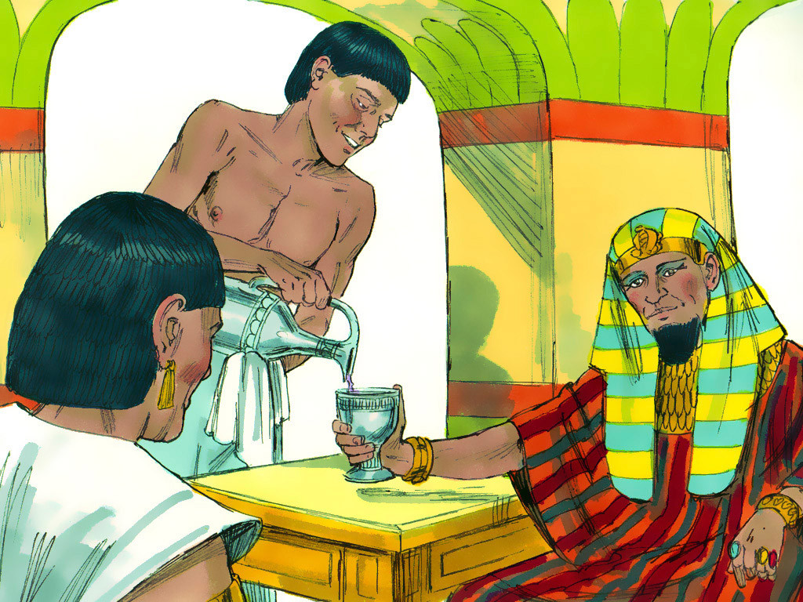

Slide 31
THE GOSPEL “MEMORY GAME”
- Play like “Concentration.”

Slide 32
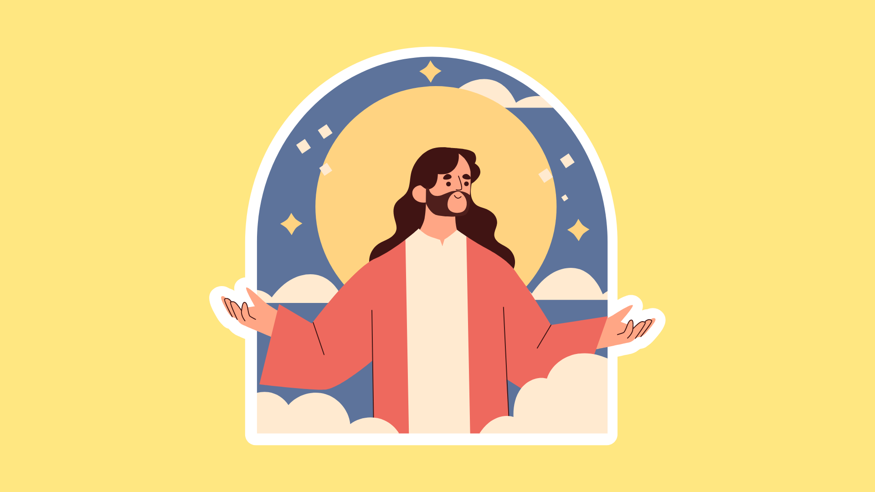
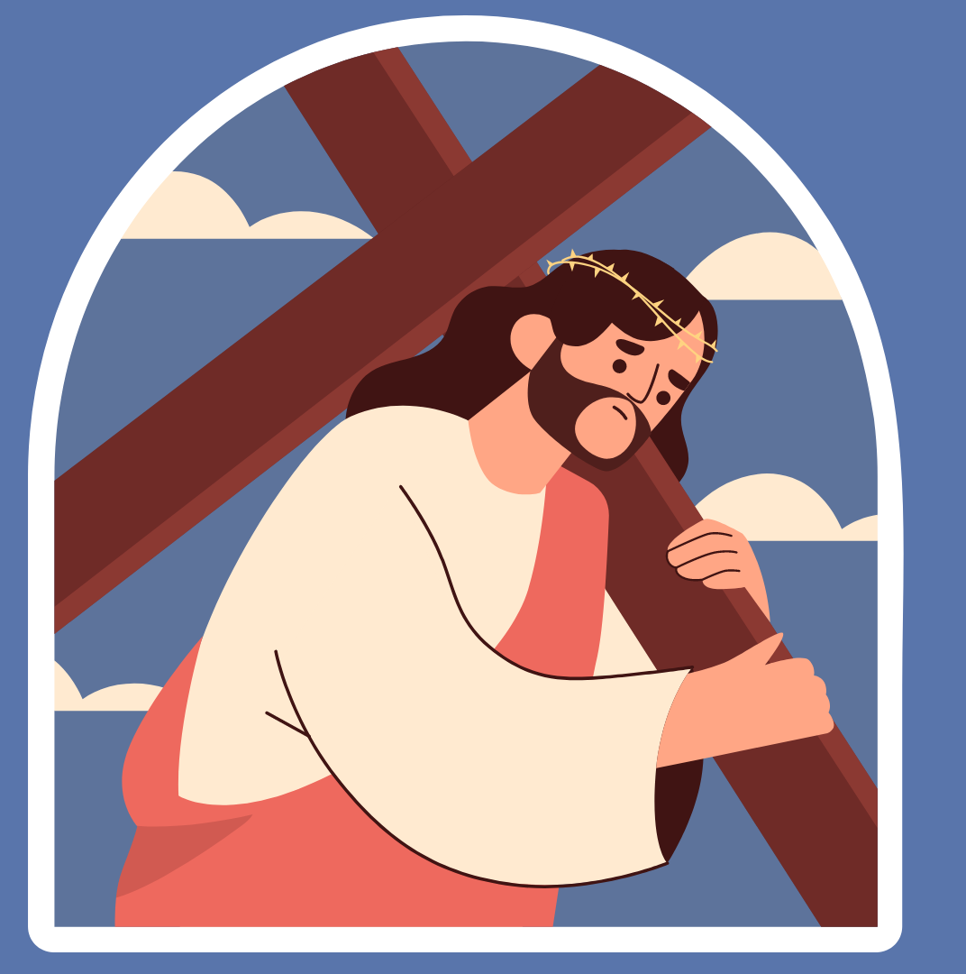
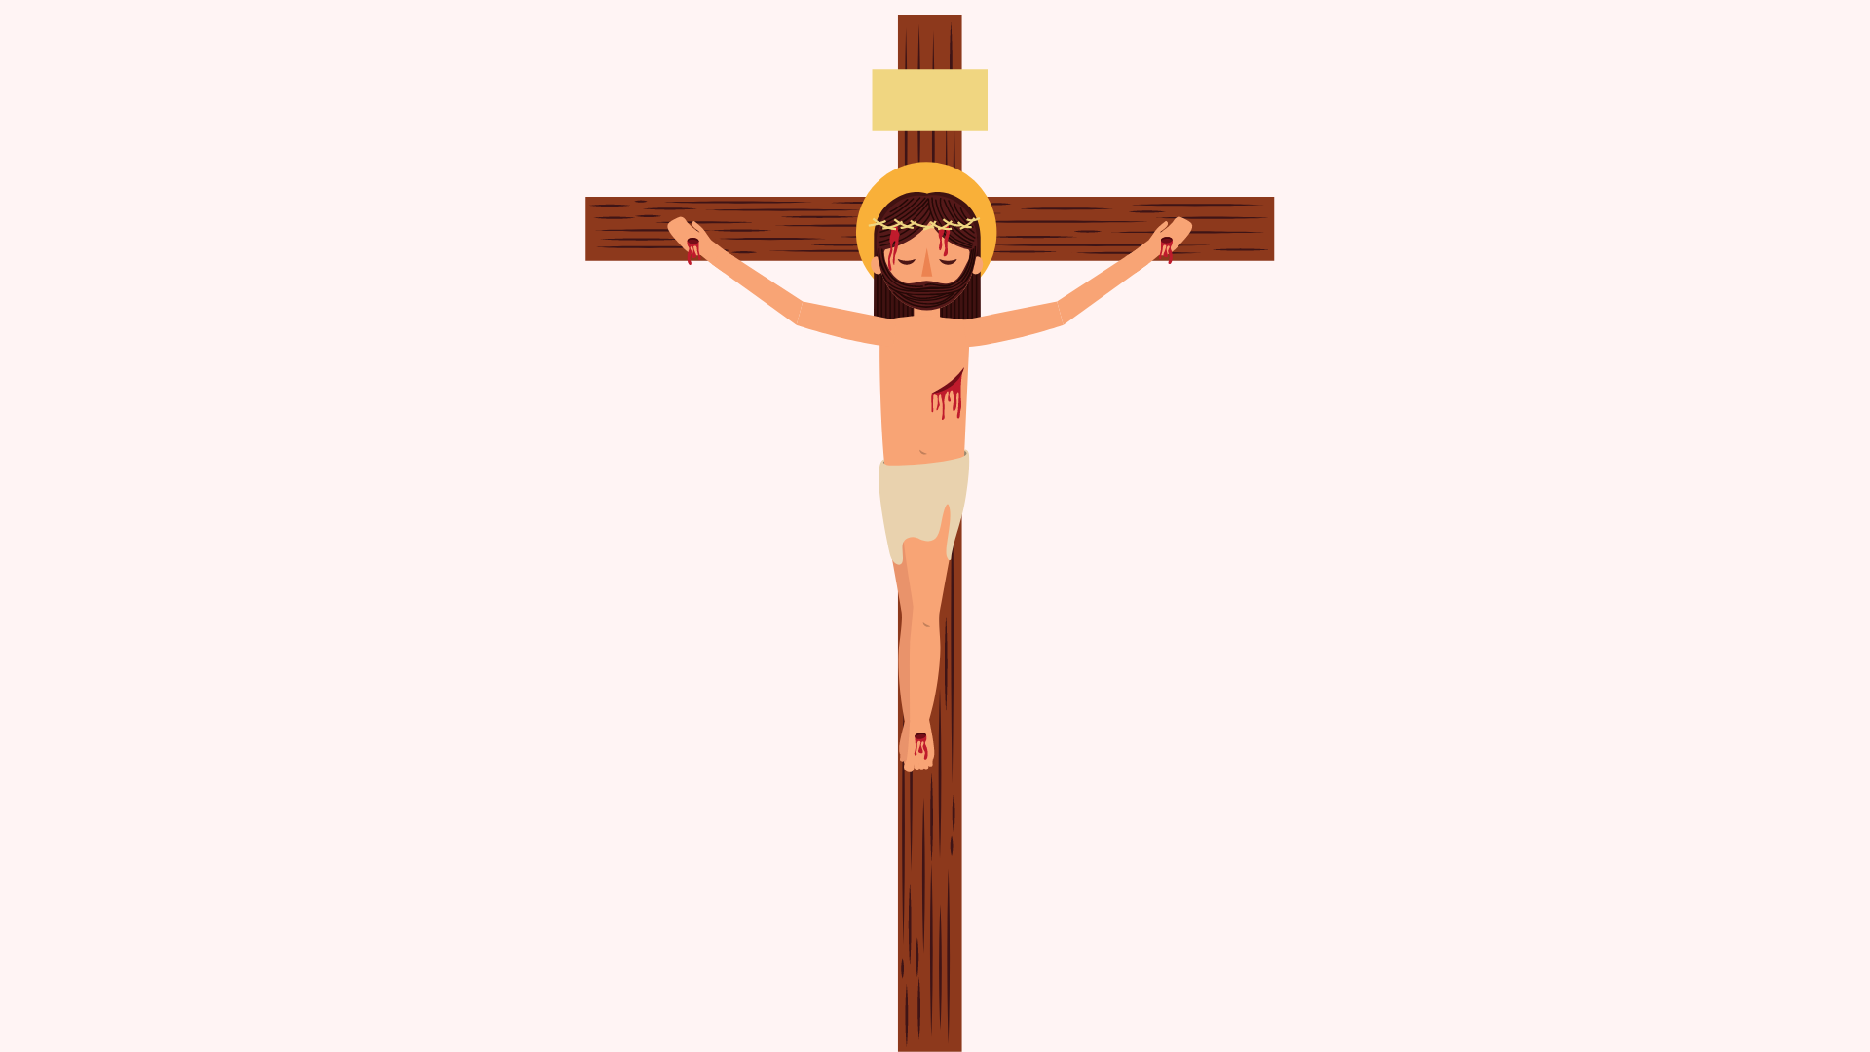
1
2
3
4
5
6
7
8
9
10
11
12

