Slide 1
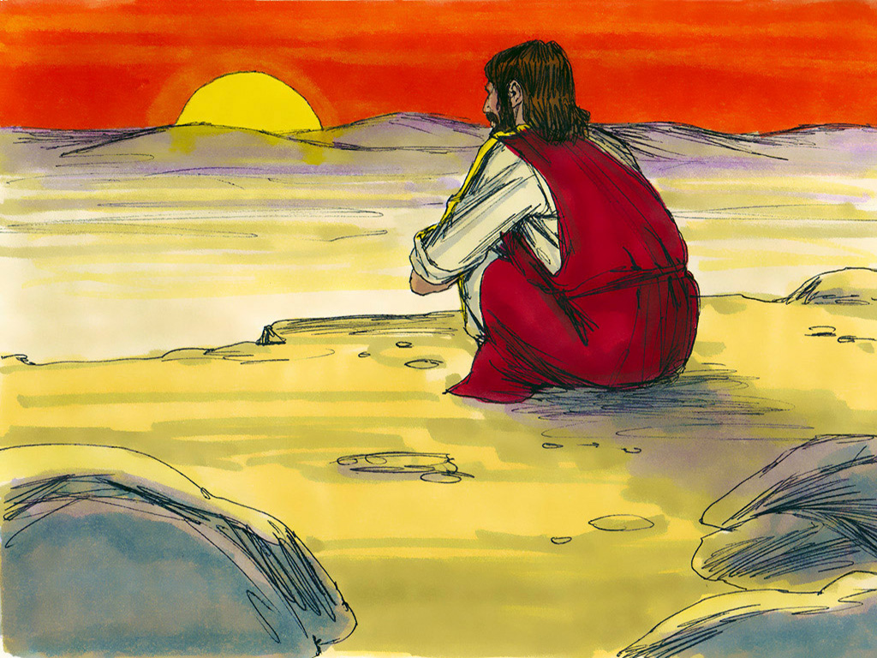
Winning Over Temptation
Matthew 3:1-6, 13-17; 4:1-11;
Mark 1:4-13;
Luke 3:1-16, 21-22; 4:1-13

Slide 4
Notes:
Song: “Obey, Obey the Lord!"

Slide 5
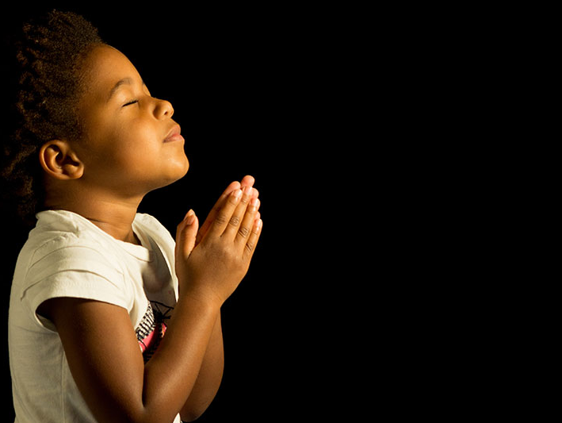
Dear Heavenly Father, ​
Thank You for....​
_________________
Please ….​
_________________
In Jesus' name,​
Amen​

Slide 6
Winning Over Temptation
Matthew 3:1-6, 13-17; 4:1-11;
Mark 1:4-13;
Luke 3:1-16, 21-22; 4:1-13

Slide 7
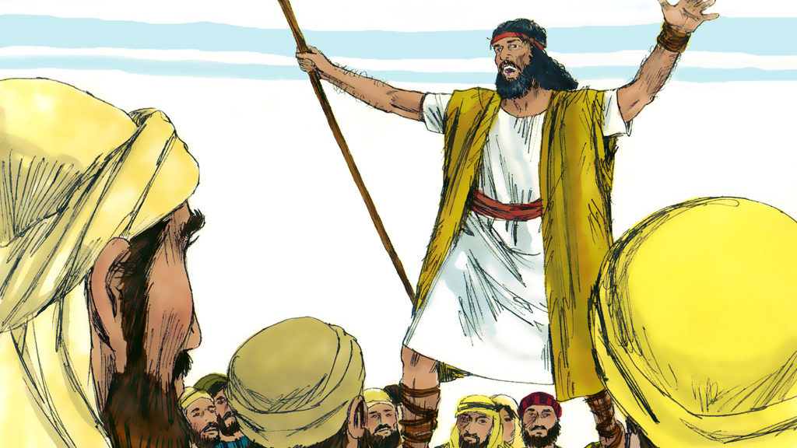

Slide 8
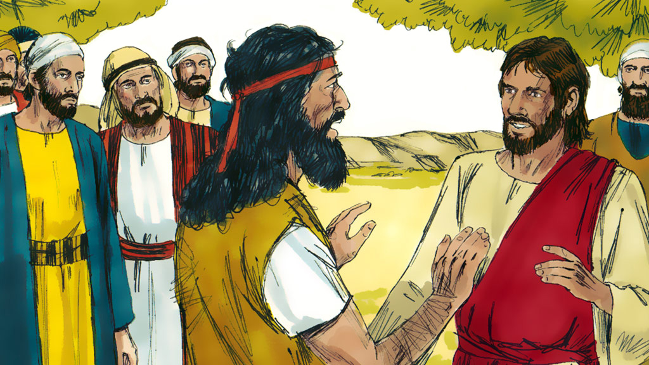

Slide 9
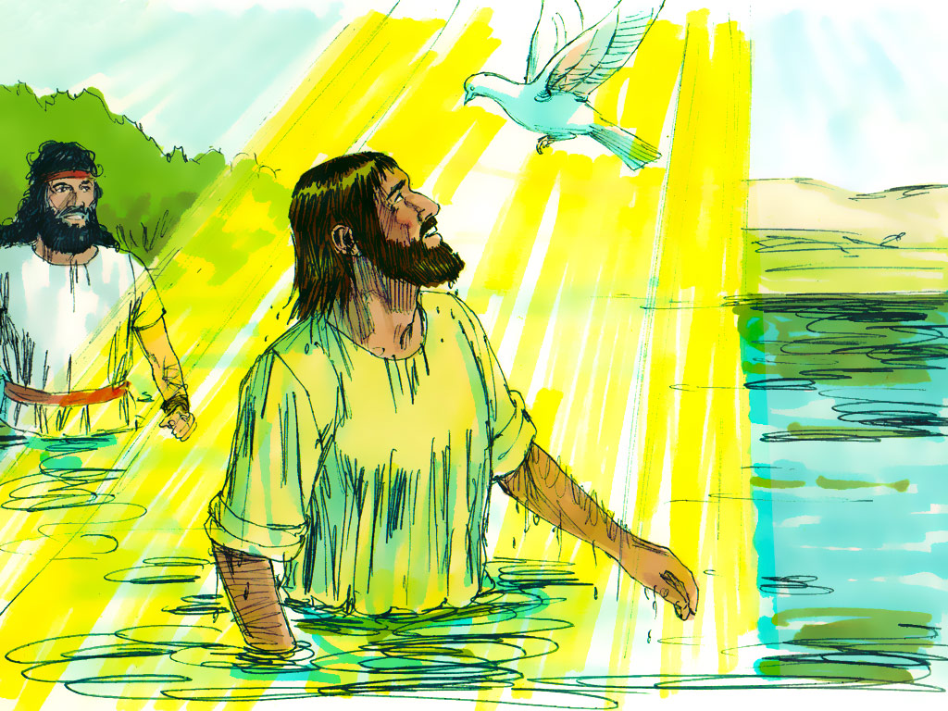
“THIS IS MY BELOVED SON, IN WHOM I AM WELL PLEASED.”

Slide 11
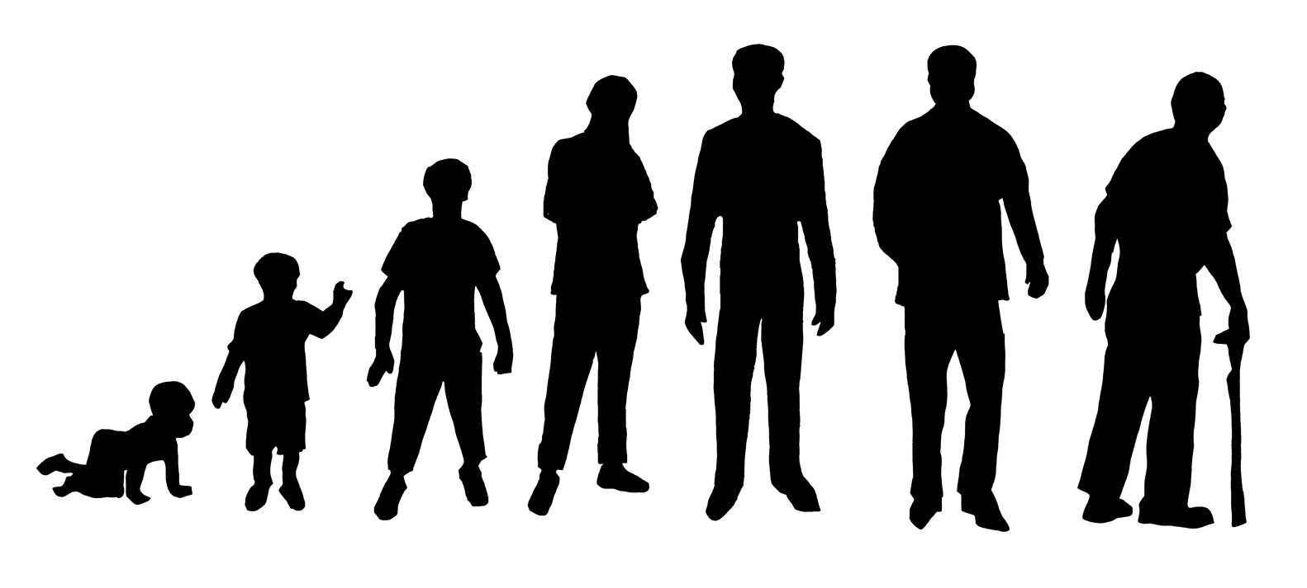
1 Kings 8:46
“…For there is no man
who sinneth not….”

Slide 13
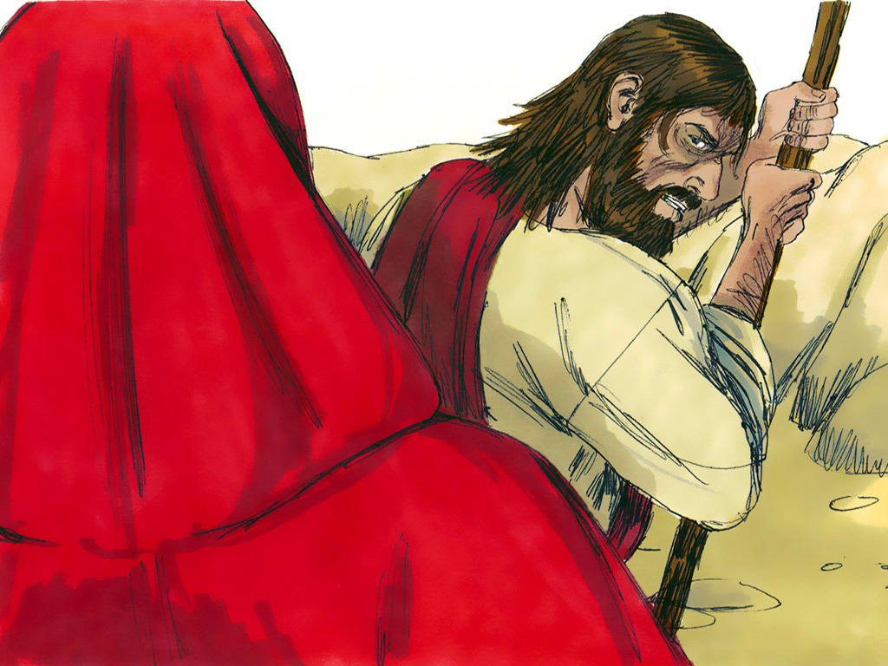

Slide 14
You need to know God’s Word and believe what It says.

Slide 15
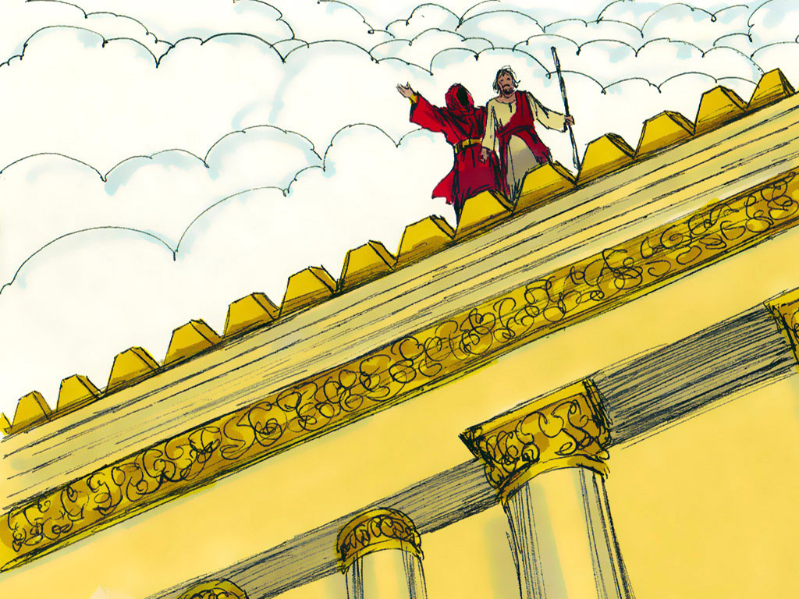

Slide 16
You need to know God’s Word and believe what It says.

Slide 17
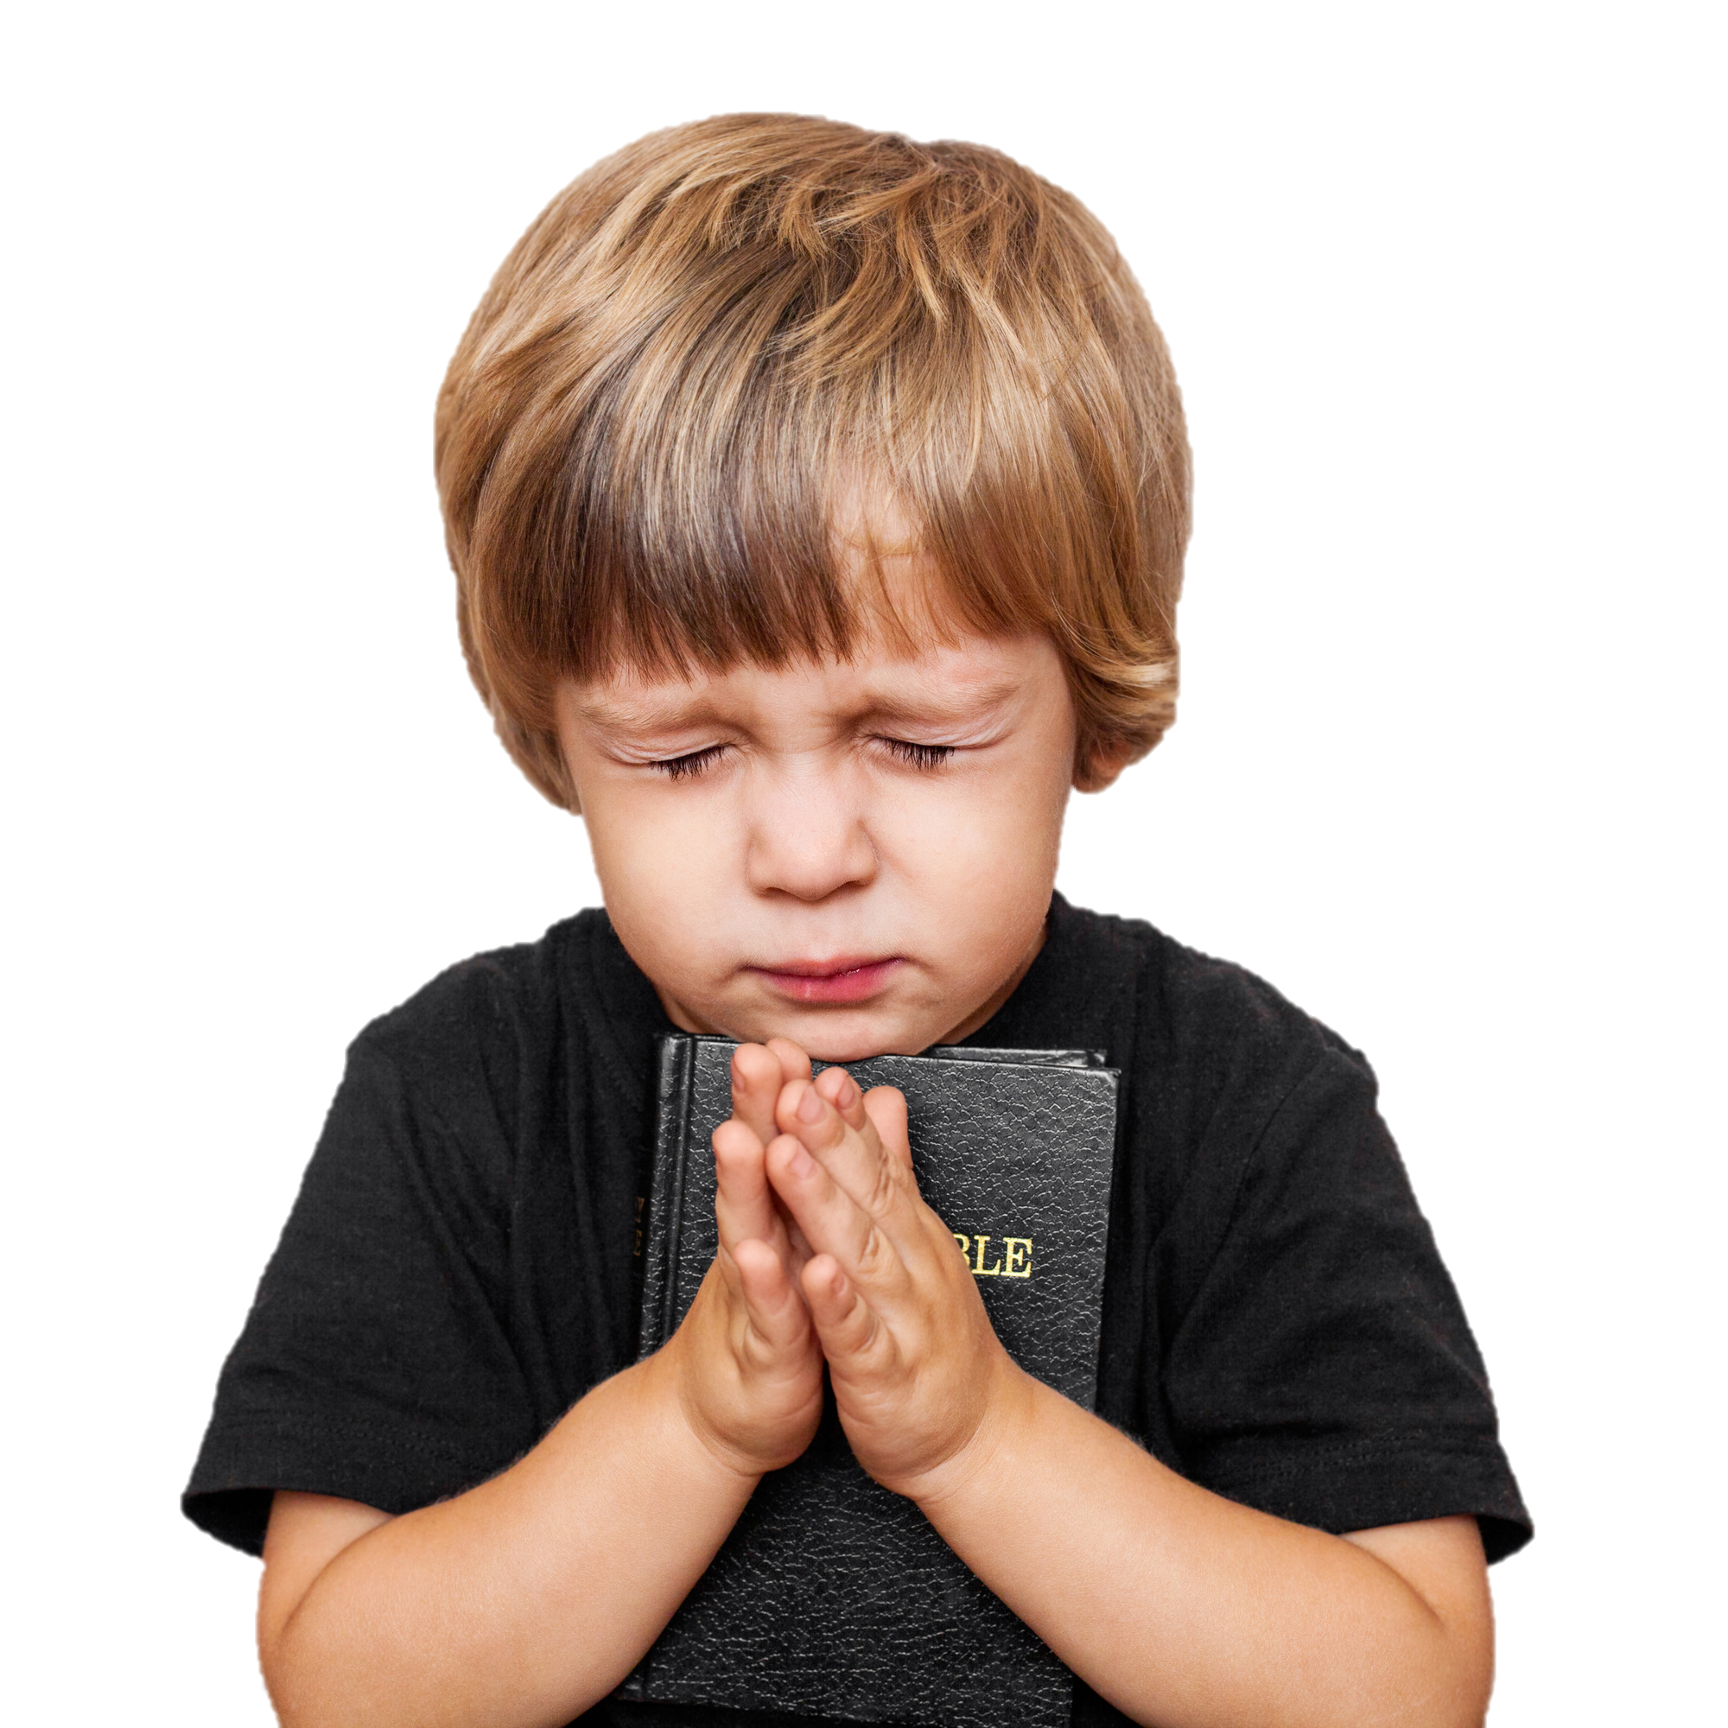
Psalm 119:11
“Thy Word have
I hid in my heart,
that I might not sinned against Thee.”

Slide 18
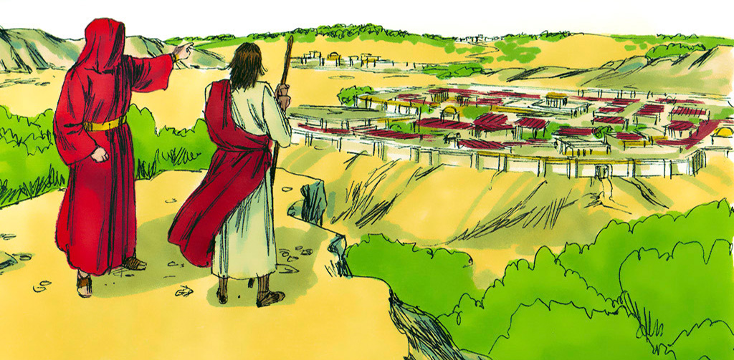

Slide 19
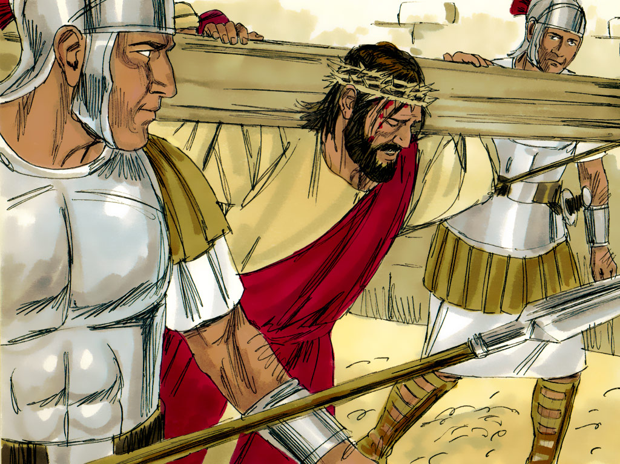
Hebrews 9:22
“…Without shedding
of blood is
no remission.”

Slide 21
You need to know God’s Word and believe what It says.

Slide 22
Psalm 119:11
“Thy Word have
I hid in my heart,
that I might not sinned against Thee.”

Slide 23
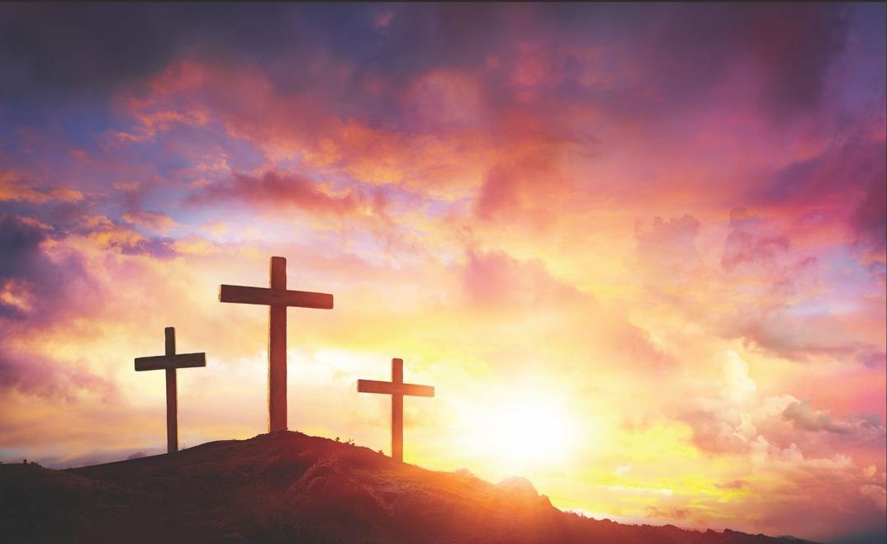
Acts 16:31
“…Believe on the Lord Jesus Christ
and thou shalt be saved….”

Slide 26
Psalm 119:11
“Thy Word have
I hid in my heart,
that I might not sinned against Thee.”

