Slide 1
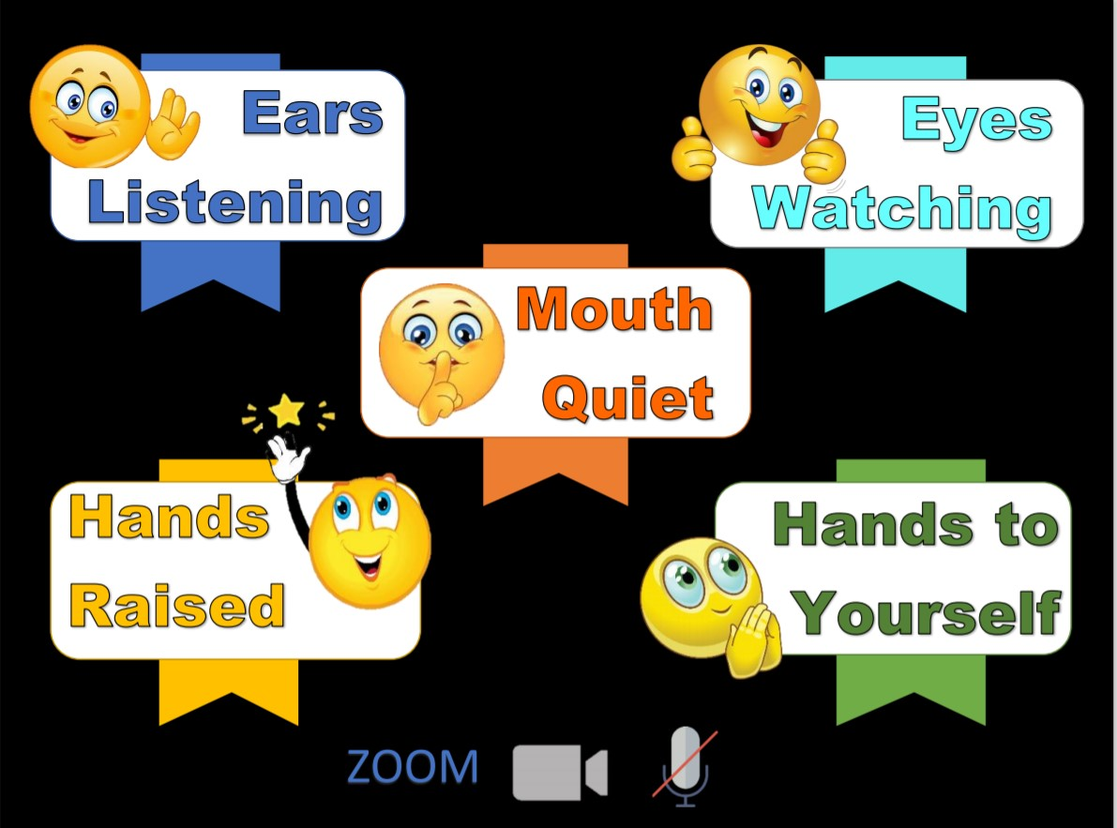
Memory Verse
Main Truth
Books of the Bible

Slide 3
Notes:
Rule Chart

Slide 4
Dear Heavenly Father,
Thank You for
______________
Please
_____________
In Jesus’ name,
Amen.

Slide 5
Notes:
Song: “Shout Hosanna!”

Slide 6
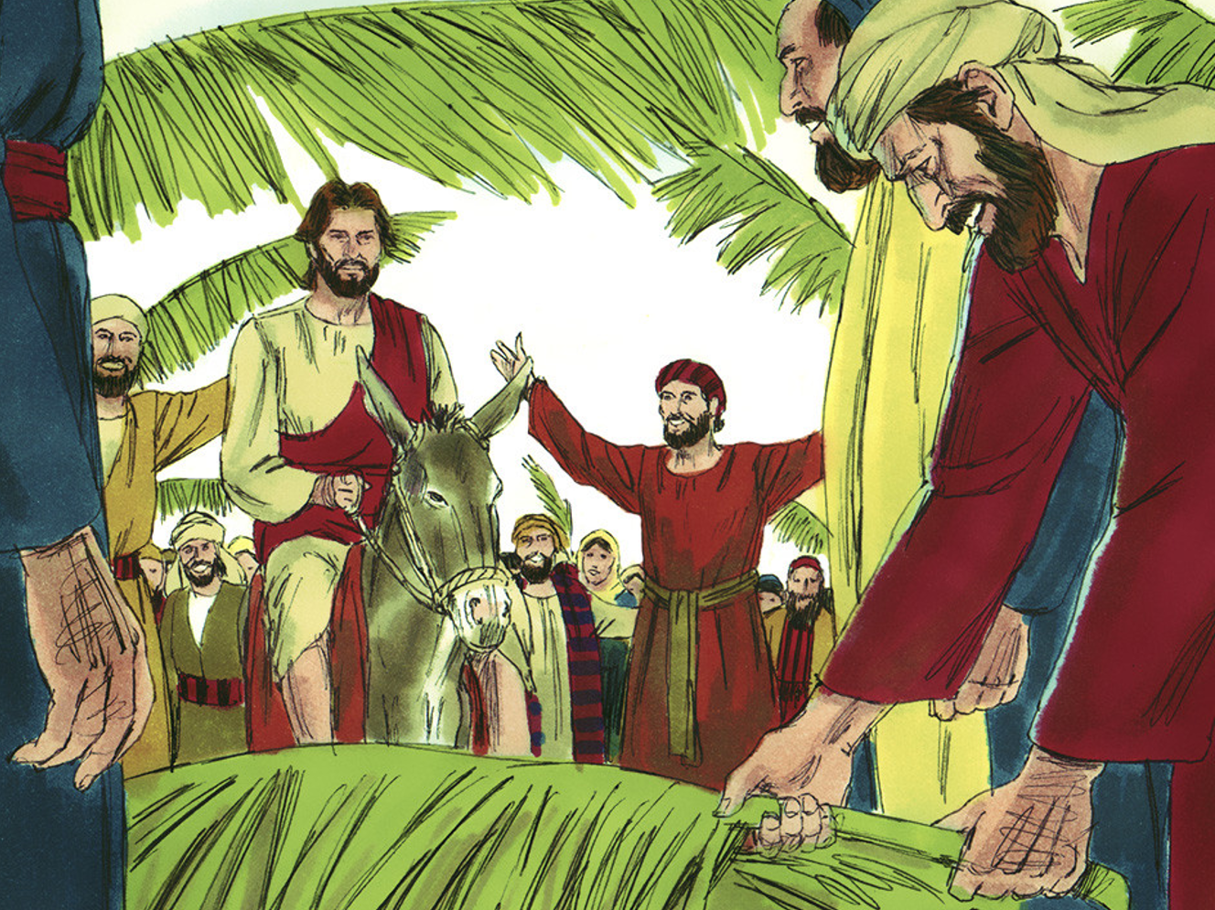
The King Comes
Matt. 21:1-17; Mark 11:1-11; Luke 19:28-40; John 12:12-19

Slide 7
MY RULE!

Slide 8
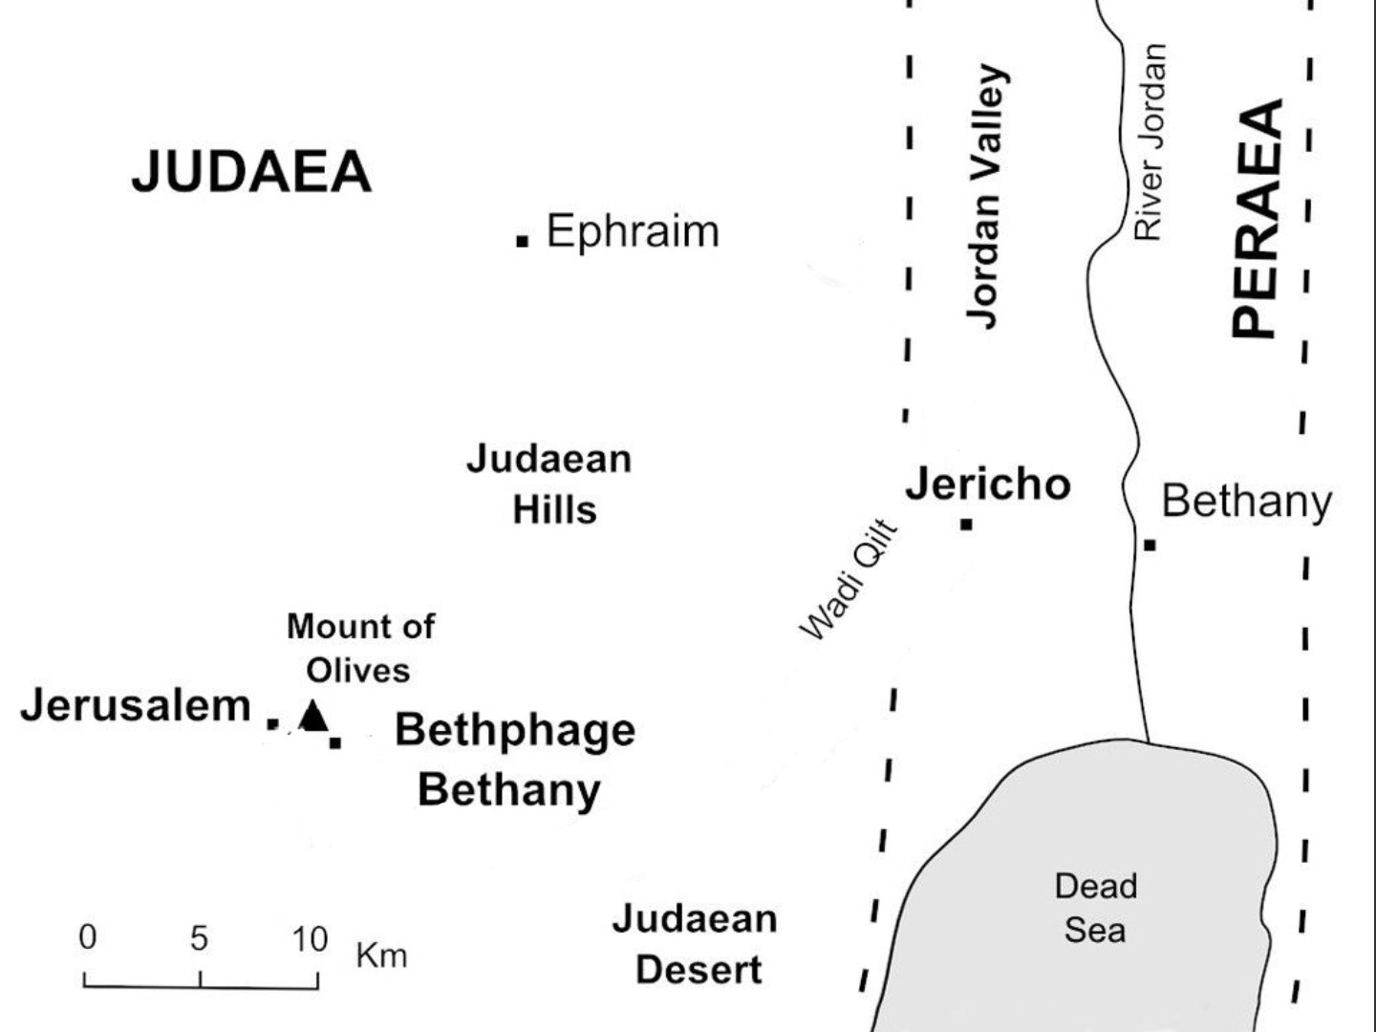

Slide 9
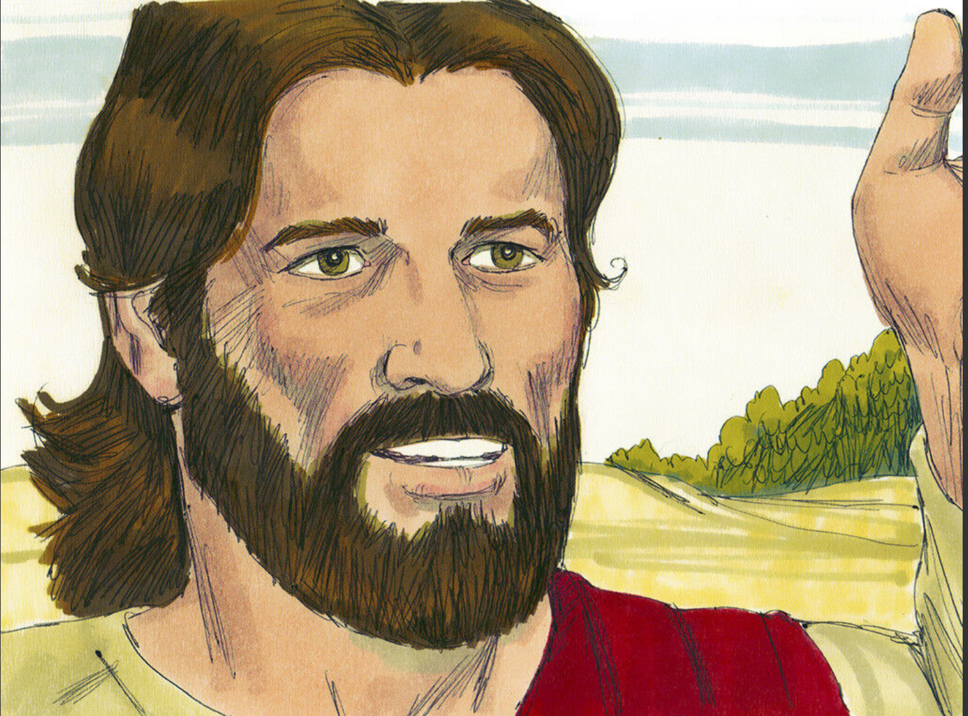

Slide 10
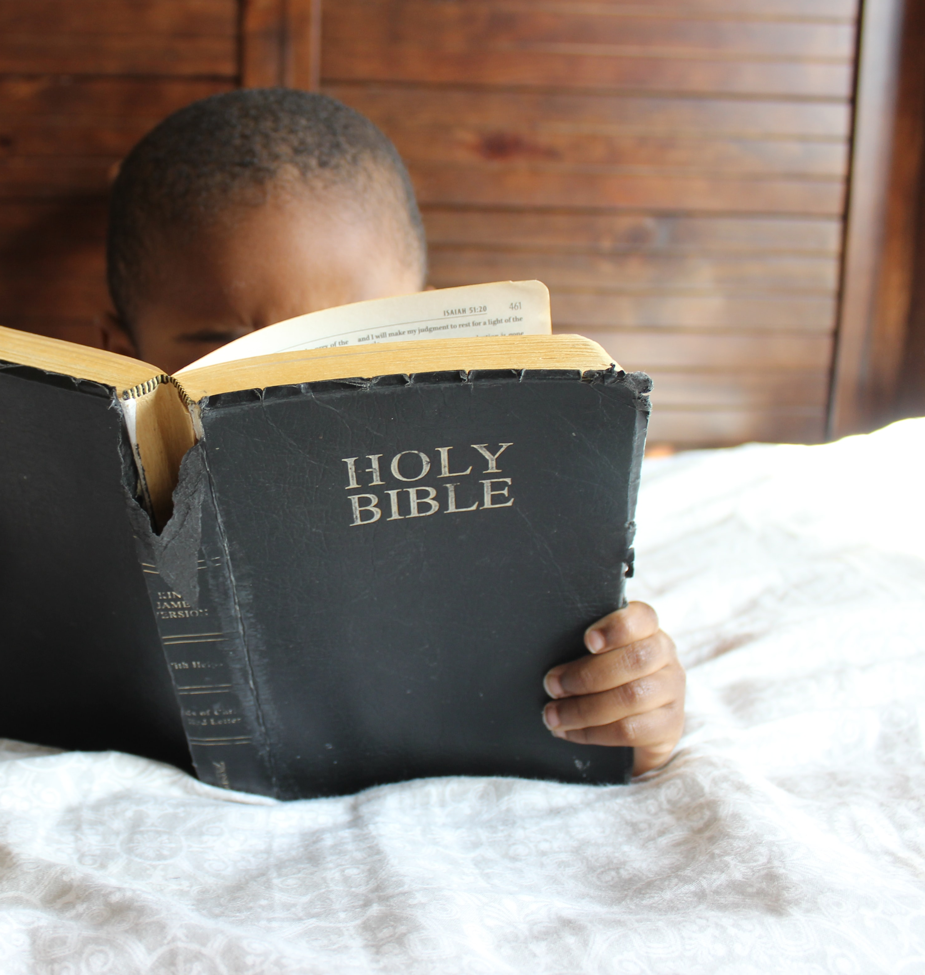
Galatians 3:22
“But the Scripture
hath concluded
all under sin….”

Slide 11
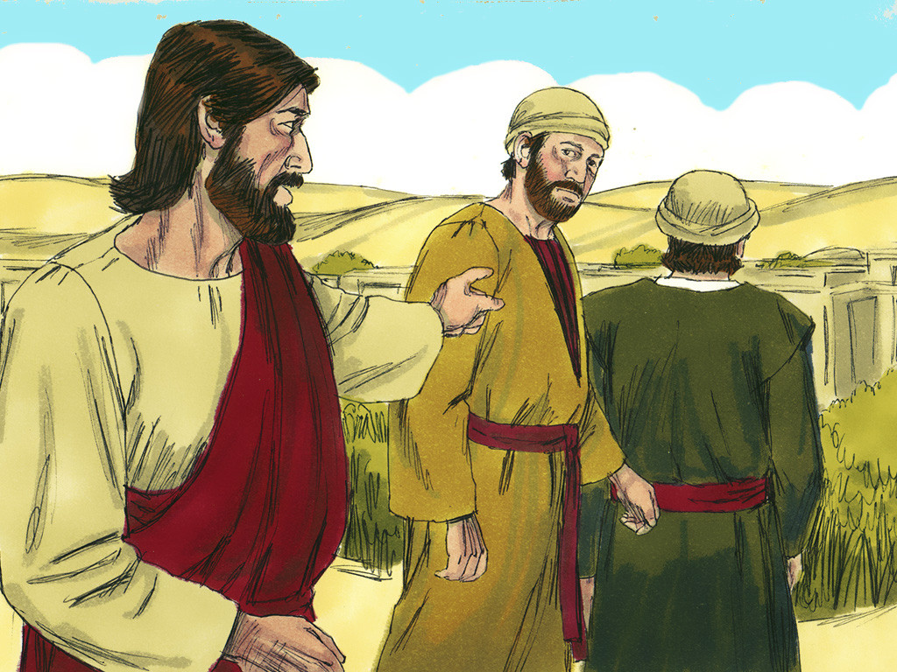

Slide 12
You should believe
God’s way is best

Slide 14
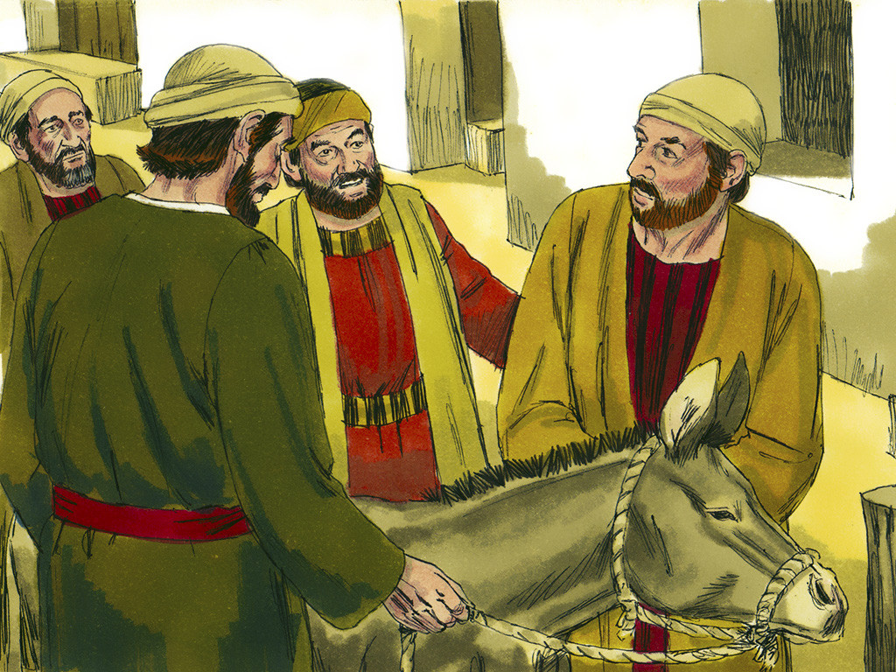
“The Lord
needs them.”

Slide 15
Hosanna! Hosanna!

Slide 16
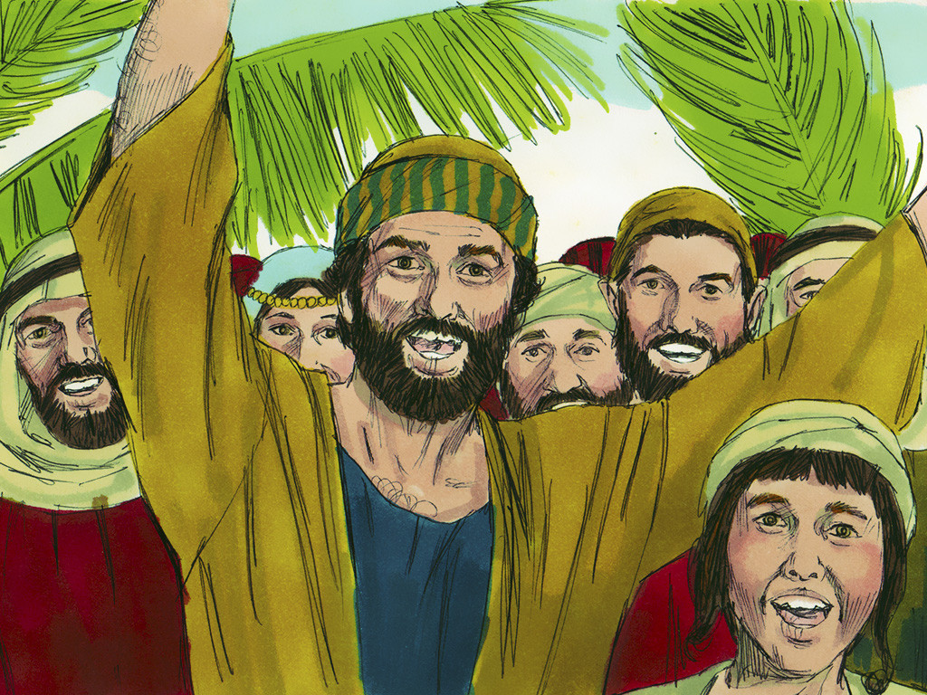
Zechariah 9:9
“Behold, your King is coming to you;
He is just and having salvation,
Lowly and riding on a donkey, a colt…”

Slide 17
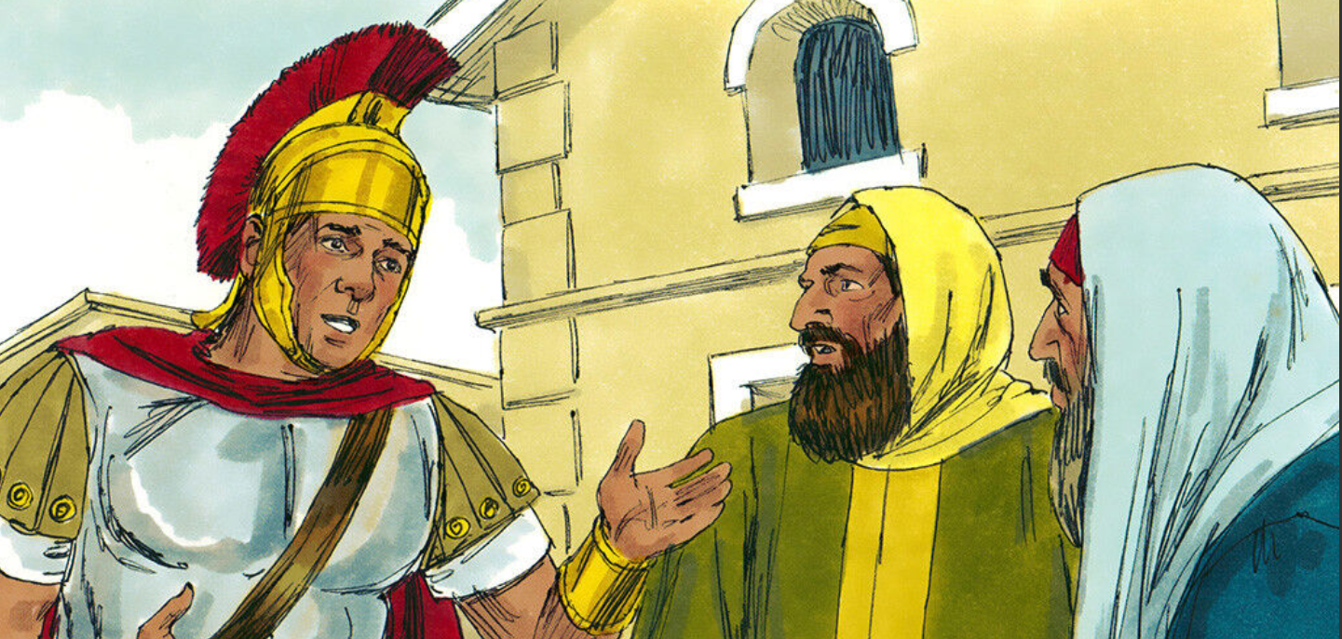
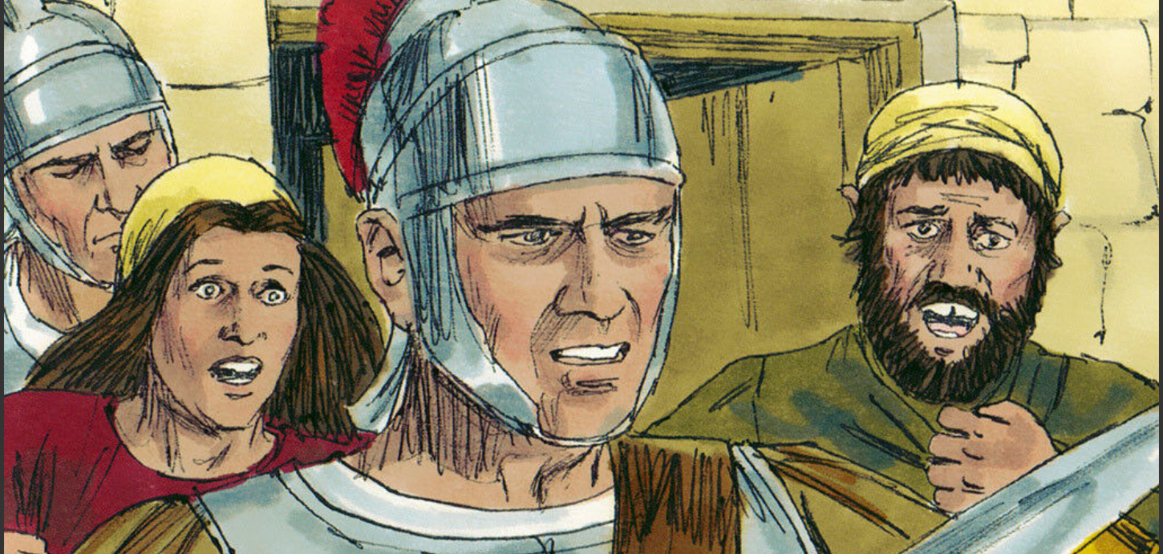

Slide 18
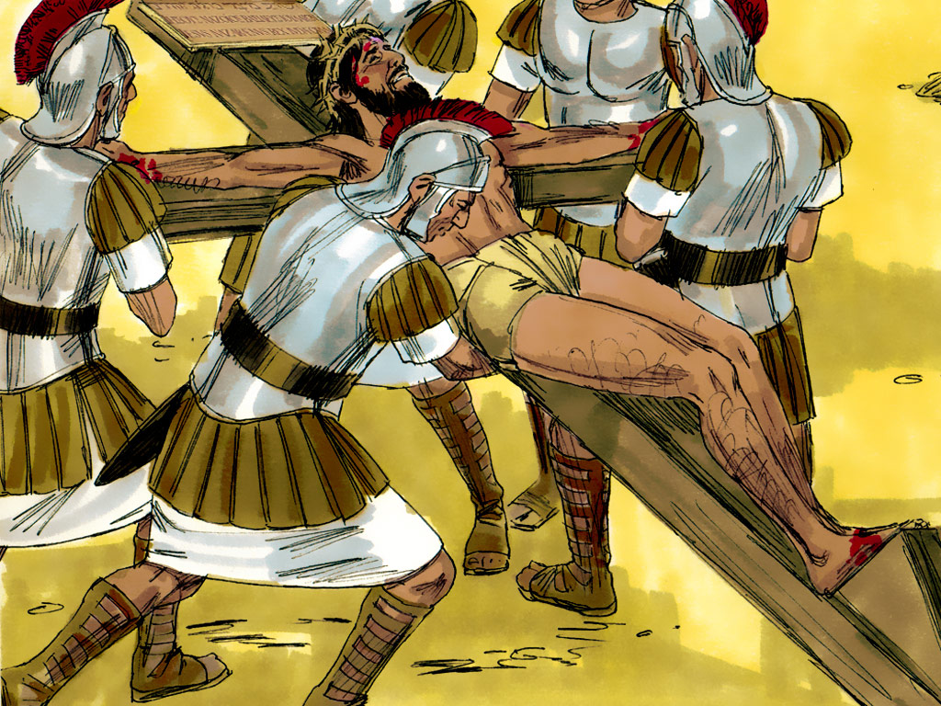
Hebrews 9:22
“…Without shedding of blood
is no remission (forgiveness of sin).”

Slide 20
You should believe
God’s way is best

Slide 21
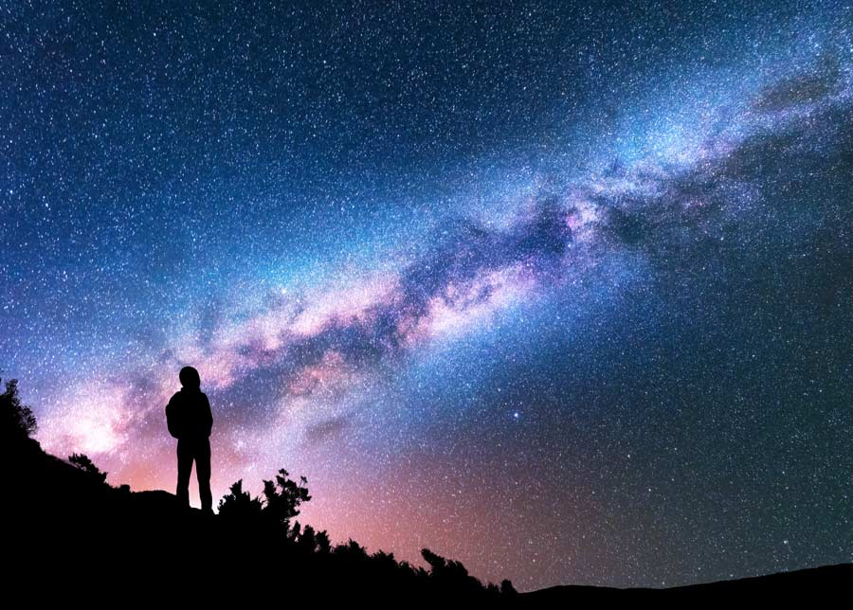
Isaiah 55:9
“For as the heavens are
higher than the earth,
so are My ways
higher than your ways,
and My thoughts than your thoughts.”

Slide 22
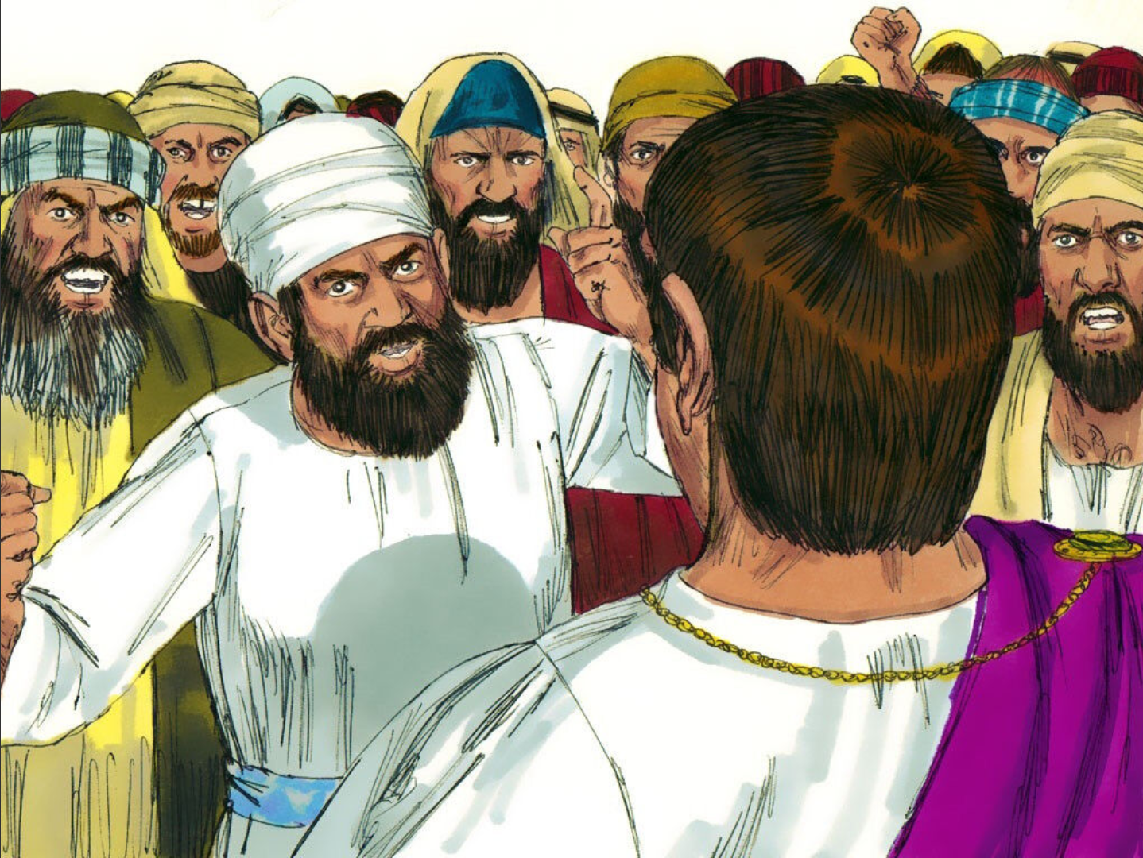
Crucify Him!
Crucify Him!

Slide 23
You should believe
God’s way is best

Slide 24
Isaiah 55:9
“For as the heavens are
higher than the earth,
so are My ways
higher than your ways,
and My thoughts than your thoughts.”

Slide 25
Romans 6:23
For the wages of sin is death,
but the gift of God is
eternal life
in Christ Jesus our Lord.

Slide 26
Notes:
“Jesus, Strong and Kind!”

Slide 28
Zechariah 9:9
“…Behold, thy King is coming to thee: He is just and having salvation; Lowly and riding upon… a colt….”
Notes:
(Add a Word/ Solo Word/ Clap A Word)

Slide 29
Let’s Make a Deal!
500
200
100
100
500
200
200
SPIN!
100
100
500
200
100
500
200
100
500
200
100
500
200
tekhnologic

Slide 30
Learning About the bible

Slide 31
Books of the New Testament
Romans
1 Thessalonians
1 Corinthians
2 Thessalonians
14 LETTERS
2 Corinthians
1 Timothy
Galatians
2 Timothy
Ephesians
Titus
Philippians
Philemon
Colossians
Hebrews
Notes:
We have been learning the names of Paul’s Letters. How many letters did Paul write? (14.)
Some of his letters were written to churches and some were written to individual people.
Let’s say the names of the nine letters written to churches.
(Romans, 1 Corinthians, 2 Corinthians, Galatians, Ephesians, Philippians, Colossians, 1 Thessalonians, and 2 Thessalonians}
We have learned the names of three letters that Paul wrote to individual people. Let’s say the names of these letters.
(Place 1 Timothy, 2 Timothy, and Titus. Paul wrote a letter to one other person. His name and the name of the book is Philemon.
Let’s say the four New Testament books that Paul wrote to individual people.
Most people believe that Paul wrote one other book. It is called Hebrews.
This book, or letter, was written to Jewish, or Hebrew, people who believed that Jesus was the Messiah and had placed their trust in Him to be their Saviour from sin.
Let’s review all the names of Paul’s Letters. (Practice together.)

Slide 32
Books of the New Testament
THE GOSPELS
LETTERS
Matthew
Romans
1 Thessalonians
Mark
1 Corinthians
2 Thessalonians
2 Corinthians
1 Timothy
Luke
Galatians
2 Timothy
John
Ephesians
Titus
HISTORY
Philippians
Philemon
Acts
Colossians
Hebrews
Notes:
Now we will practice saying the names of all of the books of the New Testament that we have learned.
(Practice several times saying the names of the Gospels, the book of History, and the 14 books of Paul’s Letters.)

