Slide 1
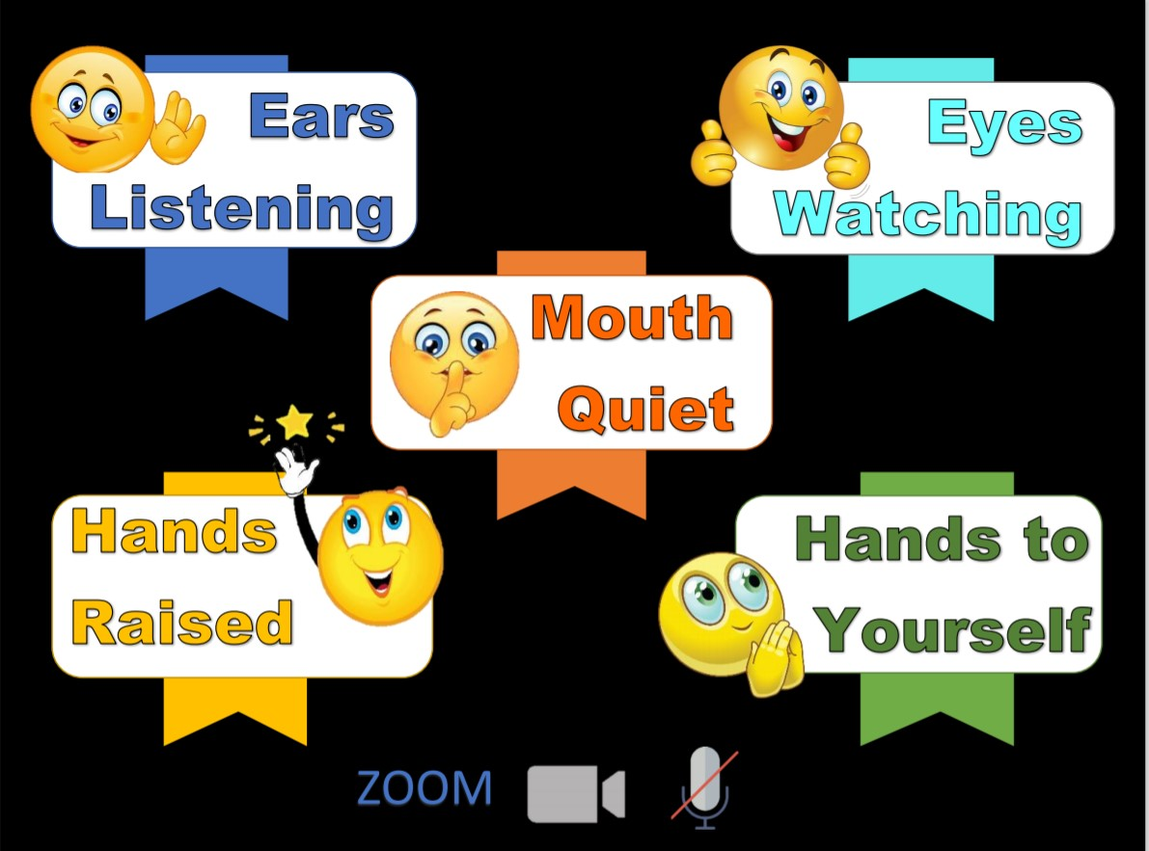
Memory Verse
Main Truth
Books of the Bible

Slide 2
Notes:
GNC Intro:

Slide 3
Notes:
Rule Chart:

Slide 4
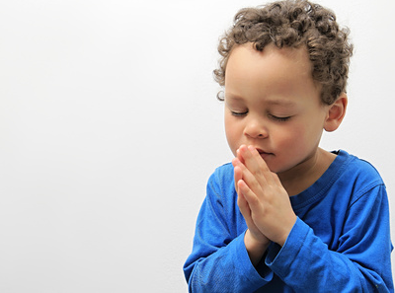
Dear Heavenly Father,
Thank You for
______________
Please
_____________
In Jesus’ name,
Amen.
Notes:
Prayer

Slide 5
Notes:
Song: “Jesus, Strong and Kind!”

Slide 6
The King’s Undeserved Death
Matthew 27:31; Mark 15:20-47;
Luke 23:26-5; John 19:16-42

Slide 8
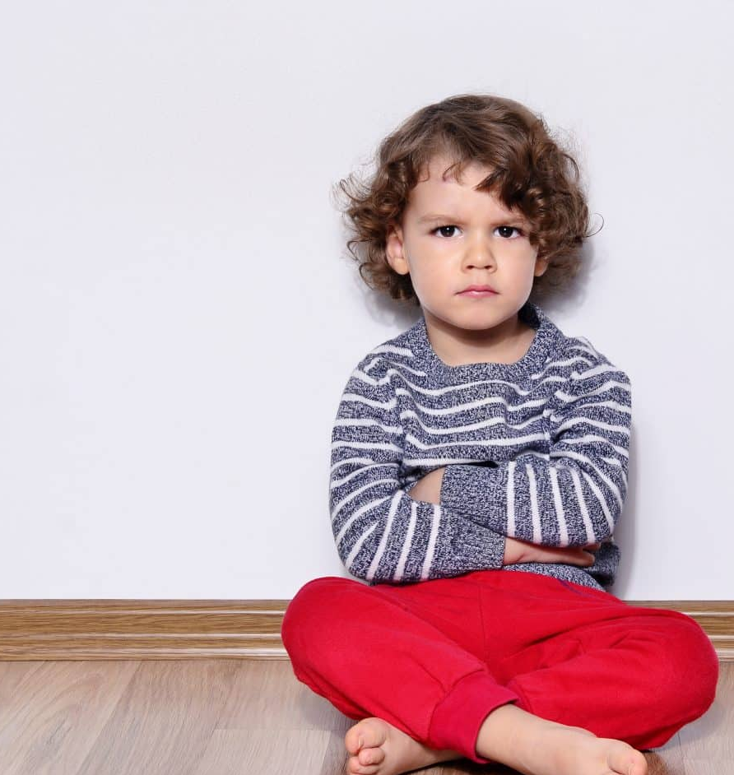
Isaiah 53:6
“All we like sheep have gone astray; we have turned every one to his own way….”

Slide 10
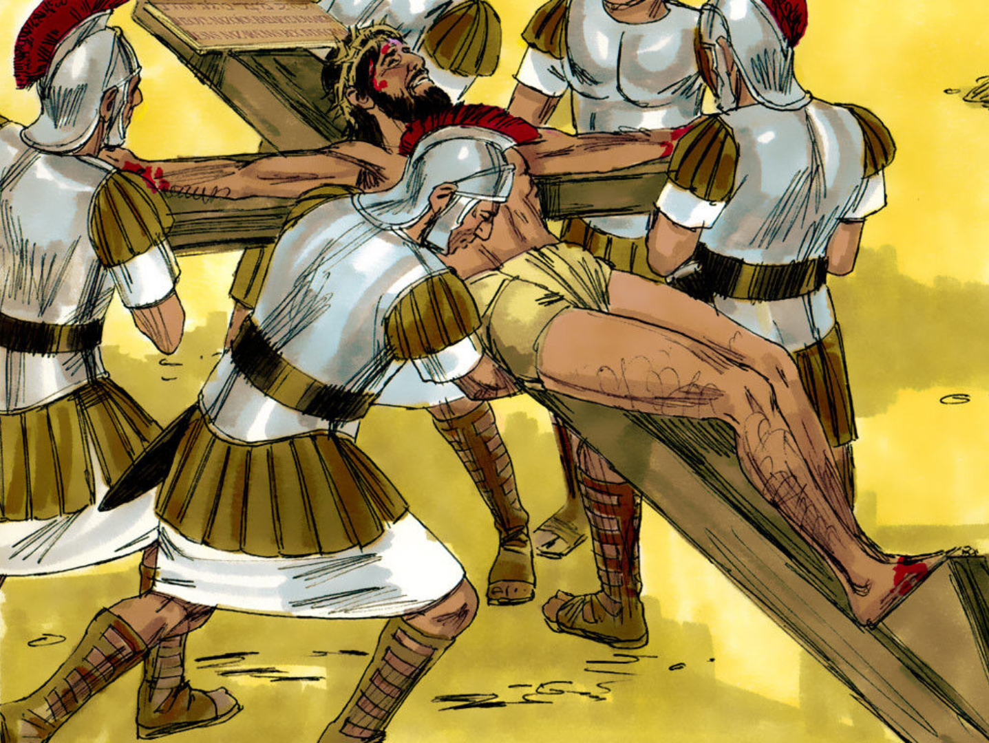

Slide 11
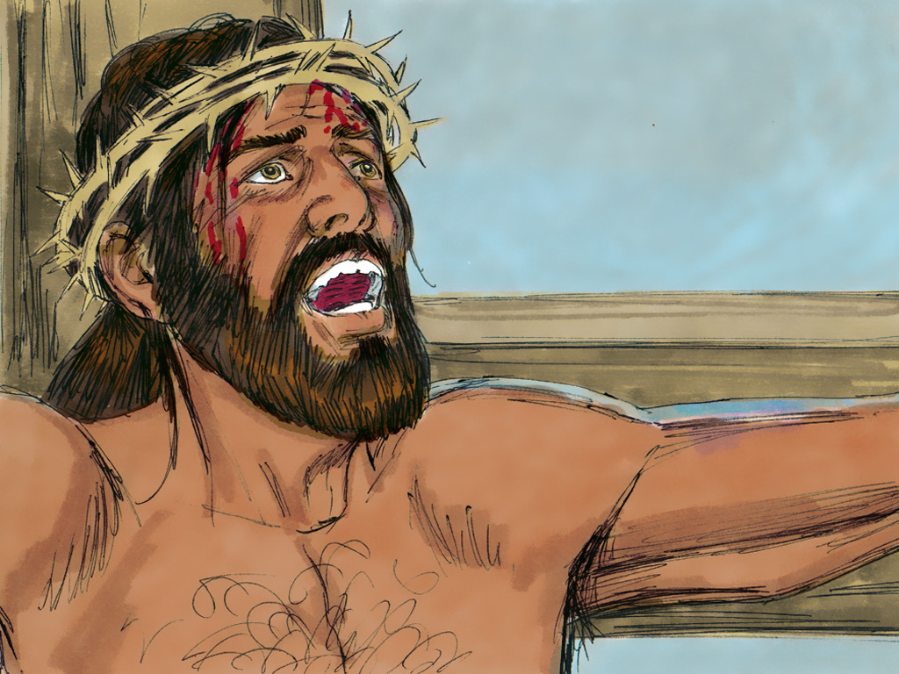
“Father, forgive them, for they know not what they are doing.”

Slide 12
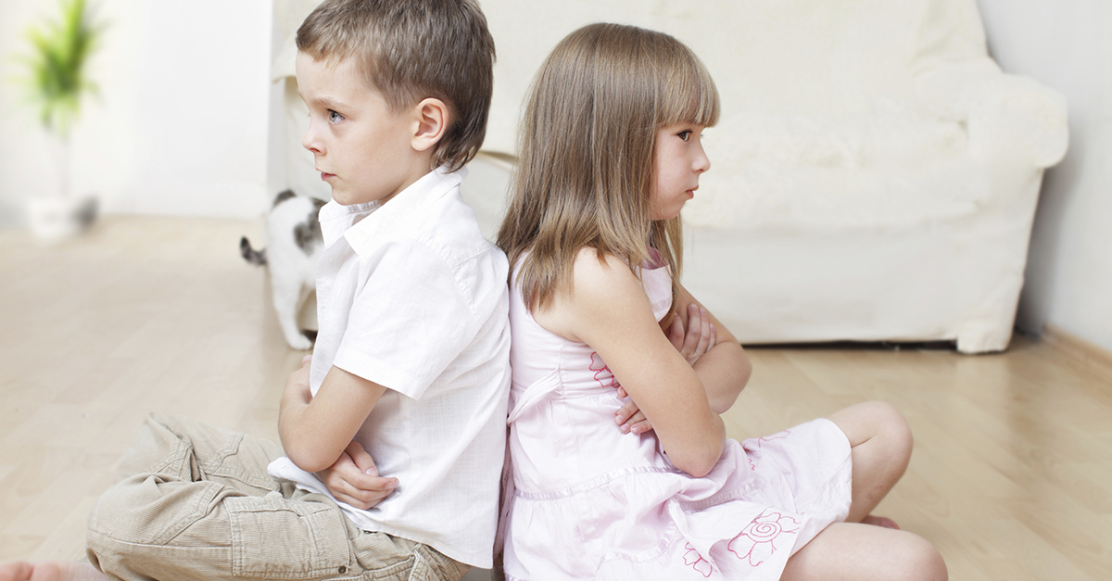
God wants you to
love your enemies

Slide 13
“Father, forgive them, for they know not what they are doing.”

Slide 14
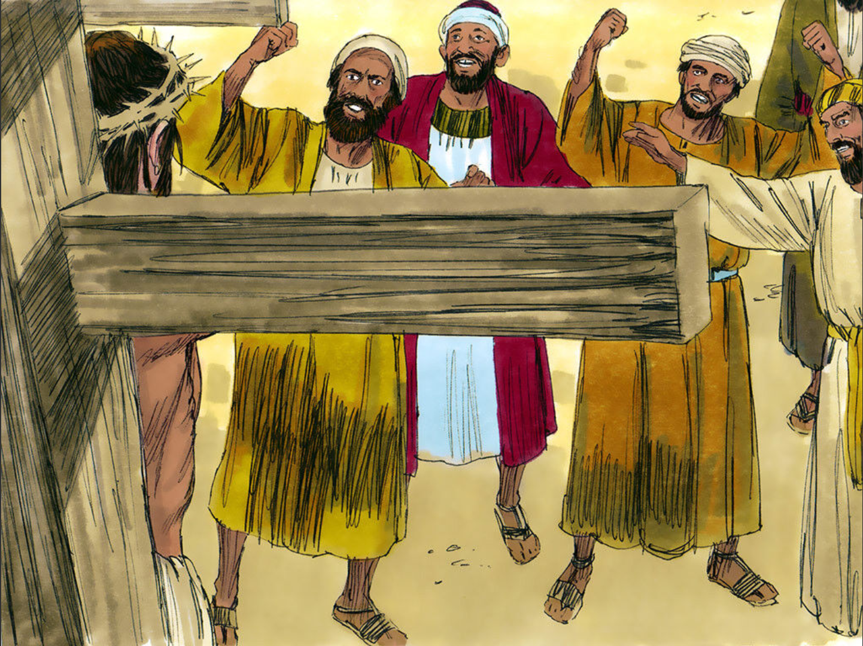

Slide 15
God wants you to
love your enemies

Slide 16
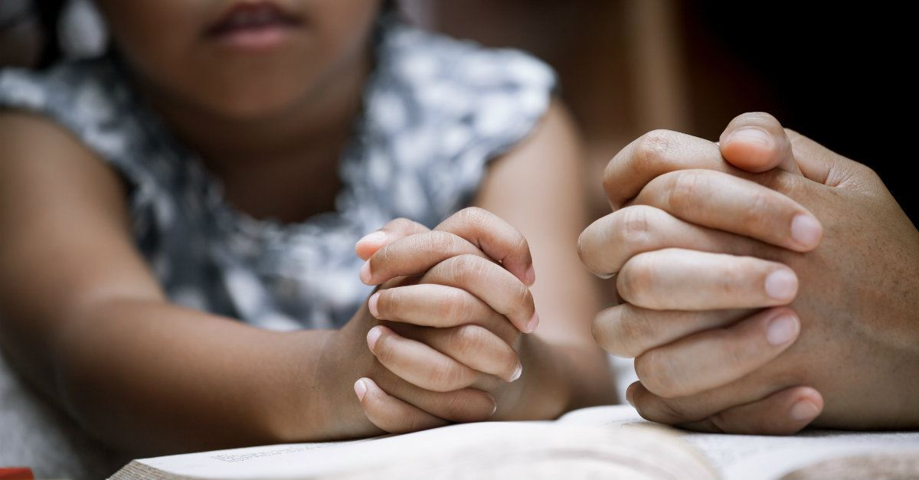
Matthew 5:44
“But I say unto you, Love your enemies,
bless them that curse you,
do good to them that hate you,
and pray for them….”

Slide 18
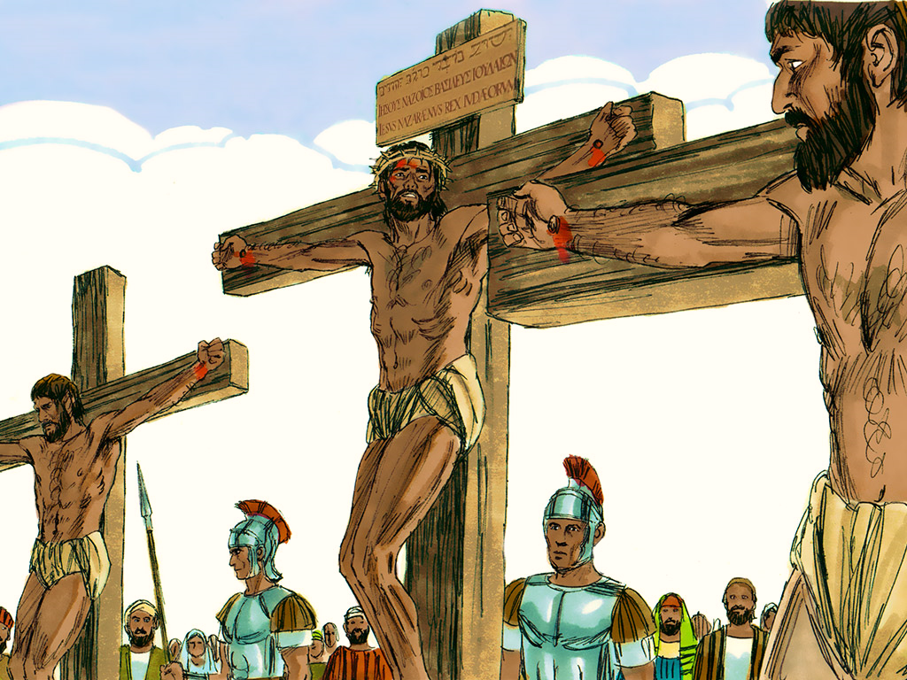
Today, you will be with Me in Paradise.
Remember me when You come into Your Kingdom.

Slide 19
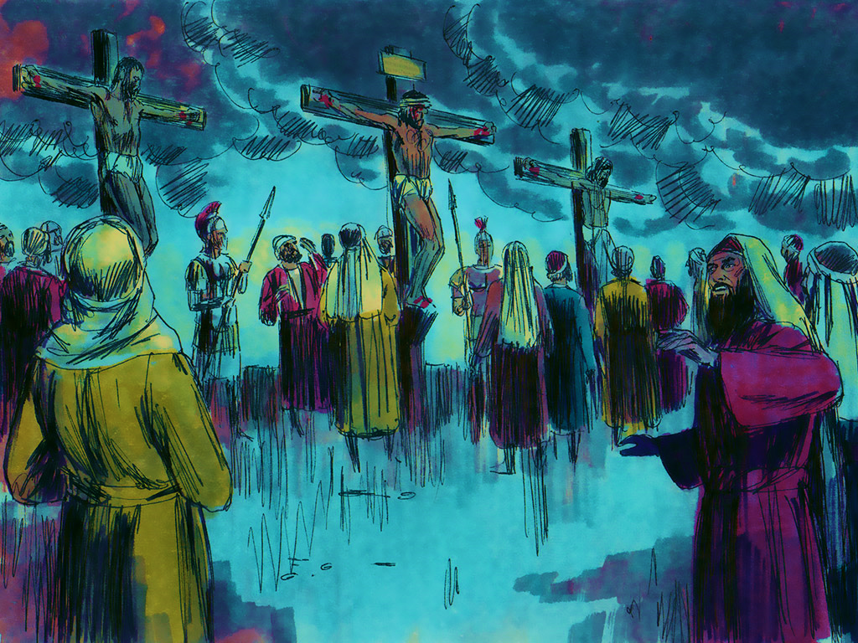
IT IS FINISHED!

Slide 20
1 Peter 2:24
“Who His own self bare our sins
in His own body on the tree….”

Slide 21
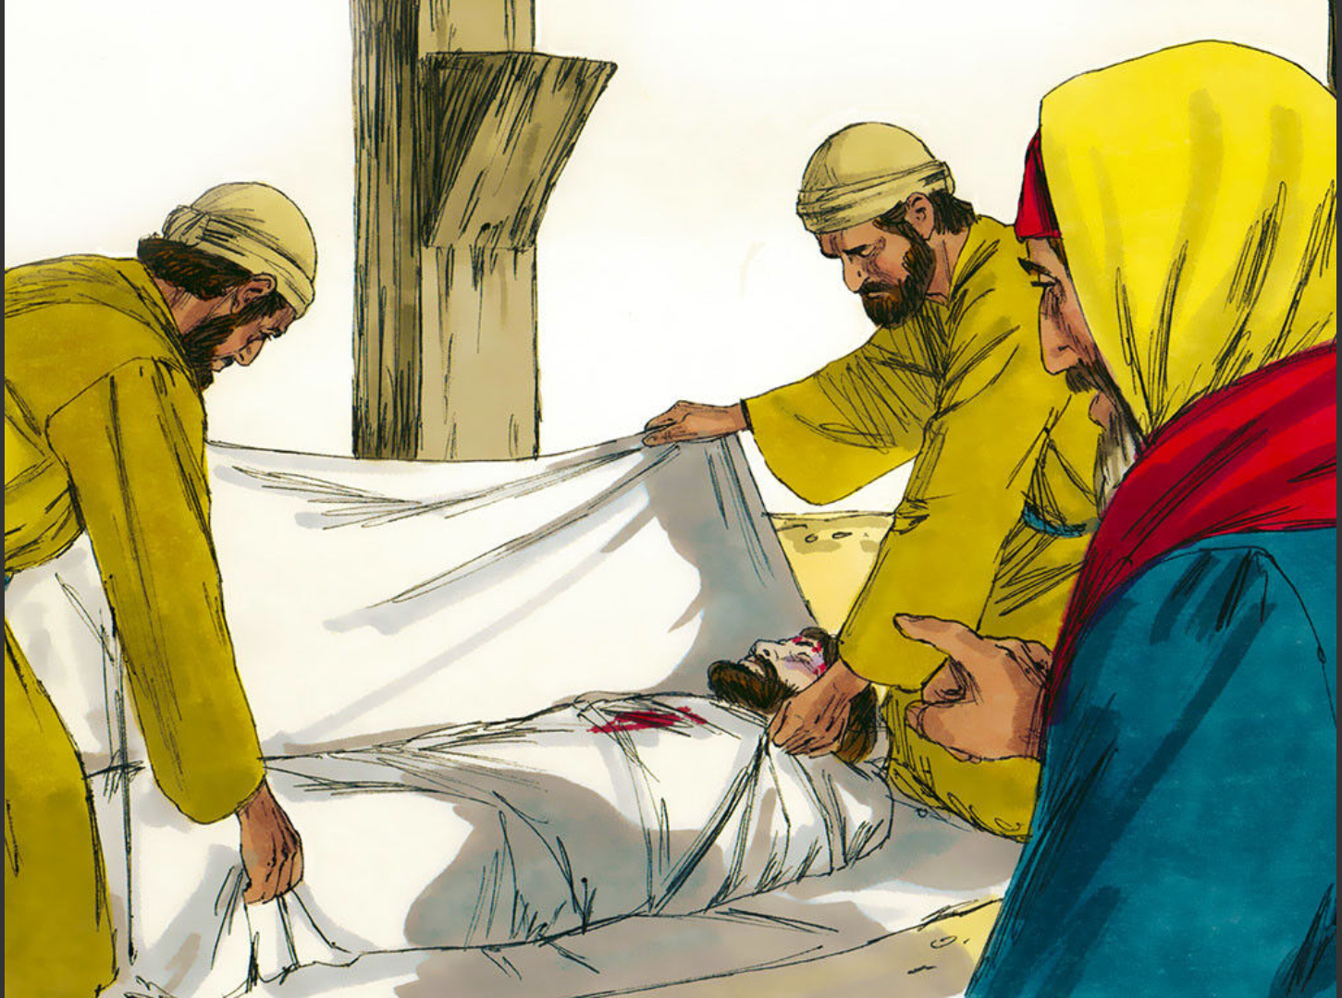

Slide 22
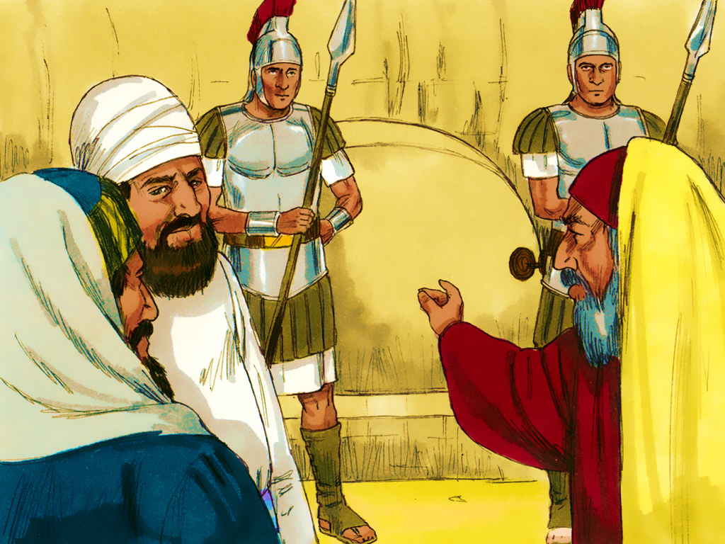

Slide 23
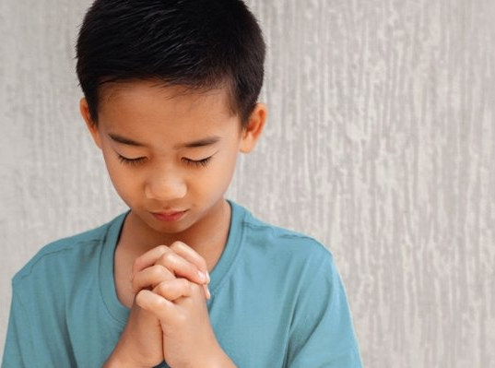
John 6:47
“…He that believeth
on Me
hath everlasting life.”

Slide 24
God wants you to
love your enemies

Slide 25
Matthew 5:44
“But I say unto you, Love your enemies,
bless them that curse you,
do good to them that hate you,
and pray for them….”

Slide 26
I hear the Savior say,
“Your strength indeed is small; Child of weakness, watch and pray,
Find in Me your all in all.”
Jesus paid it all, all to Him I owe;
sin had left a crimson stain, He washed it white as snow.

Slide 28
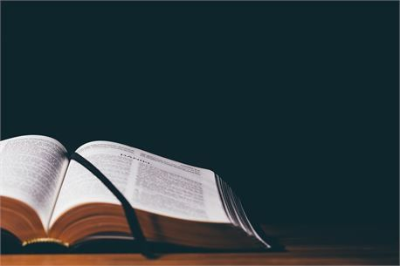
Isaiah 53:6
“All we like sheep have gone astray;
we have turned every one to
his own way….”
Notes:
“Repetition” – Choose one of the children’s favorite memory verse games to do this week.

Slide 29
Learning About the bible

Slide 30
Gospels
Matthew
Mark
Acts
Luke
John
HISTORY
Romans
Philippians
1 Timothy
Paul’s Letters
1 Corinthians
Colossians
2 Timothy
2 Corinthians
1 Thessalonians
Titus
Galatians
2 Thessalonians
Philemon
Ephesians
Hebrews
Notes:
Who can tell me the names of the four Gospels? Who can name the book of History?
Who can say all 14 of Paul’s Letters?

Slide 31
1 John
General Letters
(7)
James
2 John
1 Peter
3 John
2 Peter
Jude
Notes:
What is the name of the next group of books in the New Testament? Yes, they are called General Letters. There are seven letters written by four different men.
What book did Jesus’ half brother James write? (James.) How many books did Peter write? (Two.) What are they called? (First and Second Peter.)
The next three books were written by the same man. It is the same man who wrote one of the Gospels. His name is John. John, another one
of Jesus’ disciples, wrote First, Second, and Third John. The last of the General Letters is Jude.
This book was written by a man named Jude. Let’s practice saying all the names of the General Letters.
Now we can review all the names of the books of the New Testament that we have learned.

Slide 32
Notes:
Review game - “Juggling” - When a child answers a question click for next slide, see how many balls our friend can juggle before time is up/game is over. (There are 10 balls total, use as many or few as you desire)

Slide 33
Notes:
Review Invitation - At the end of the club tell the children “After I say ‘Amen’ you may log off, if you wanted to talk to me about asking Jesus to be your Saviour please stay on and I will help you after the others have logged off.”

Slide 34
Notes:
You can Screen Share these Counseling Card slides to go through as you normally would.

