Slide 1
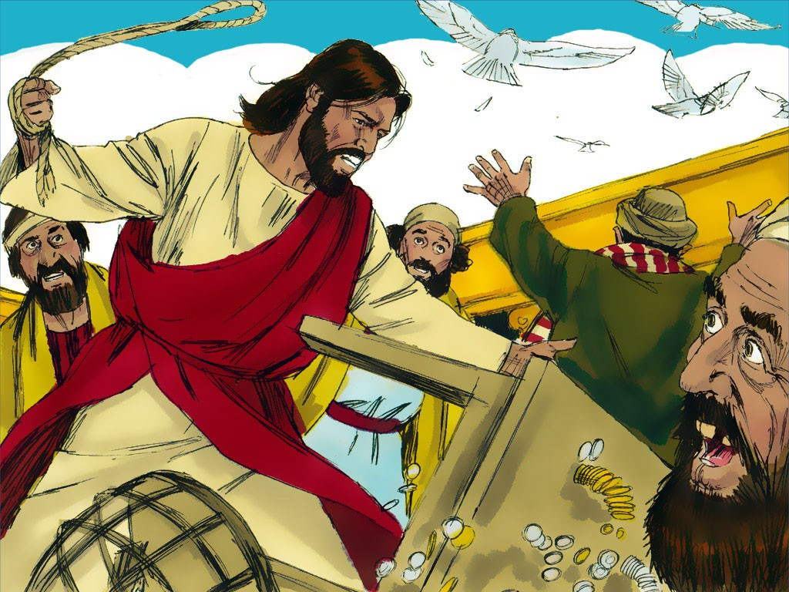
Jesus Cleanses The Temple
John 2:12- 25

Slide 5
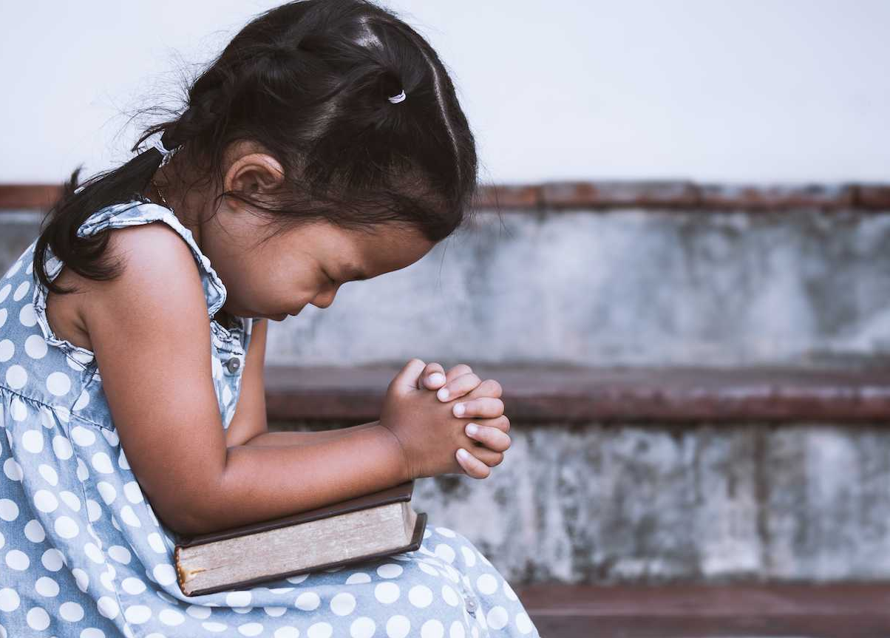
Dear Heavenly Father,
Thank You for...
______________
Please…
_______________
In Jesus' name,
Amen

Slide 6
Jesus Cleanses the Temple
John 2:12-25

Slide 7
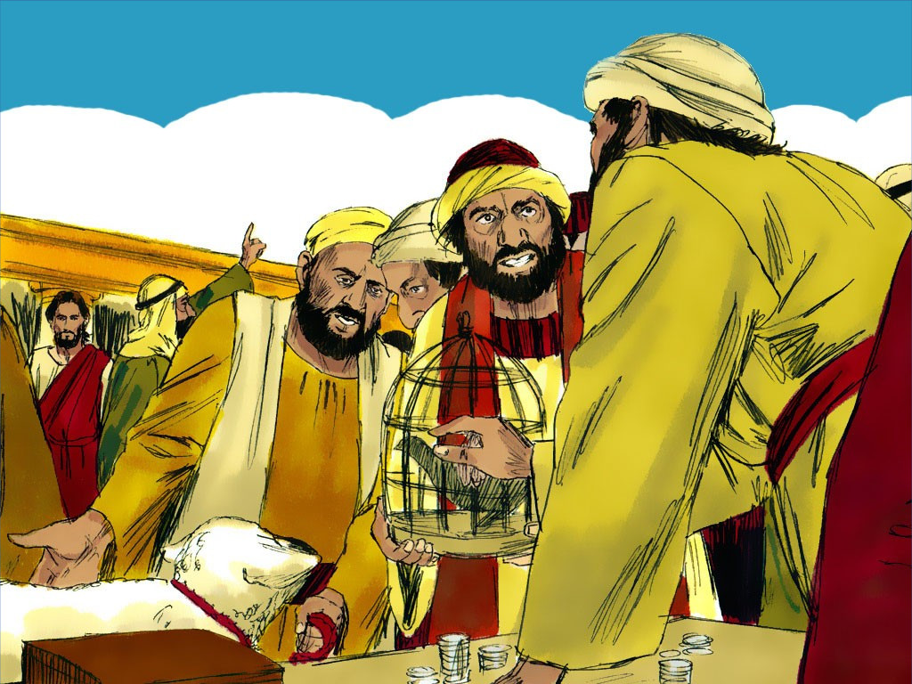

Slide 8
Romans 3:23
“For all have sinned,
and come short of
the glory of God.”

Slide 10
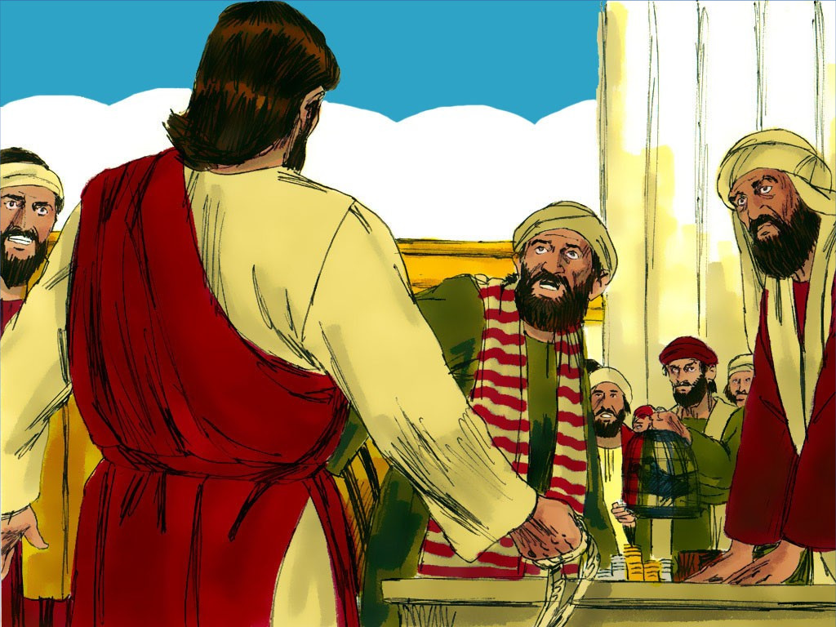

Slide 11
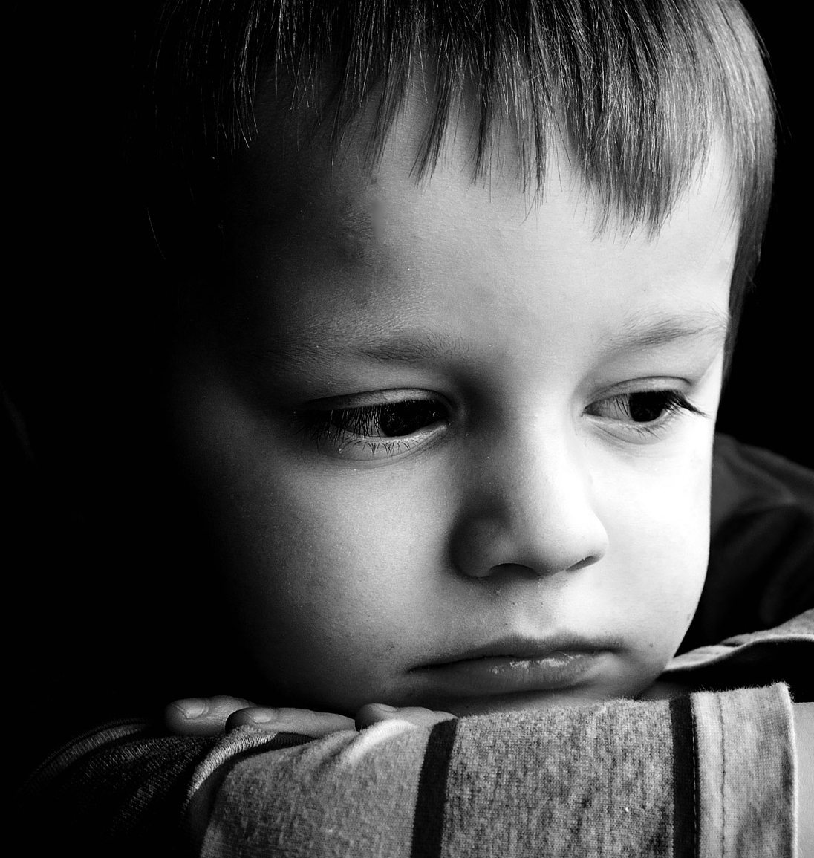
You should hate sin just like God does

Slide 14
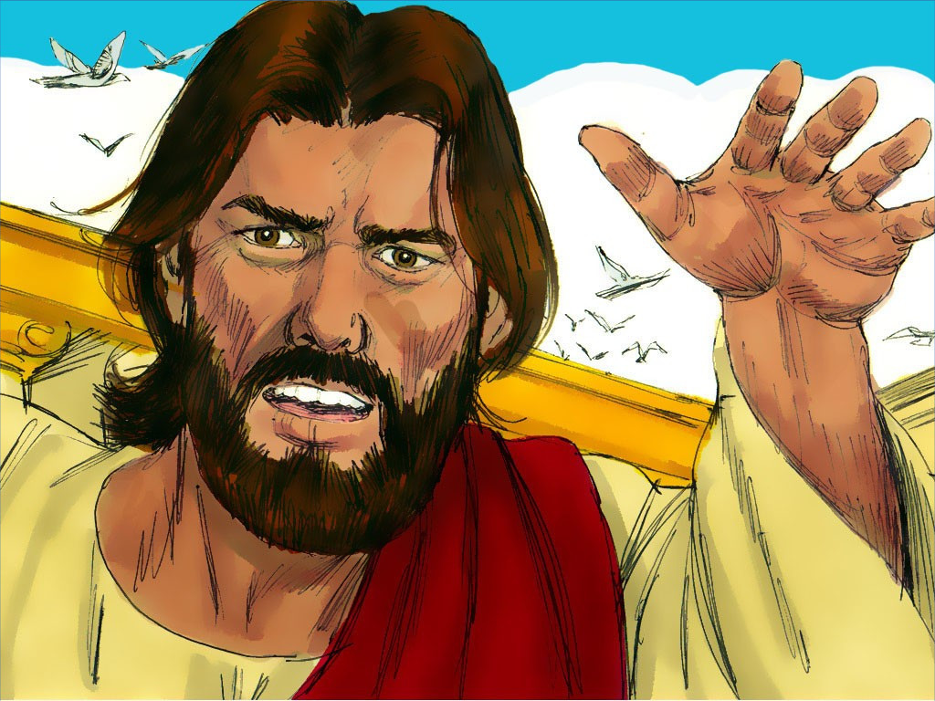

Slide 15
Take these things away!
Do not make My Father’s house a house of business!

Slide 16
You should hate sin just like God does

Slide 17
I John 2:15
“Love not the world, neither the things that are in the world.
If any man love the world, the love of the Father is not in him. ”

Slide 18
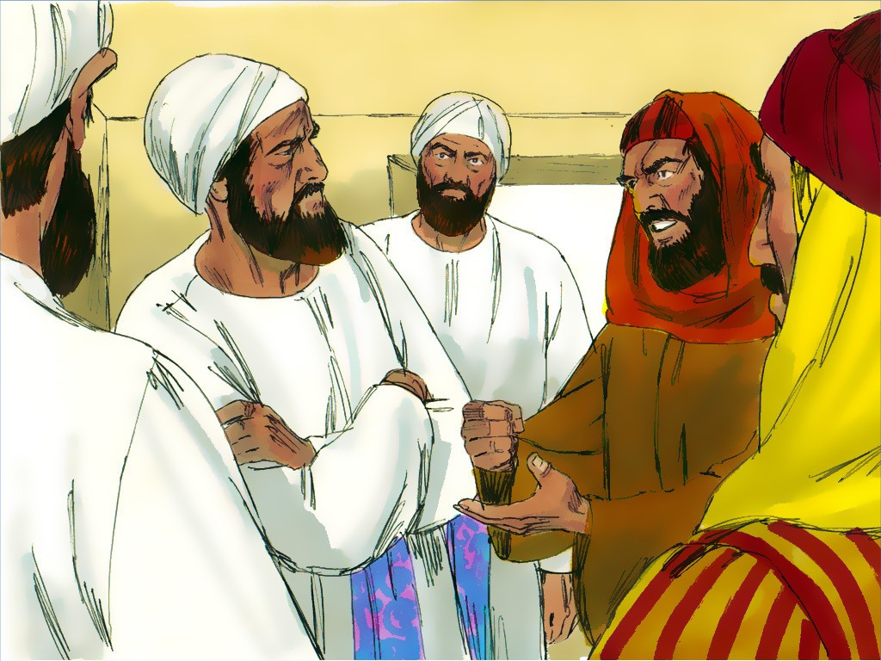

Slide 19
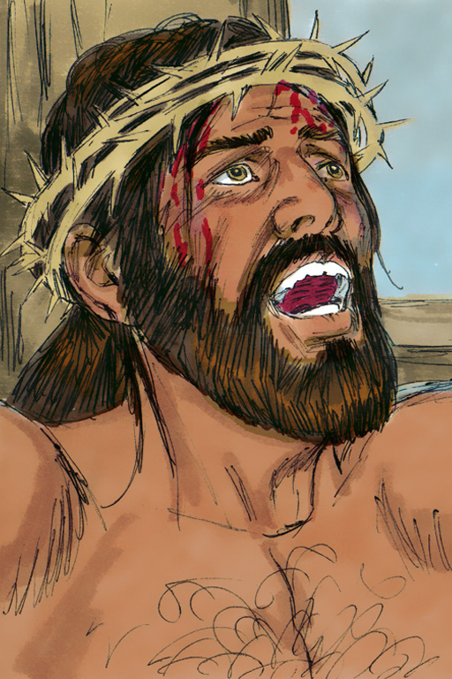
1 Peter 3:18
“…Christ… suffered for sins,
the Just for the unjust,
that He might bring us to God….”

Slide 21
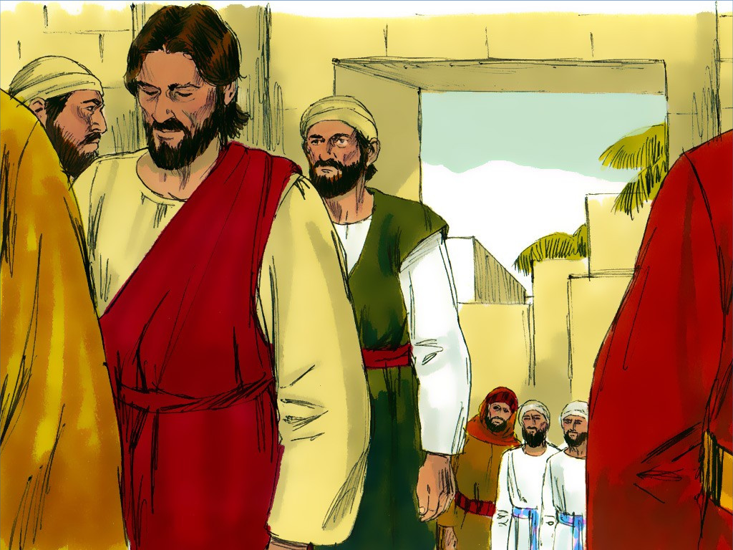

Slide 22
John 1:12
“…As many as receive Him (Jesus), to them gave He power to become the sons of God….”

Slide 23
You should hate sin just like God does

Slide 24
I John 2:15
“Love not the world, neither the things that are in the world. If any man love the world, the love of the Father is not in him. ”

Slide 28
I John 2:15
“Love not the world, neither the things that are in the world.
If any man love the world, the love of the Father is not in him. ”

