Slide 1
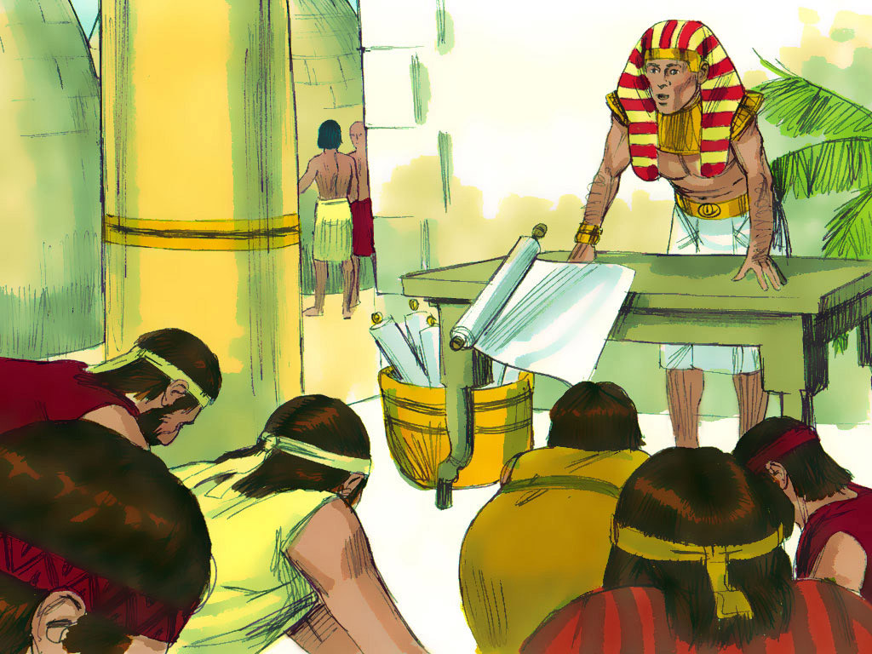
JOSEPH - 4

Slide 2
Notes:
Rule Chart

Slide 3
Notes:
When we get ready to pray…

Slide 5
Notes:
Prayer Pattern

Slide 7
Notes:
Prayer

Slide 8
Notes:
Song: Obey, Obey the Lord

Slide 9
Notes:
Memory Verse

Slide 11
Notes:
Song

Slide 13
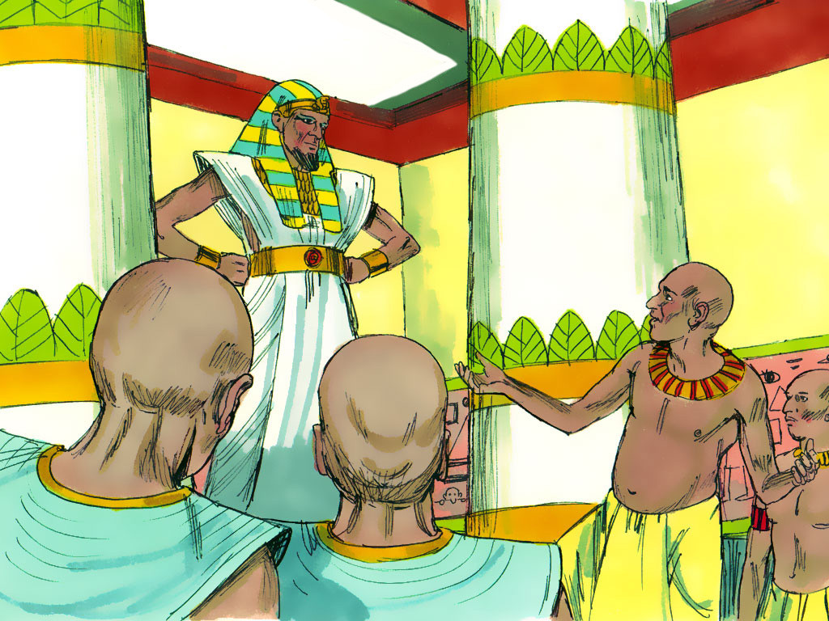
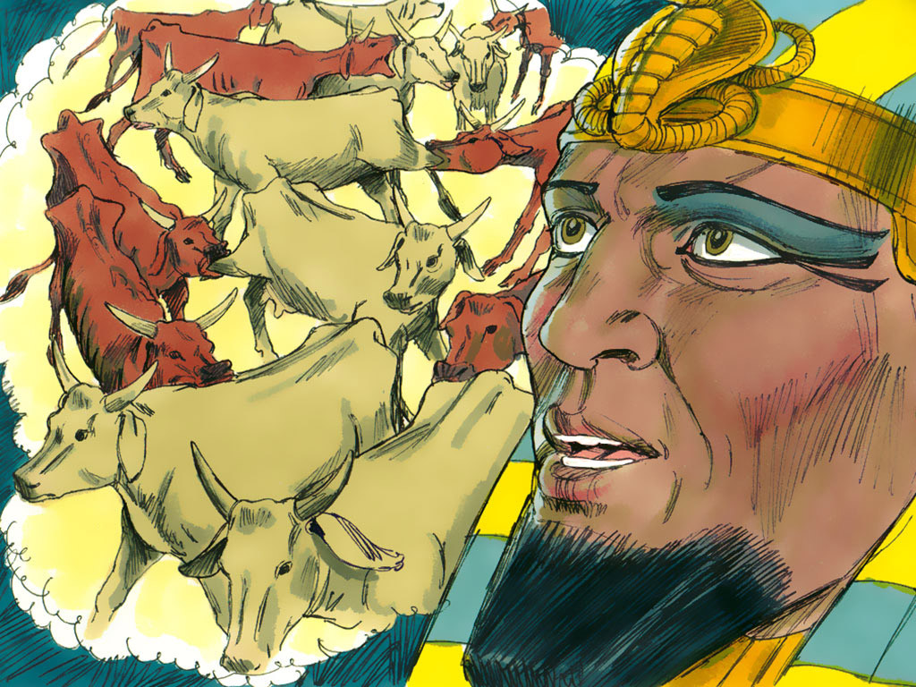
Notes:
4-3

Slide 14
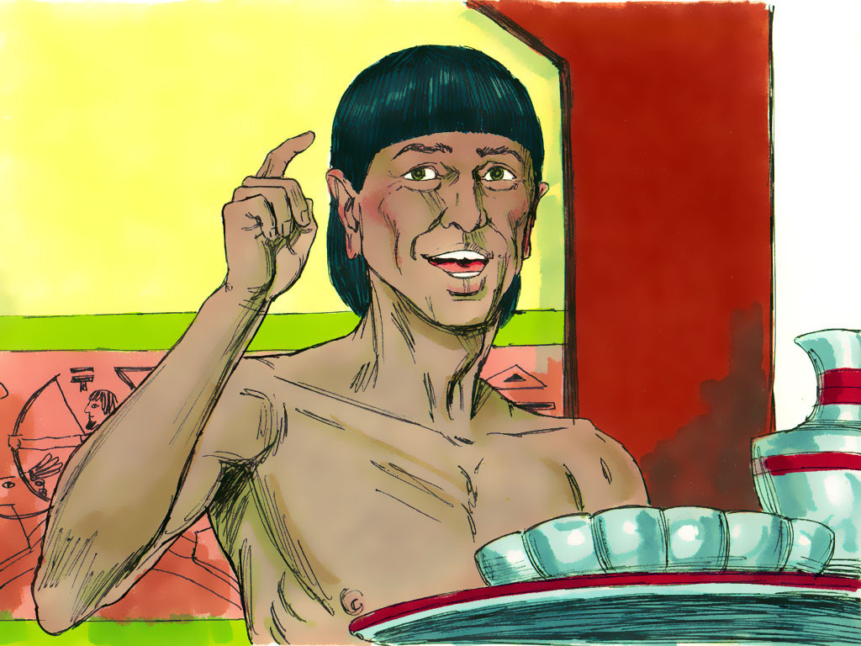
Notes:
4-4

Slide 15
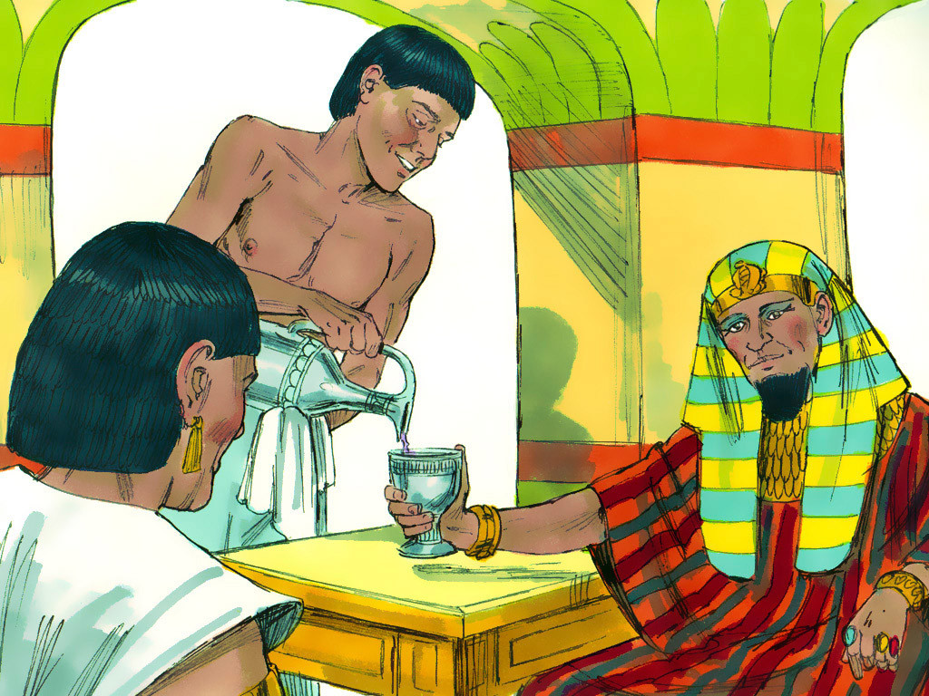
Notes:
4-1

Slide 17
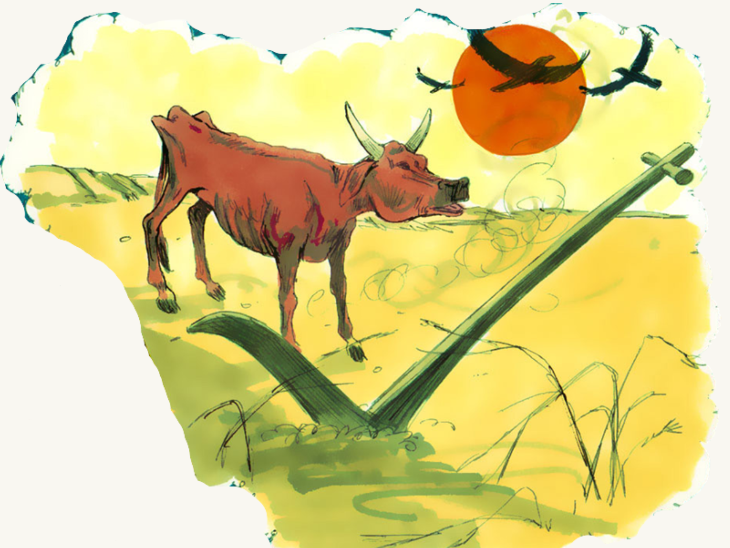
Notes:
4-1

Slide 19
Notes:
4-1

Slide 20
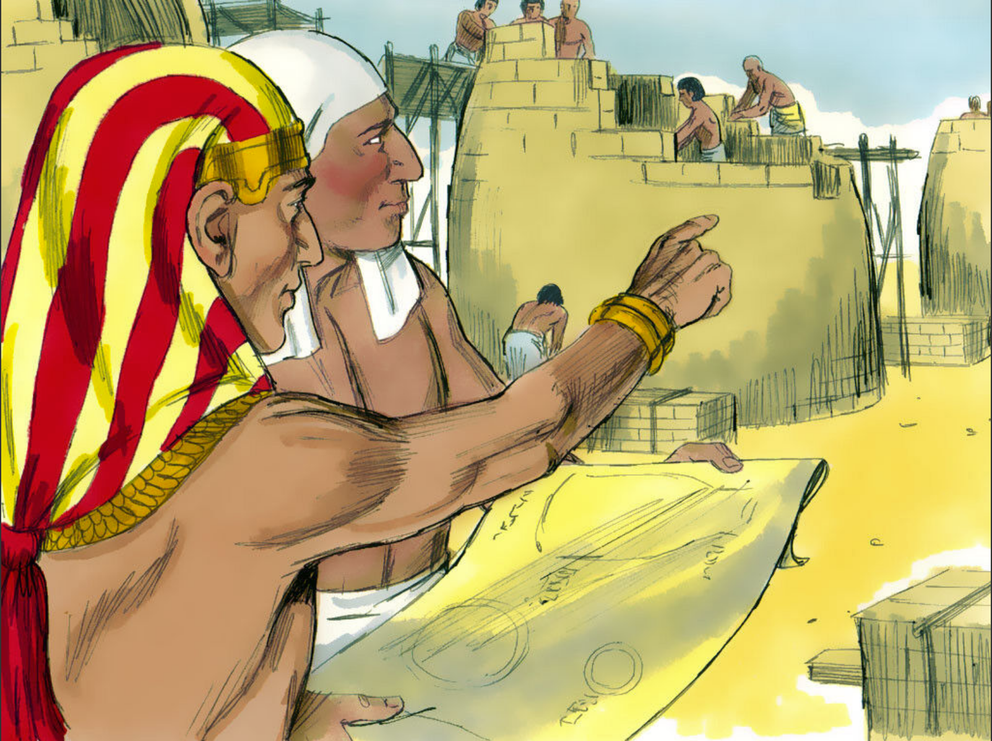
Notes:
4-6

Slide 21
Notes:
5-1, 5-2

Slide 23
Notes:
5-1, 5-2

Slide 31
THE GOSPEL “MEMORY GAME”
- Play like “Concentration.”

Slide 32
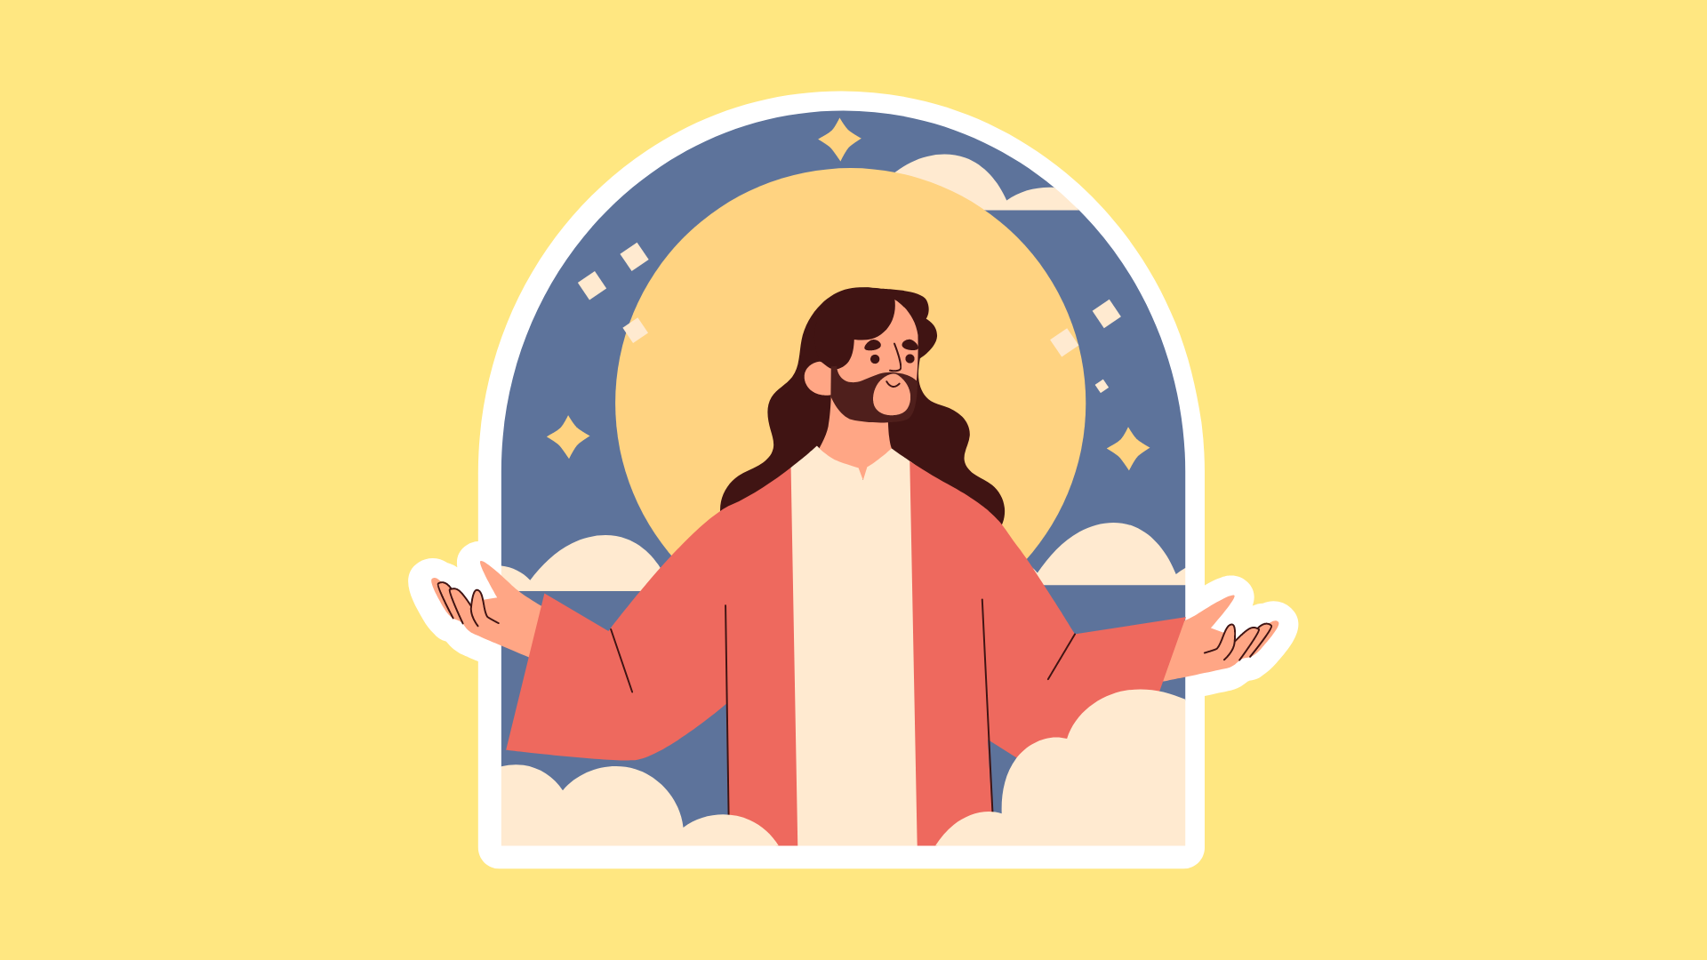
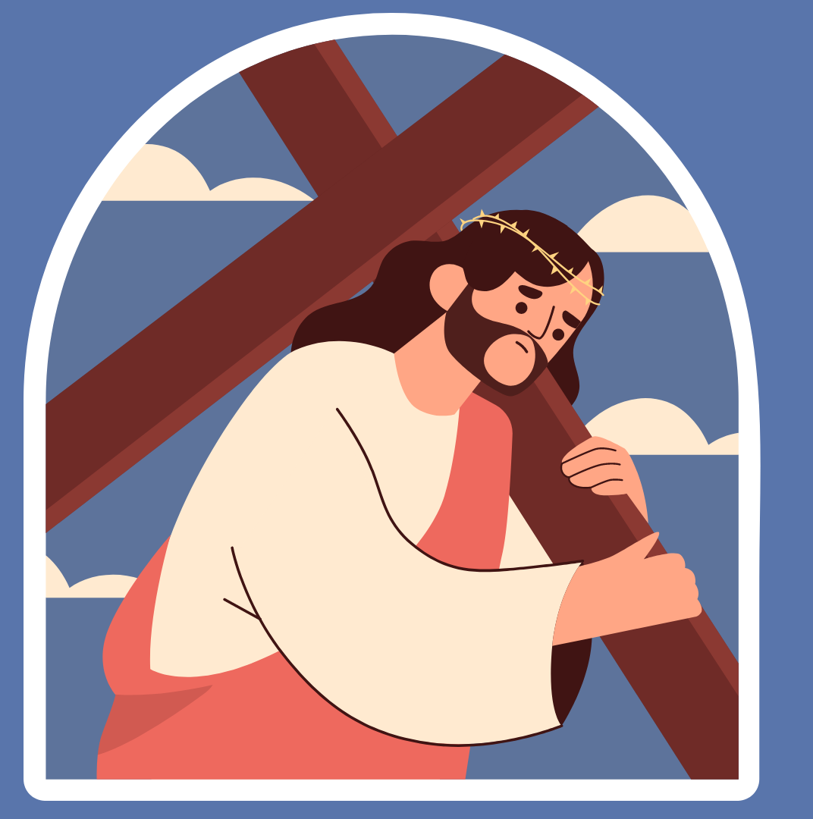
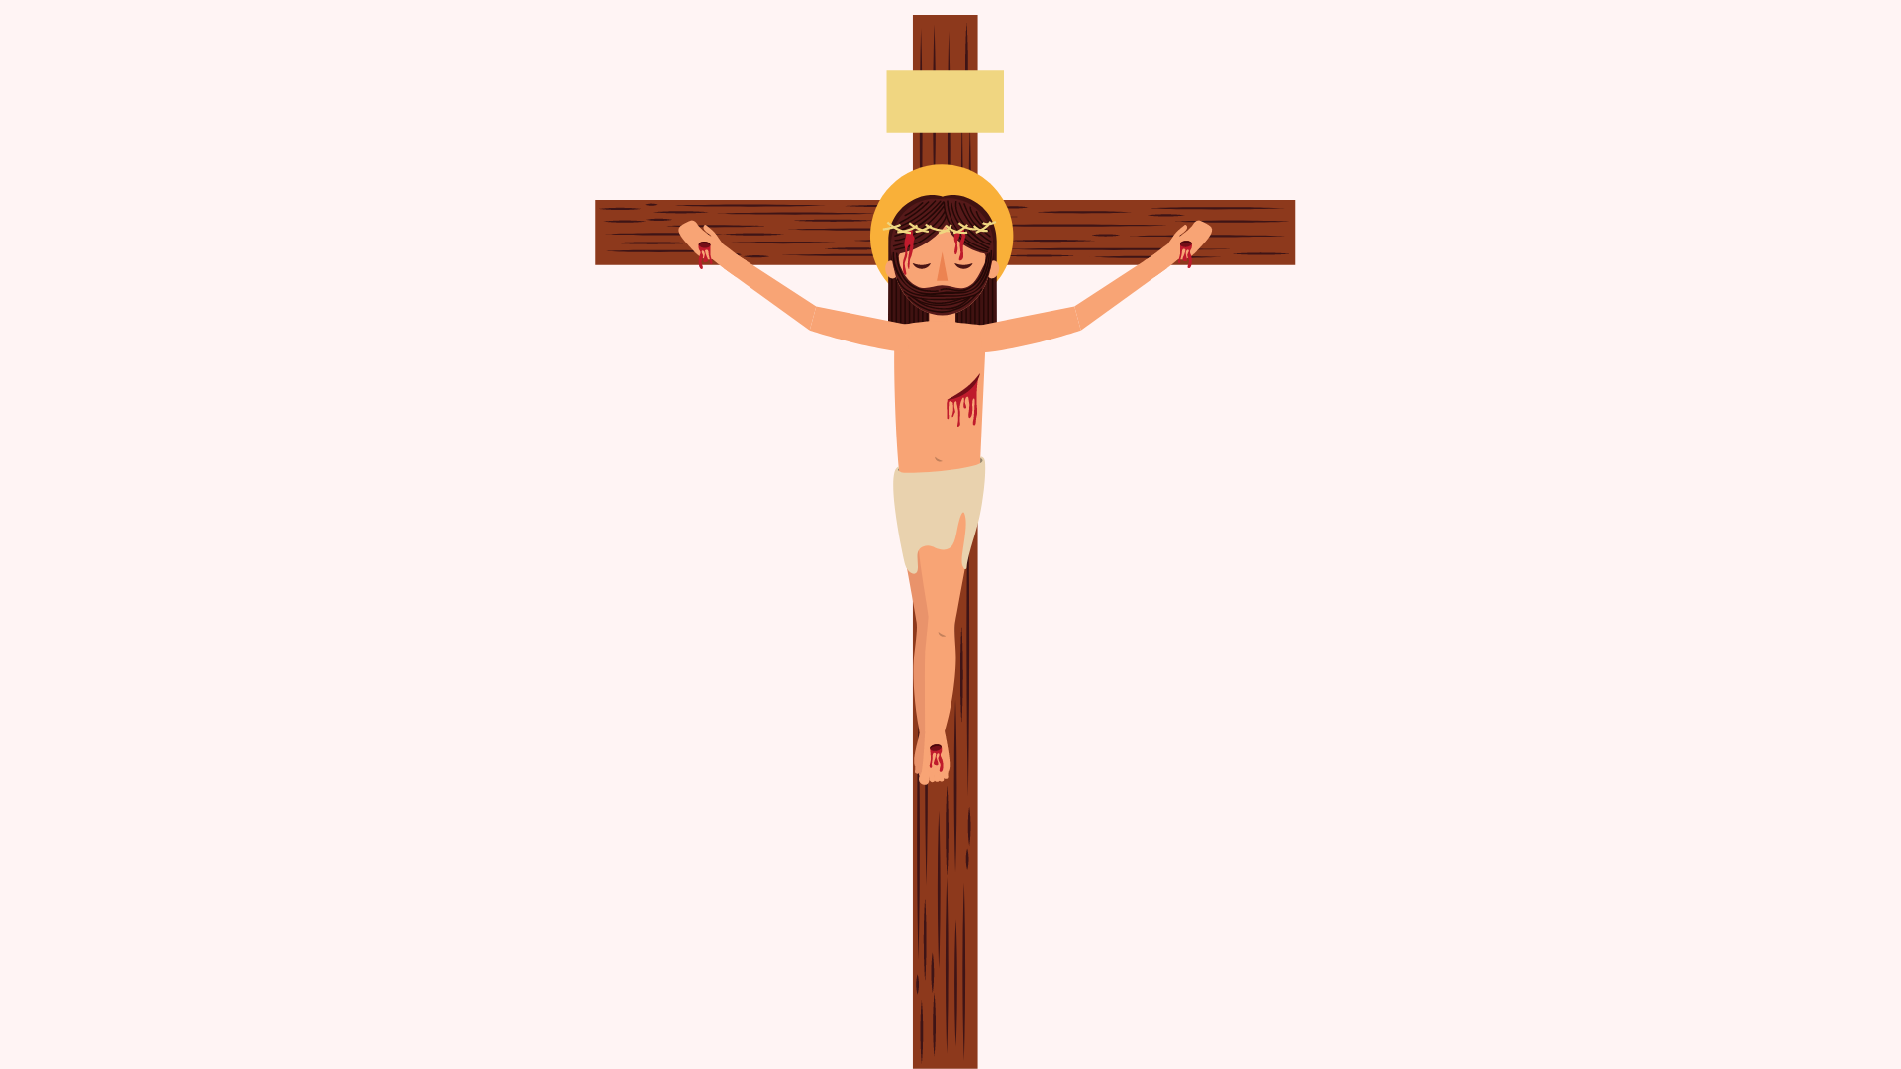
1
2
3
4
5
6
7
8
9
10
11
12

