Slide 1
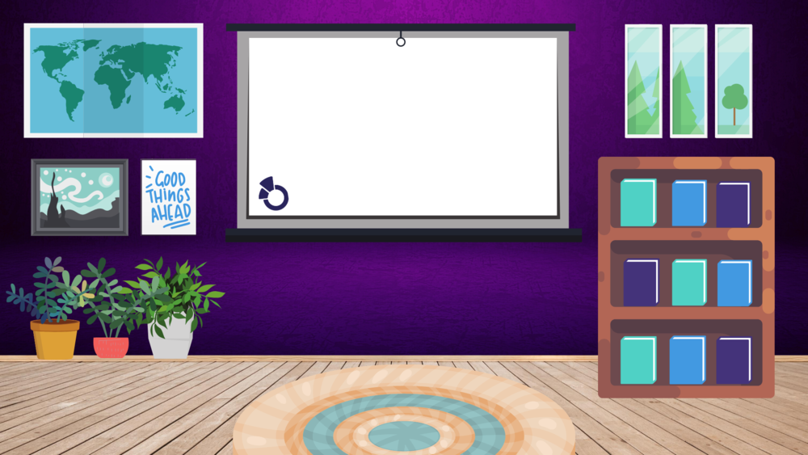
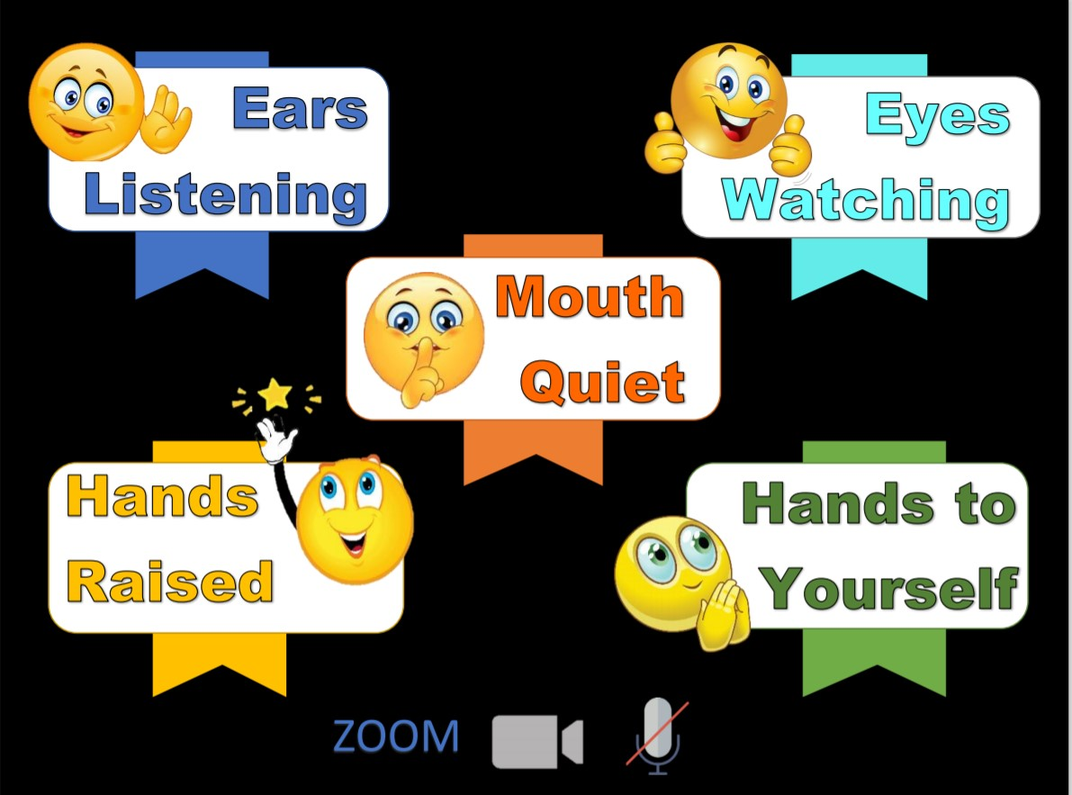
Main Truth
Memory Verse
Books of the Bible

Slide 4
Dear Heavenly Father,
Thank You for
______________
Please
_____________
In Jesus’ name,
Amen.

Slide 6
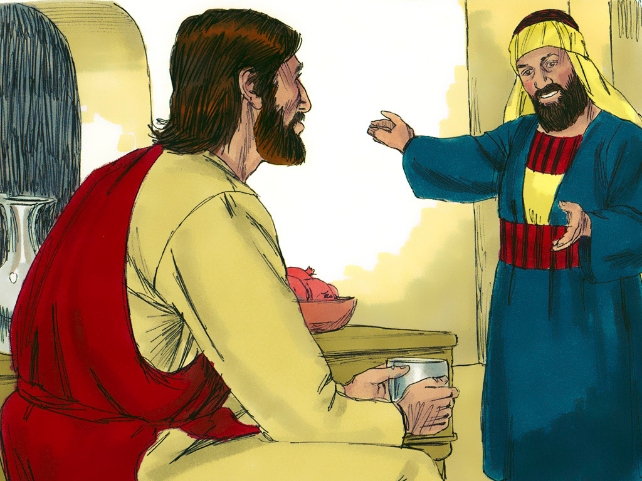
A New Life In Christ
Luke 19:1-10
www.freebibleimages.org

Slide 7
Your life should show
that you have been changed

Slide 8
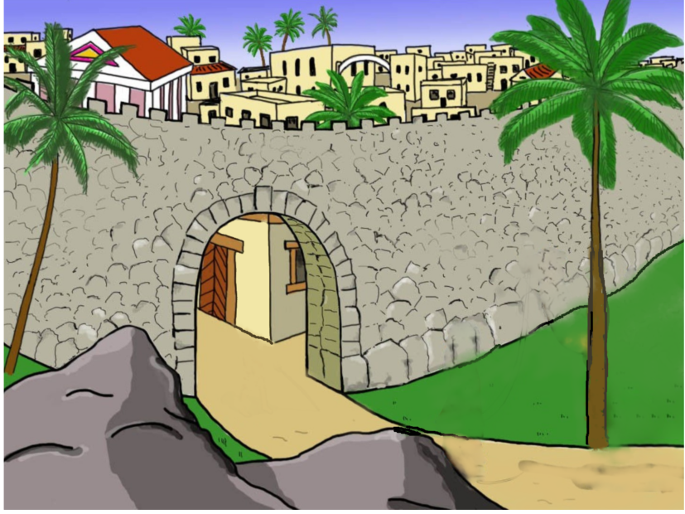

Slide 9
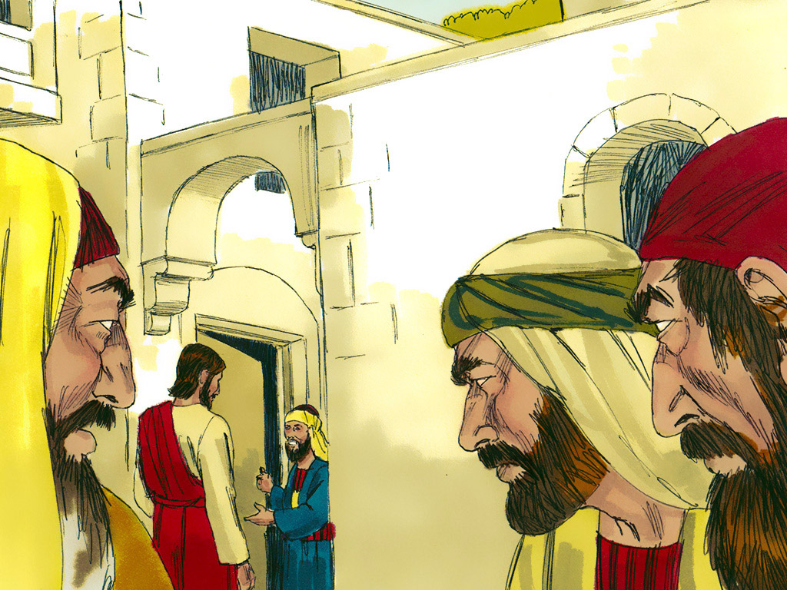
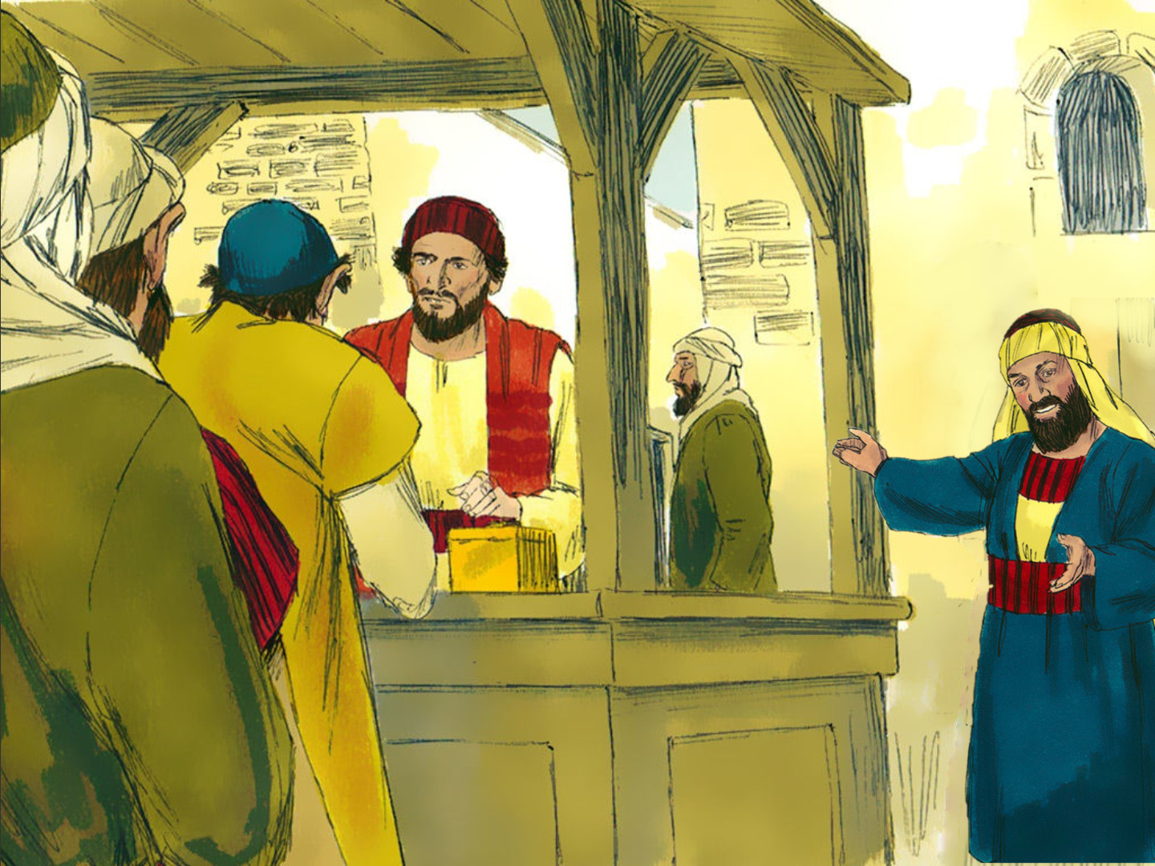

Slide 10
Romans 3:10-11
“…As it is written:
‘None is righteous,
No, not one:
No one understands;
No one seeks
for God….’”

Slide 12
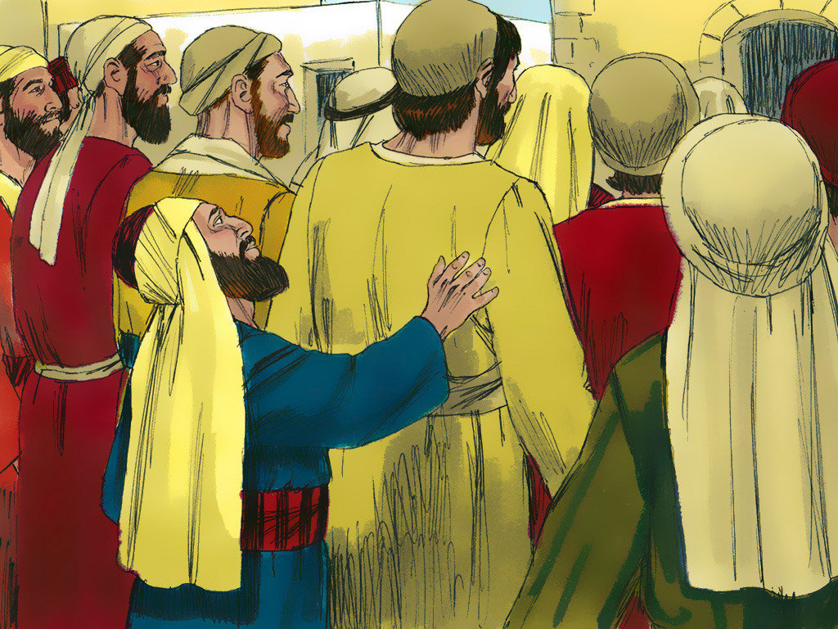

Slide 13
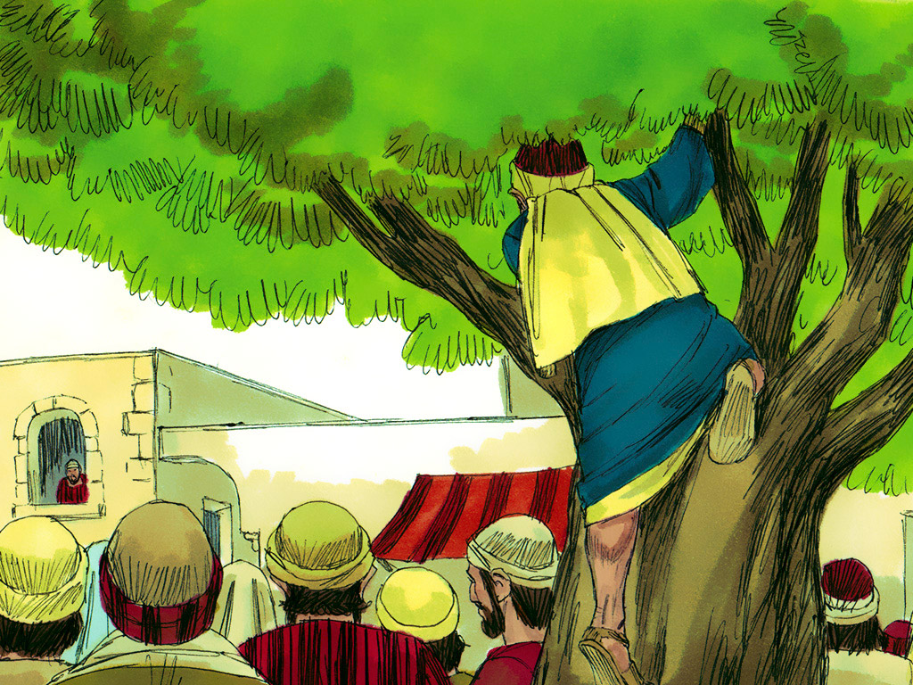

Slide 14
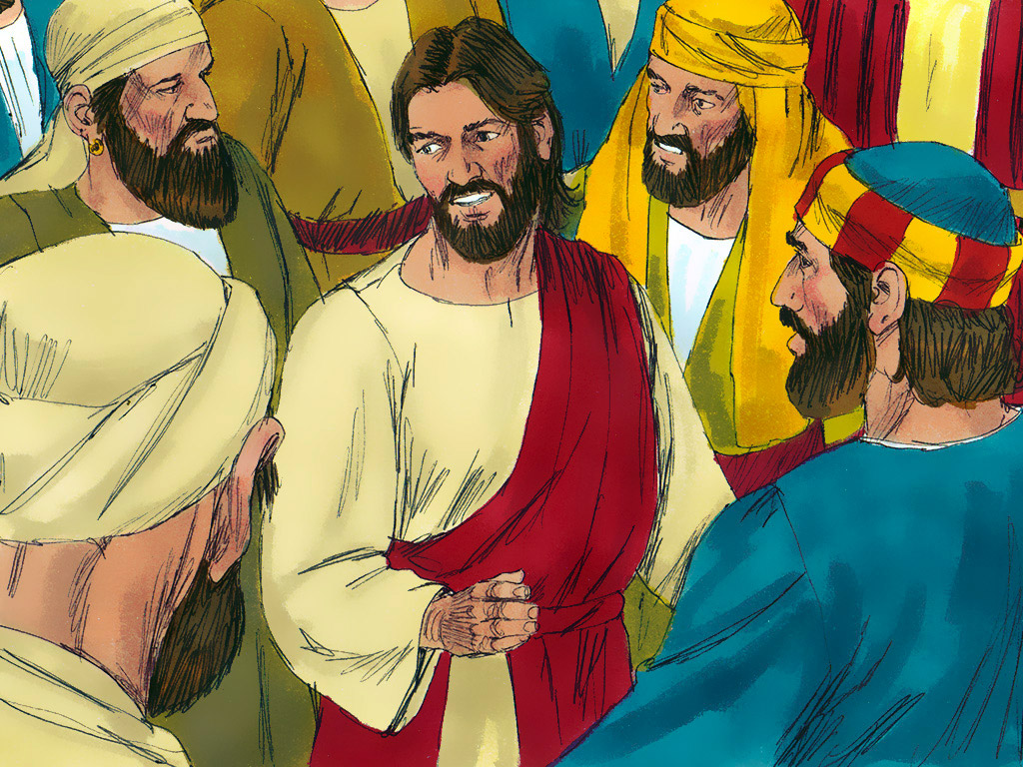

Slide 15
Romans 5:8
“But God commendeth His love toward us,
in that, while we were
yet sinners, Christ died for us.”
Notes:
For Younger Kids – Adapted from "London Bridge is Falling Down"
“I believe that He loves me, He loves me, He loves me.
I believe that He loves me, Jesus! Jesus!”

Slide 17
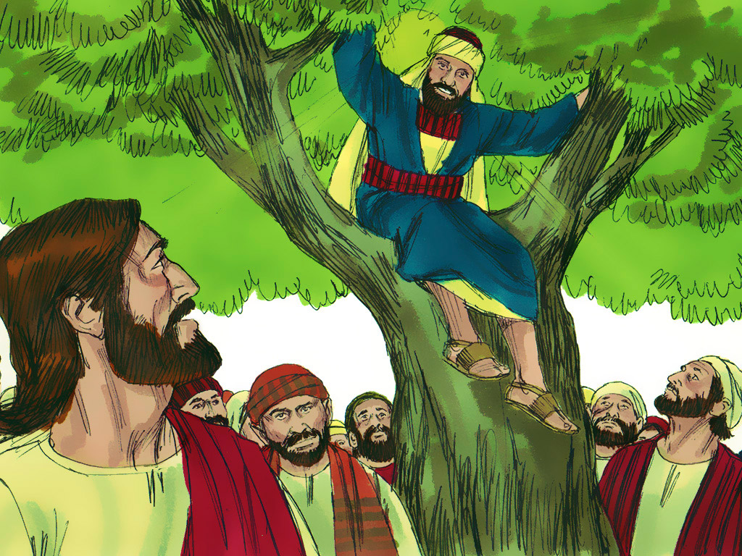
Zacchaeus, come down!

Slide 18
I am going to give half of everything I own to the poor…
If I have cheated anyone, I will pay back 4 times…

Slide 19
Your life should show
that you have been changed

Slide 20
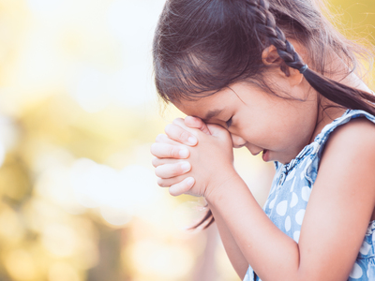
2 Cor. 5:17
“Therefore if any man be in Christ,
he is a new creature;
old things are passed away;
behold, all things are become new.”

Slide 21
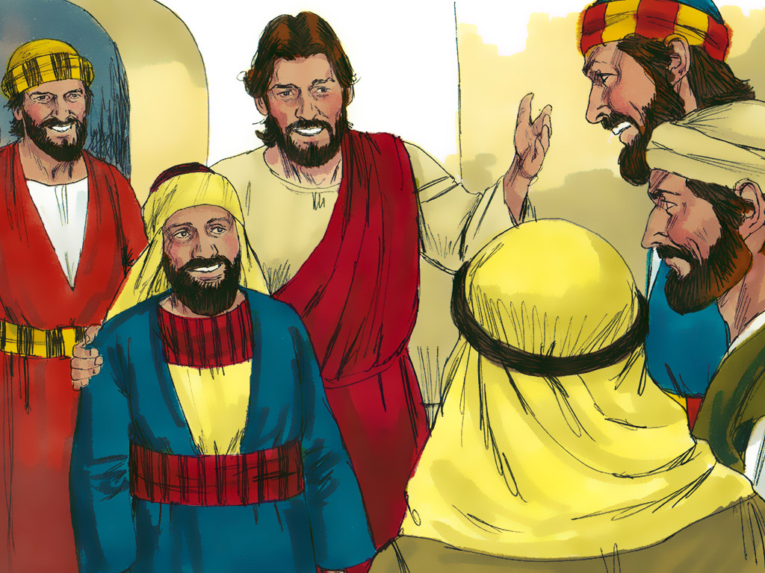
Today, salvation has come
to this house,
For the Son of Man (JESUS) came to seek and
to save the lost.

Slide 22
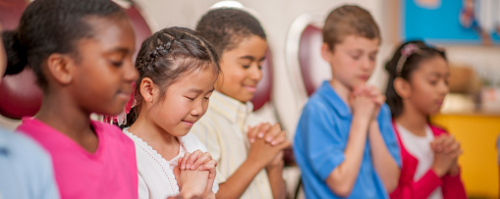
John 1:12
“But as many as received Him,
to them gave He power
to become the sons of God,
even to them that believe on His Name.”

Slide 23
Your life should show
that you have been changed

Slide 24
2 Cor. 5:17
“Therefore if any man be in Christ,
he is a new creature;
old things are passed away;
behold, all things are become new.”

Slide 27
2 Cor. 5:17
“Therefore if any man be in Christ,
he is a new creature;
old things are passed away;
behold, all things are become new.”
Notes:
“Missing Piece” – for repetition, one word will appear each time you click next.

Slide 28
2 Cor. 5:17
“Therefore if any man be in Christ,
he is a new creature;
old things are passed away;
behold, all things are become new.”

Slide 29
Learning About the bible

Slide 30
Books of the New Testament
THE GOSPELS
LETTERS
Matthew
Romans
1 Thessalonians
Mark
1 Corinthians
2 Thessalonians
Luke
2 Corinthians
Galatians
John
Ephesians
HISTORY
Philippians
Acts
Colossians
Notes:
) (Review the nine names of Paul’s Letters that were written to the churches and the names of the cities or area where the churches were located.) How many letters did Paul write? (14.)
Nine of these letters were written to churches. You can say the names of these letters as I place the name on the board. (Place Romans, 1 Corinthians, 2 Corinthians, Galatians, Ephesians, Philippians, Colossians, 1 Thessalonians, and 2 Thessalonians

Slide 31
Books of the New Testament
THE GOSPELS
LETTERS
Matthew
Romans
1 Thessalonians
Mark
1 Corinthians
2 Thessalonians
Luke
2 Corinthians
1 Timothy
Galatians
2 Timothy
John
Ephesians
Titus
HISTORY
Philippians
Acts
Colossians
Notes:
Paul also wrote letters to individual people. Three of these letters are called First and Second Timothy and Titus. (Place 1 Timothy, 2 Timothy, and Titus. Can you guess the names of the men to whom Paul was writing these letters? Yes, Timothy and Titus. Let’s review the names of the 12 letters that Paul wrote. Now we can review all the names of the books of the New Testament that we have learned.

Slide 32
Notes:
“Rock, Paper, & Scissors”
If a child answers a question correctly, he may play “Rock, Paper, Scissors” against the GNC friends on this slide.
Once he chooses either rock, paper, or scissors you may click the screen to reveal one of the friends and their choice.
Rock (closed fist), scissors (fist with two fingers extended like scissors blades), or paper (hand opened flat, palm down) .
The winner of the round is determined as follows: rock beats scissors, scissors beats paper, and paper beats rock.
Because this is a well-known game, the children are already enthusiastic about playing it. Have fun!

