Slide 2
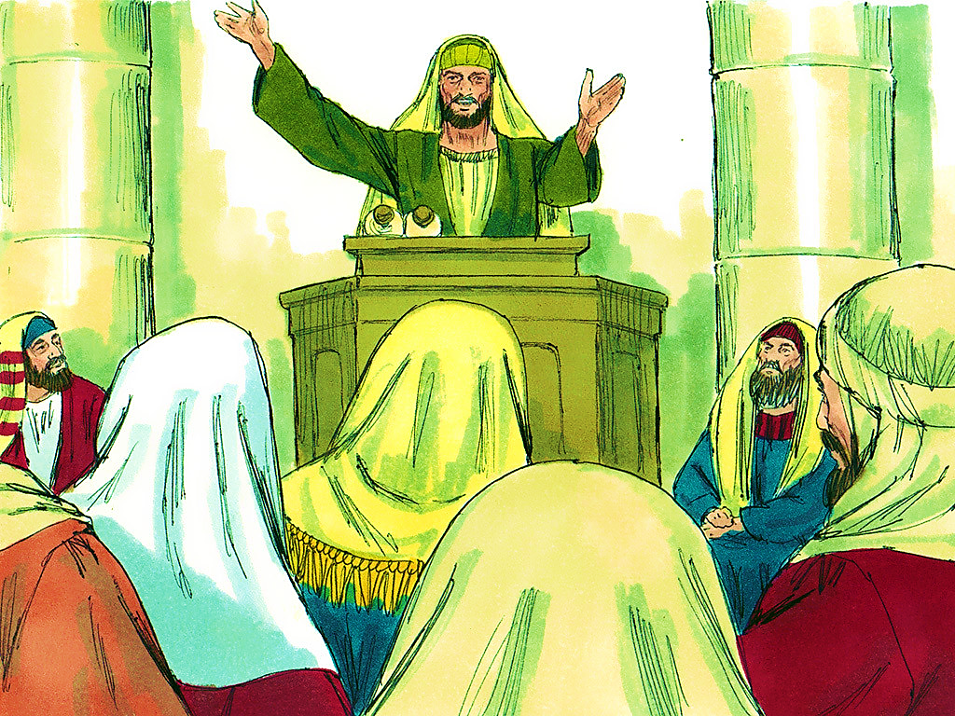
5-1
Notes:
5-1

Slide 4
5-1
Notes:
5-1

Slide 5
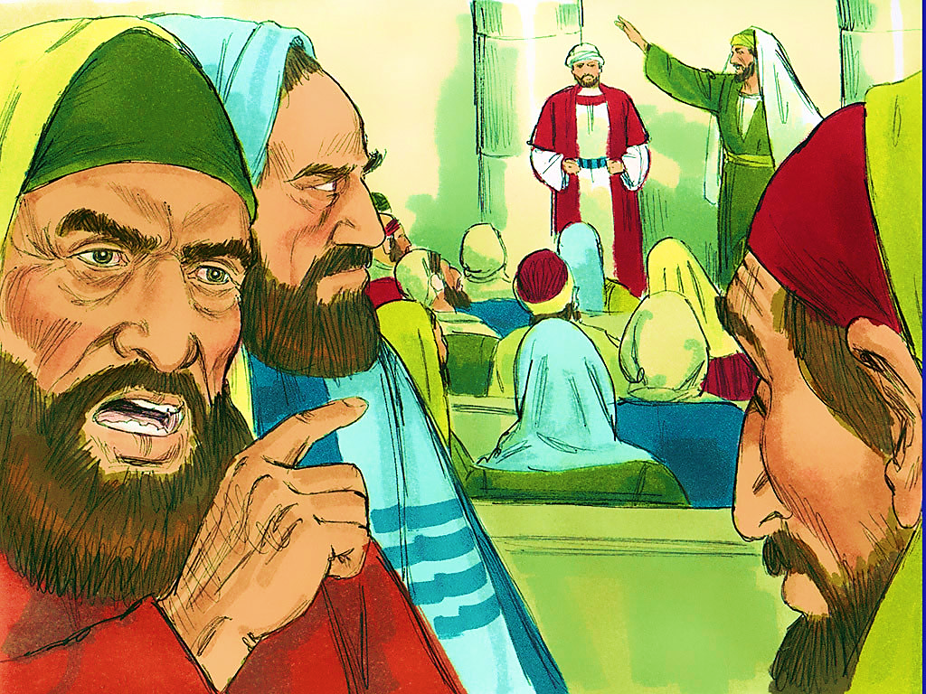
5-2
Notes:
5-2

Slide 6
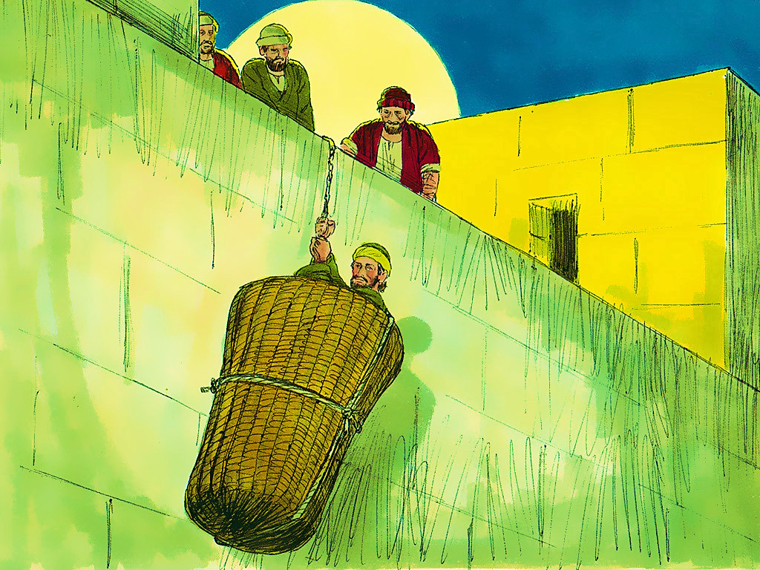
5-3
Notes:
5-3

Slide 7
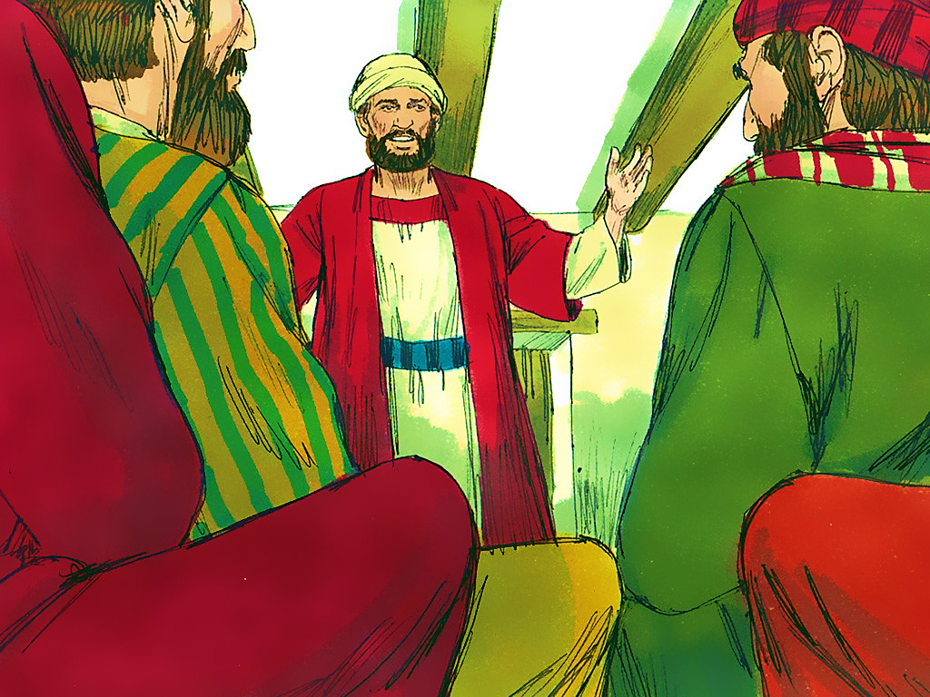
5-4
Notes:
5-4

Slide 9
5-4
Notes:
5-4

Slide 10
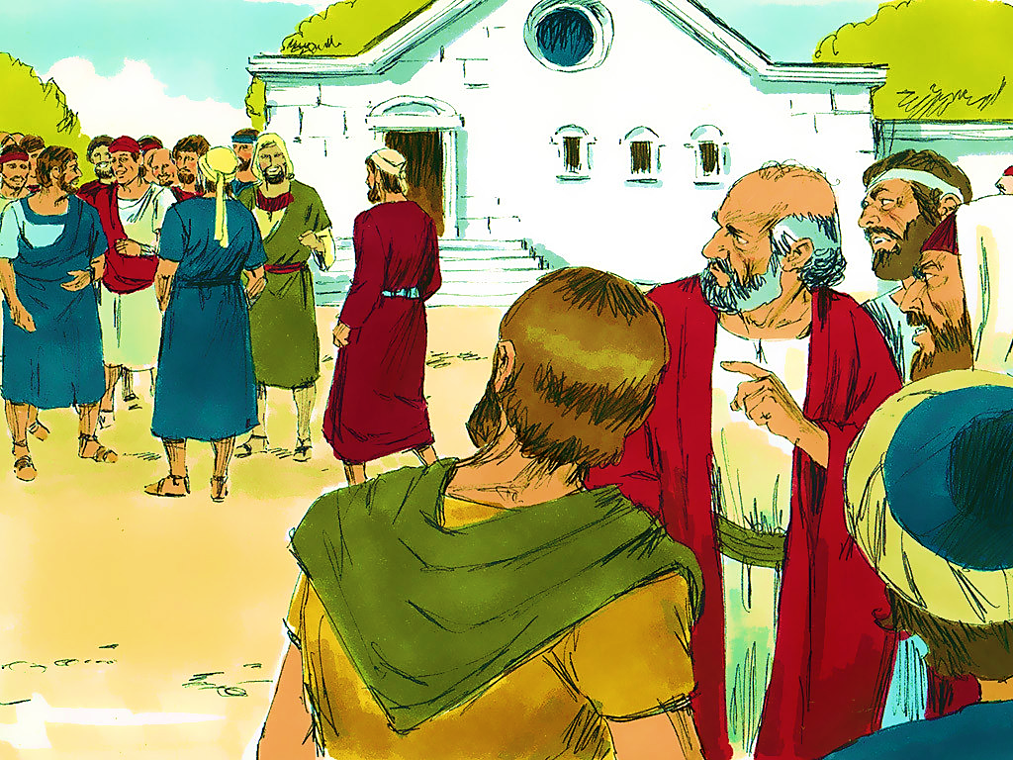
5-5
Notes:
5-5

Slide 11
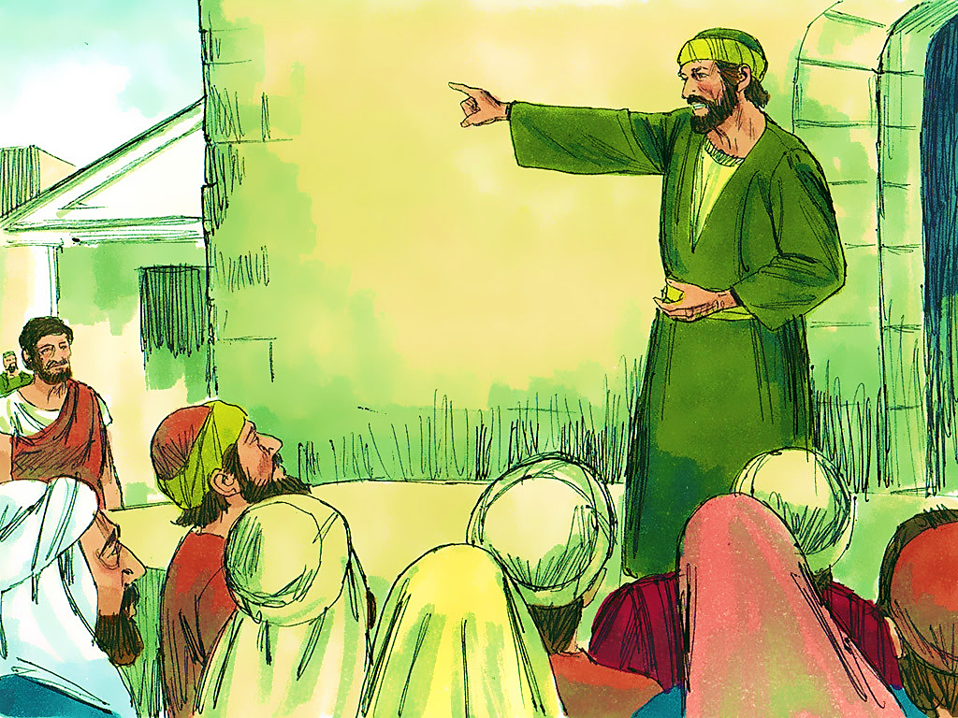
5-6
Notes:
5-6

Slide 13
Notes:
End Lesson

