Slide 1
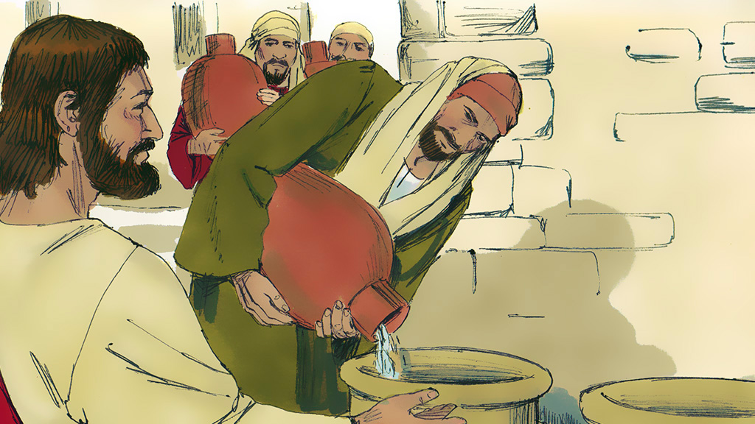
The First Miracle
John 2:1-11

Slide 5
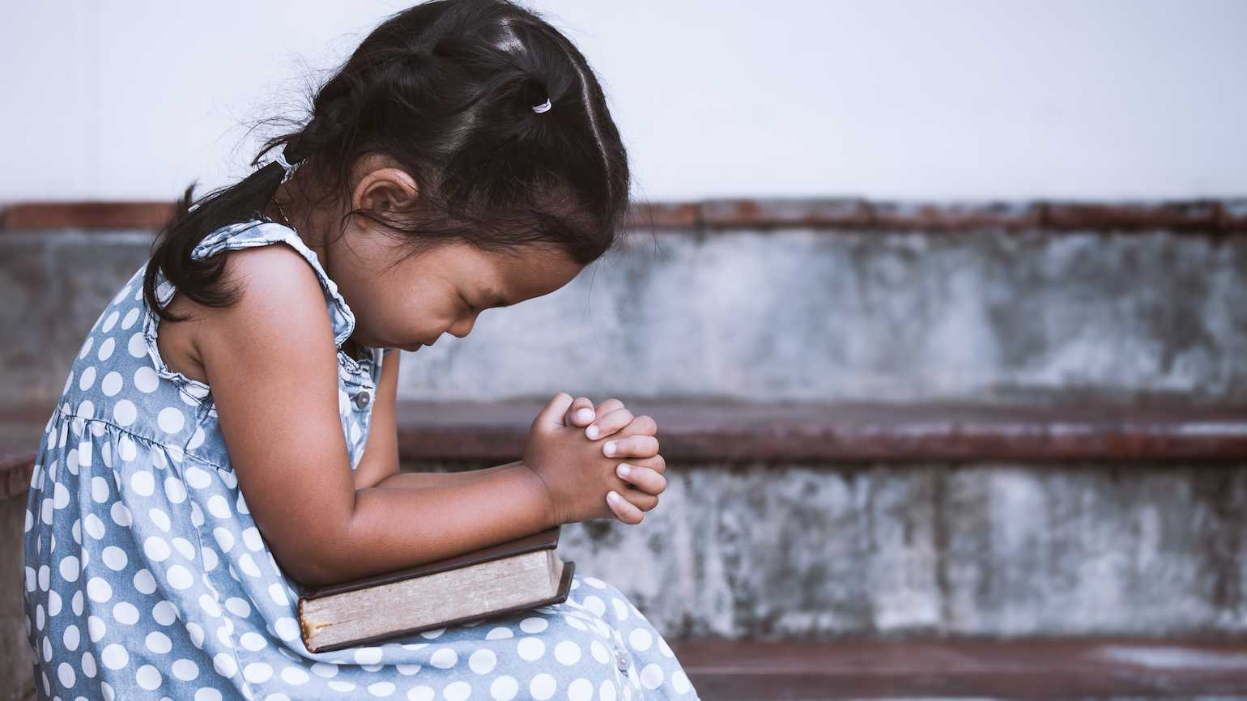
Dear Heavenly Father,
Thank You for...
___________________
Please…
___________________
In Jesus' name,
Amen

Slide 6
The First Miracle
John 2:1-11

Slide 7
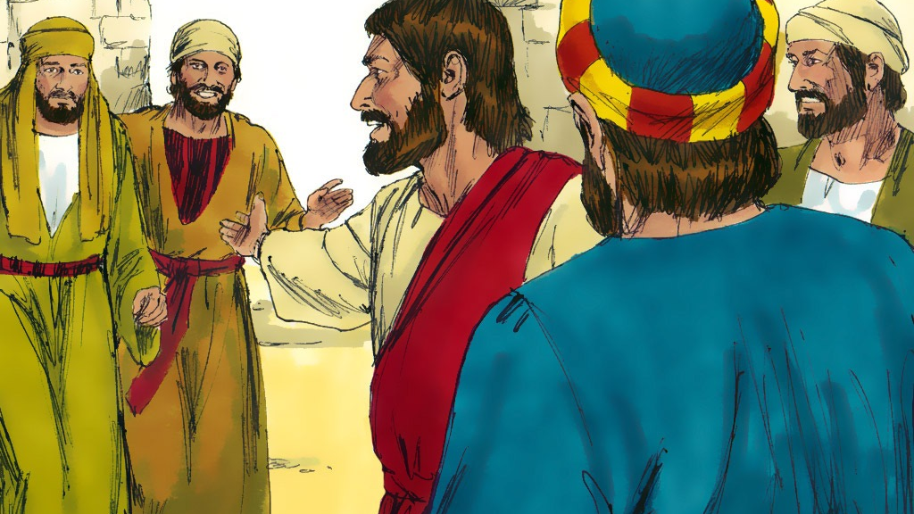

Slide 8
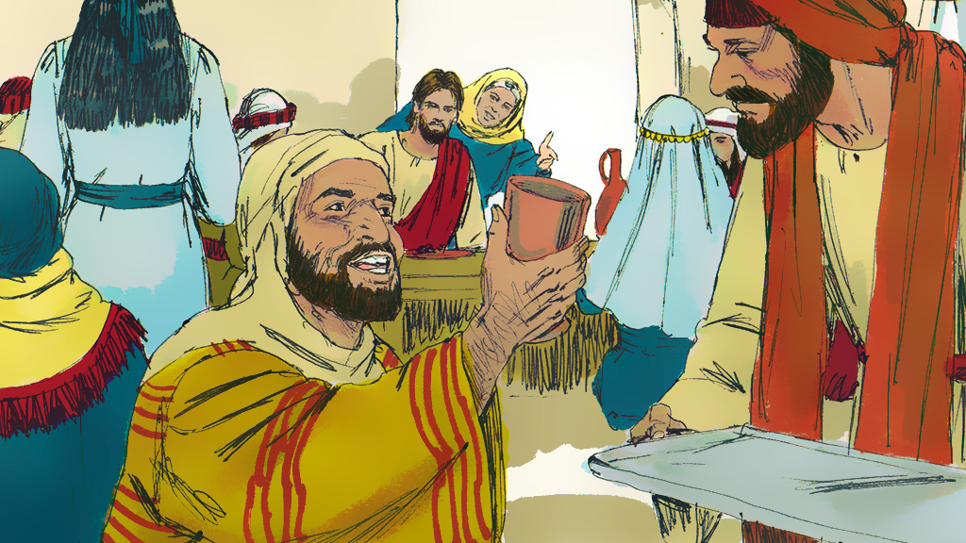

Slide 9
Romans 6:23
“For the wages
of sin
is death….”

Slide 11
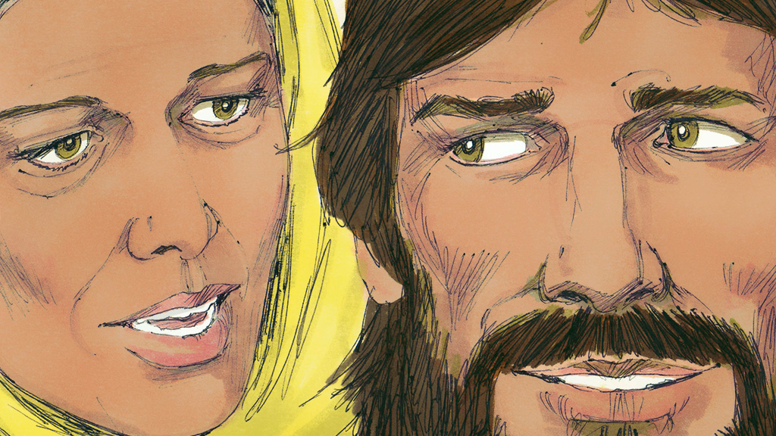

Slide 12
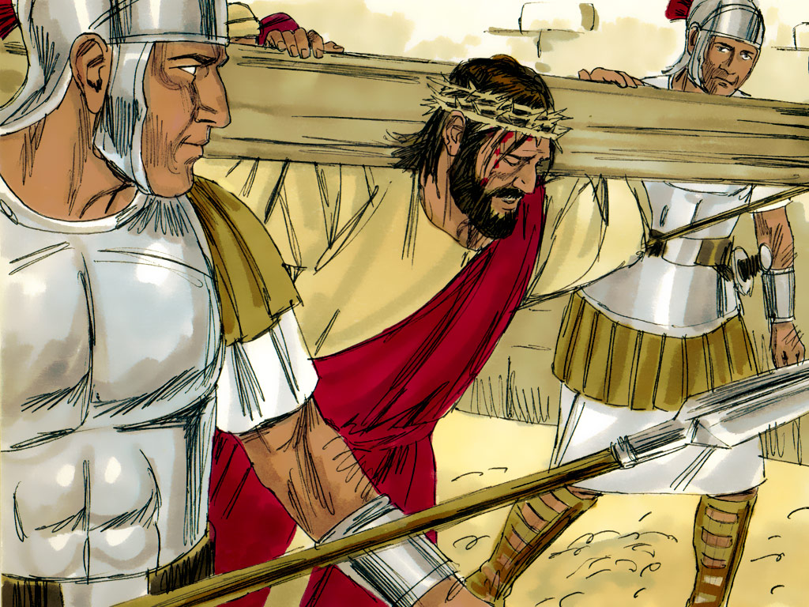
1 Peter 2:24
“Who His
own self
bore our sins
in His own body
on the tree…”

Slide 16
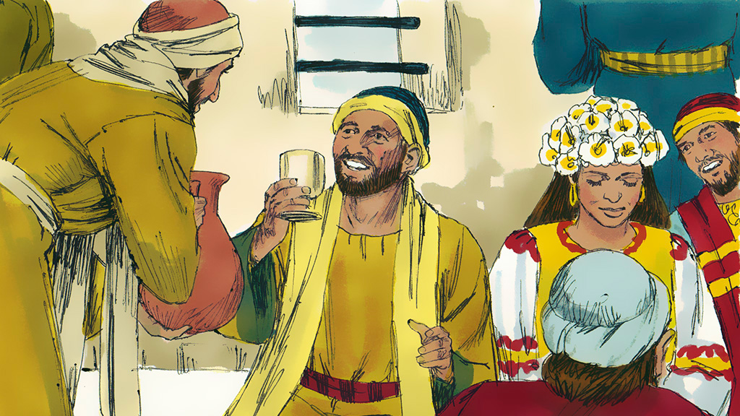

Slide 18
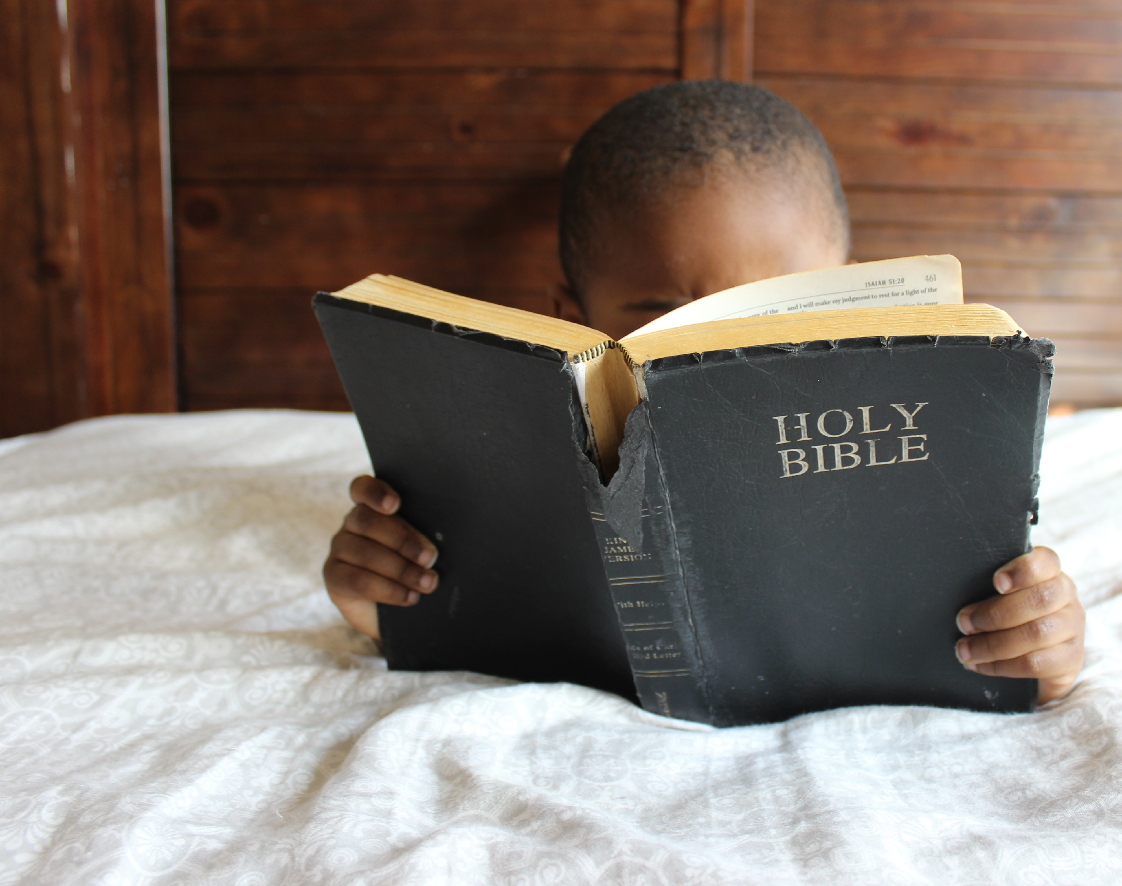
John 2:5
“Whatsoever He saith
unto you,
do it.”

Slide 20
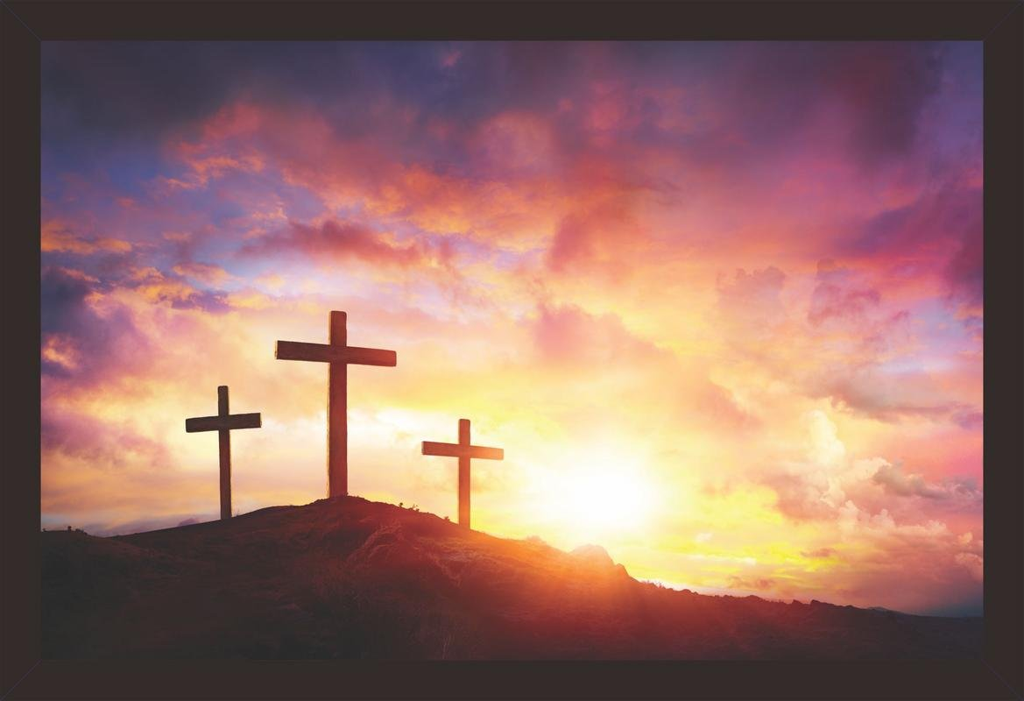
Acts 16:31
“Believe on
the Lord Jesus Christ
and thou shalt
be saved….”

Slide 22
John 2:5
“Whatsoever He saith
unto you,
do it.”

Slide 25
John 2:5
“Whatsoever He saith
unto you,
do it.”

Slide 26
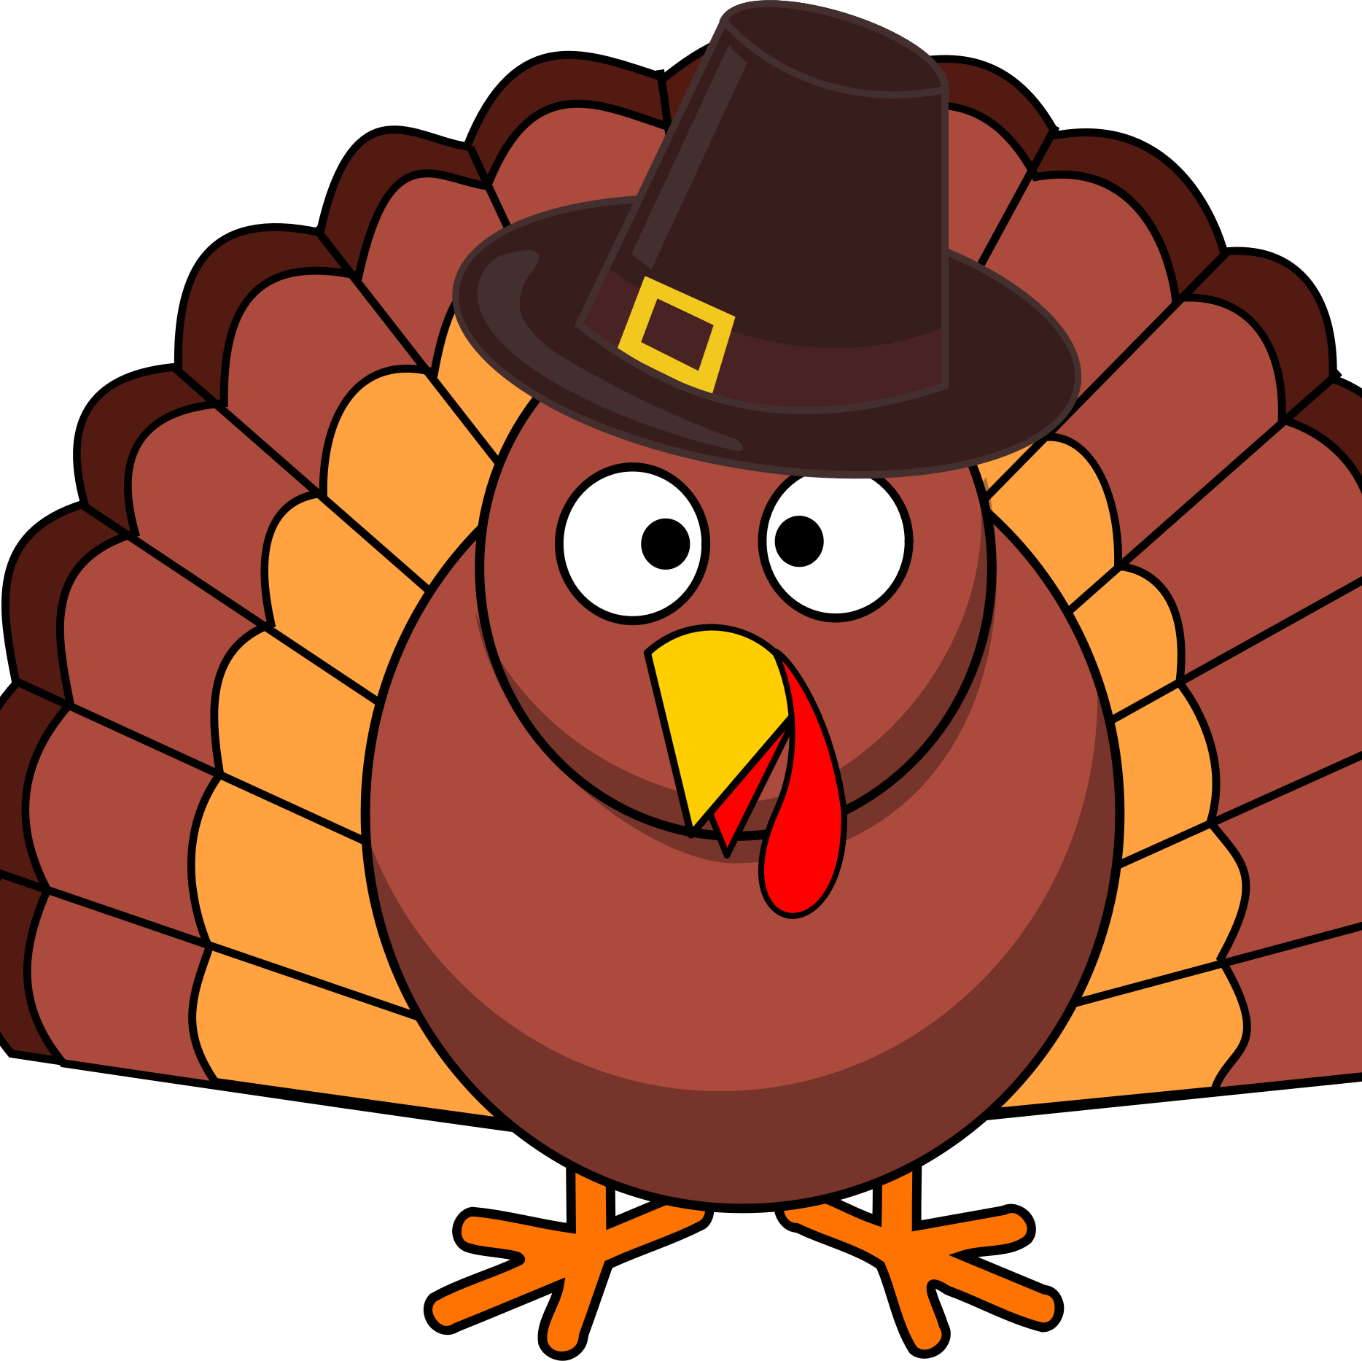
Arf,
Arf
Gooble,
Gooble
Oink,
Oink
Cluck,
Cluck
Moo,
Moo
Gooble,
Gooble
Tweet,
Tweet
Mew,
Mew
Baa,
Baa
Gooble,
Gooble

