Slide 2
Notes:
Rule Chart

Slide 4
Notes:
Song: “We Wish You a Merry Christmas!”

Slide 5
Notes:
Song: "Jingle Bells"

Slide 7
Page - 1

Slide 8
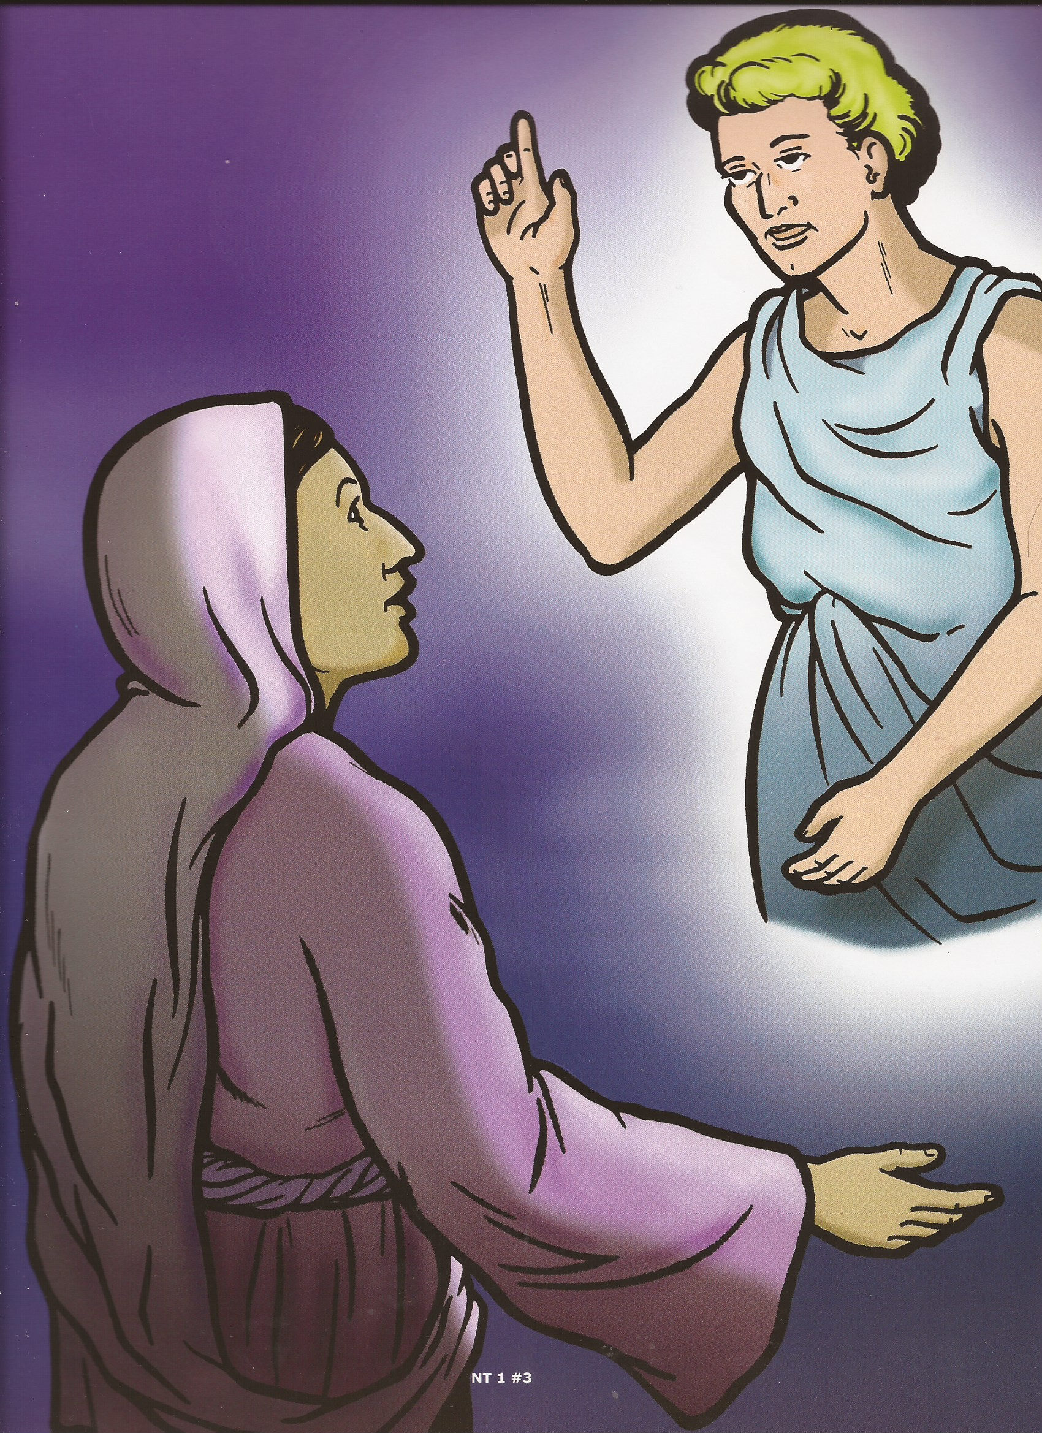
FC #1

Slide 9
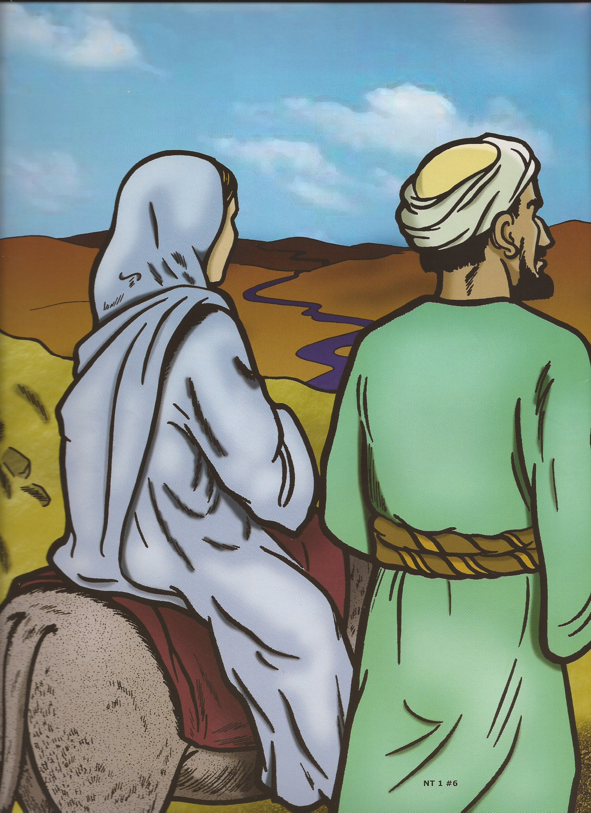
FC #2

Slide 10
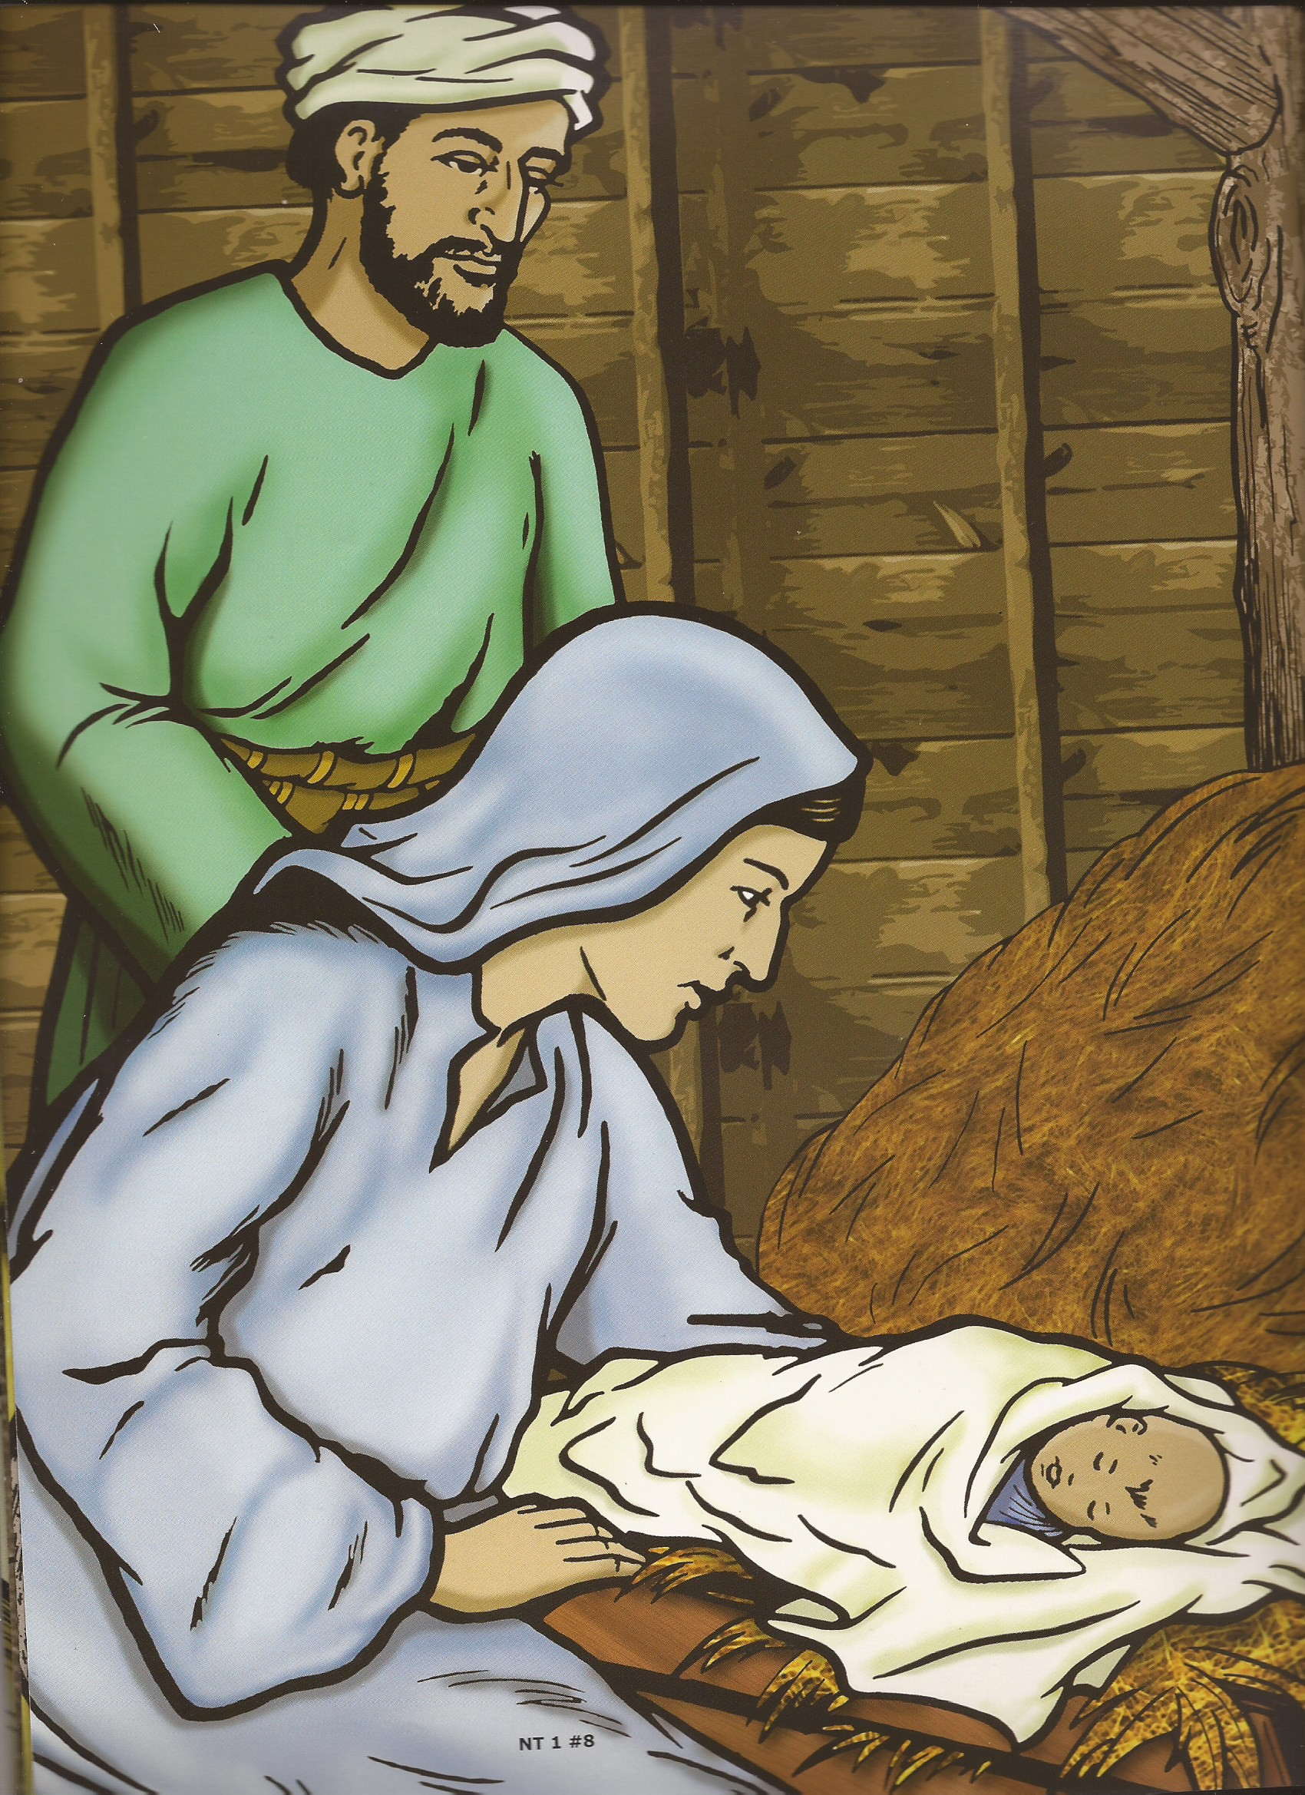
FC #3

Slide 11
SIN

Slide 12
“…The Scripture hath concluded all under sin….”
Galatians 3:22

Slide 13
“…Christ died for our sins…
He was buried, and…He rose again the third day….”
1 Corinthians 15:3-4

Slide 14
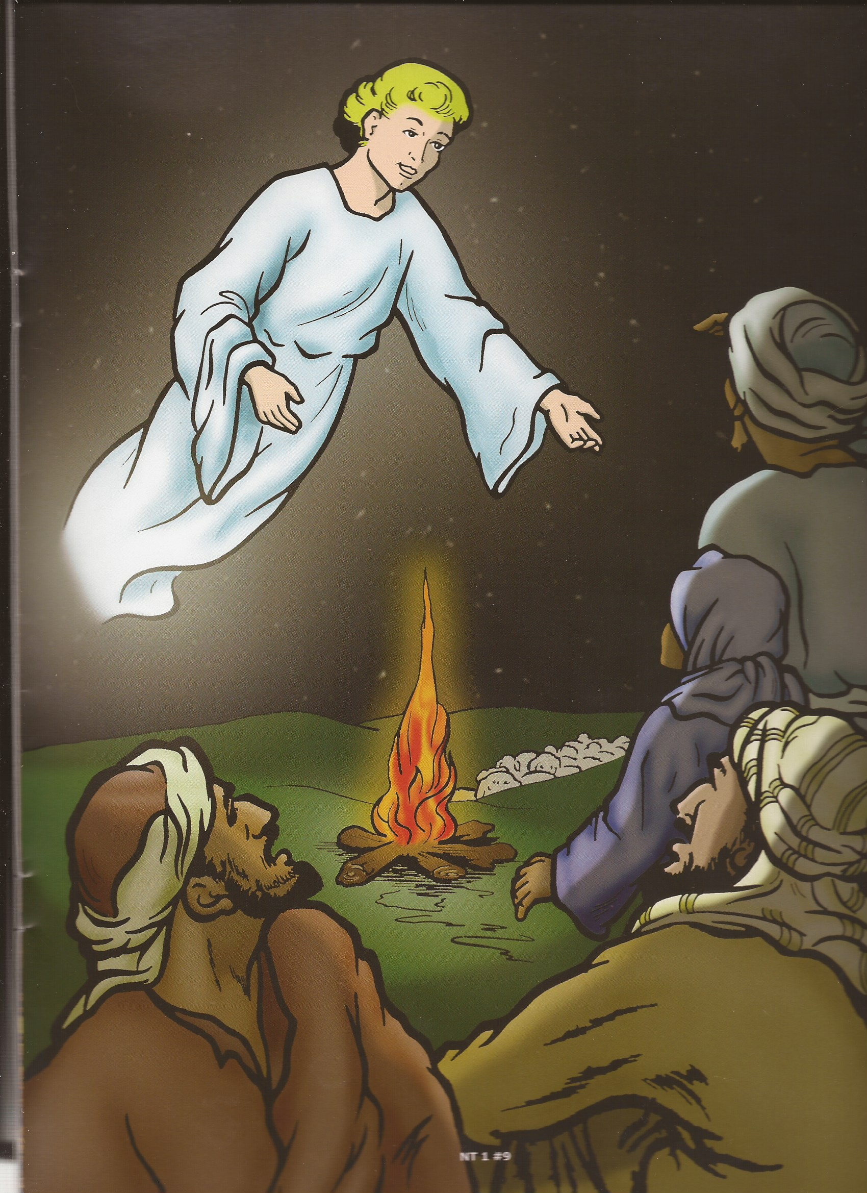
FC #4/5

Slide 15
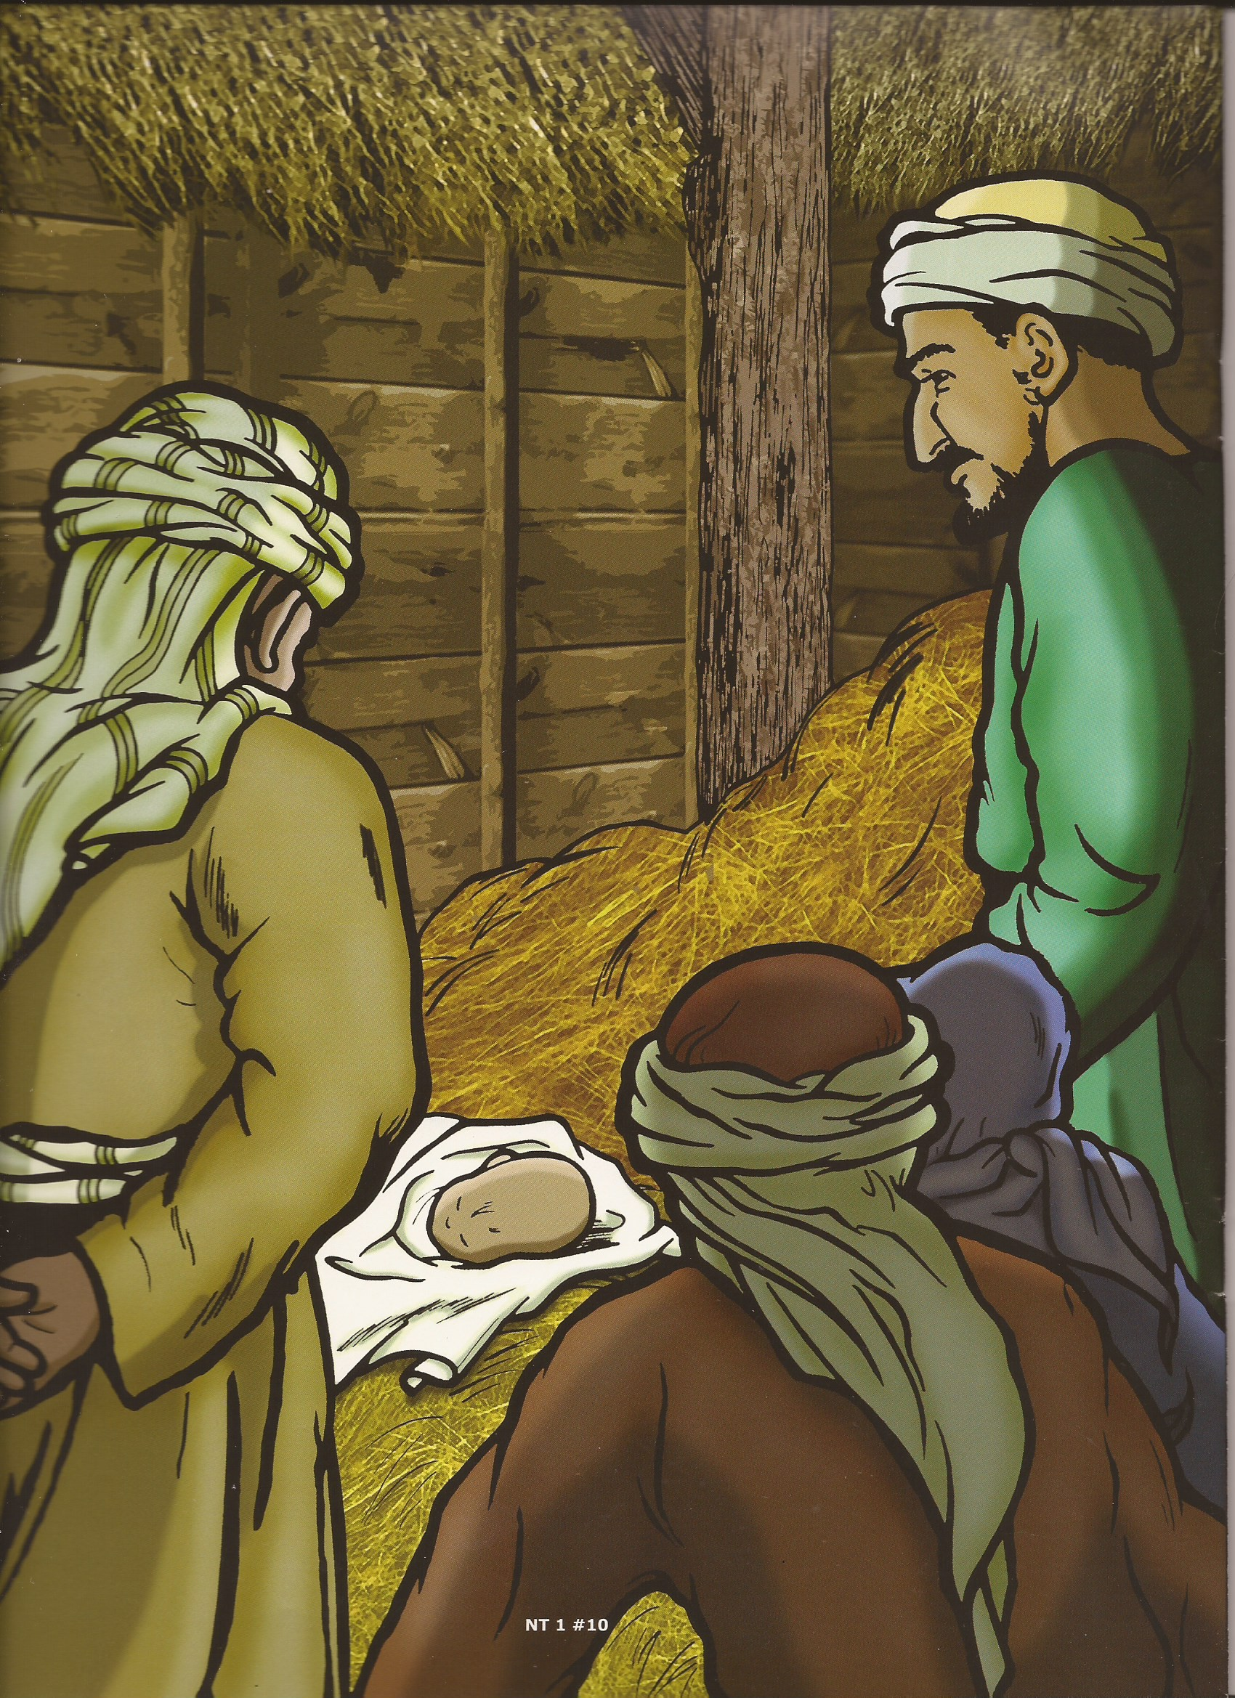
FC #6/7

Slide 16
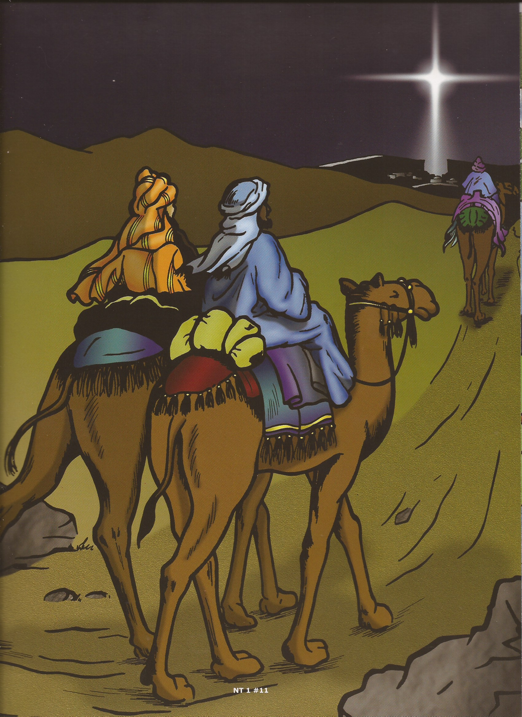
FC #8

Slide 17
FC #9

Slide 18
Page #2

Slide 19
Page #3

Slide 20
Page#4

Slide 21
Page#5

Slide 22
What will you give to Jesus?

Slide 23
Page#5

Slide 24
What will you give to Jesus?

Slide 25
“…Present your bodies a living sacrifice….”
Romans 12:1

Slide 26
Page#6

Slide 31
What will you give to Jesus?

Slide 32
“…Present your bodies a living sacrifice….”
Romans 12:1

Slide 33
“…The gift of God is eternal life through Jesus Christ our Lord.”
Romans 6:23

Slide 37
“I beseech you therefore, brethren, by the mercies of God, that ye present your bodies a living sacrifice, holy, acceptable unto God, which is your reasonable service.”
Romans 12:1

Slide 39
A
B
C
D
E
F
G
H

