Slide 1
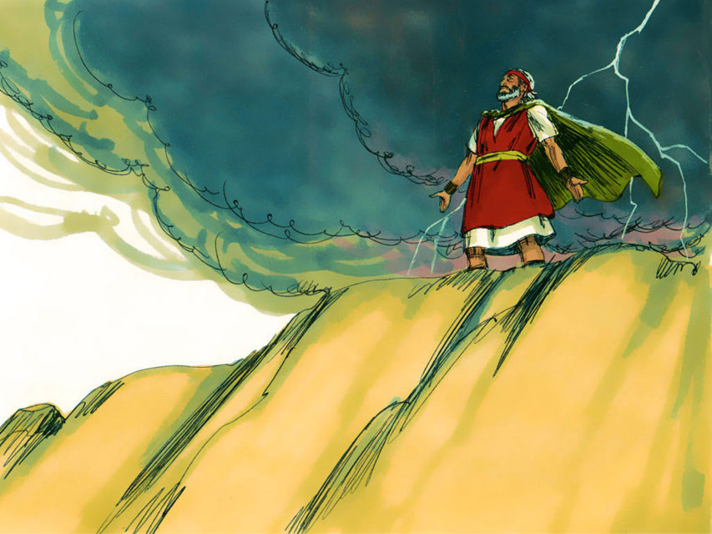
MOSES #9
“God’s Presence with Moses”

Slide 3
Notes:
Rule Chart

Slide 4
Notes:
Prayer

Slide 5
Notes:
Song: “All that is Good”

Slide 8
Notes:
Song: “My God is Powerful”

Slide 9
Notes:
Bible Lesson

Slide 10
Notes:
2-1

Slide 12
Notes:
2-1

Slide 14
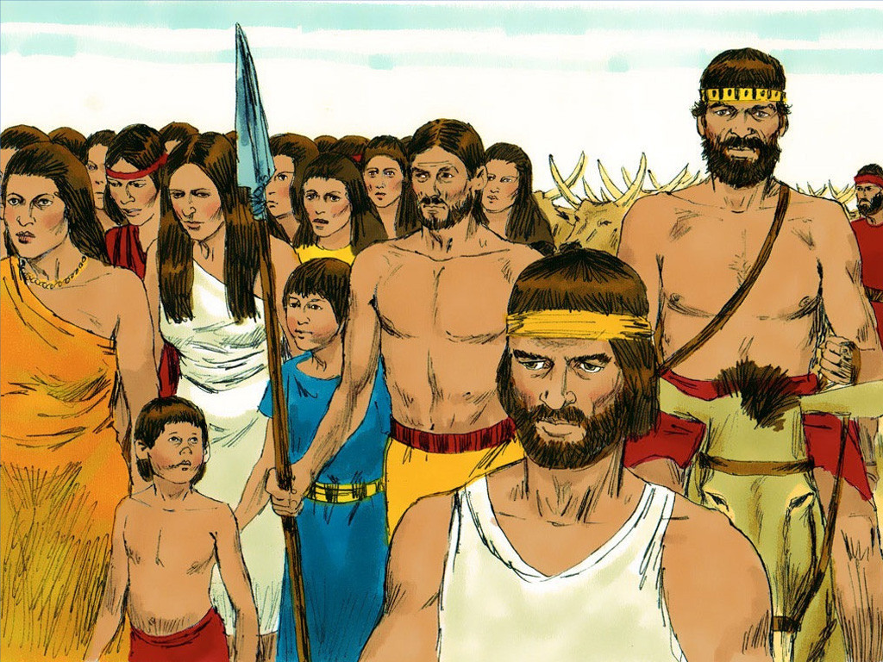
Notes:
2-2

Slide 15
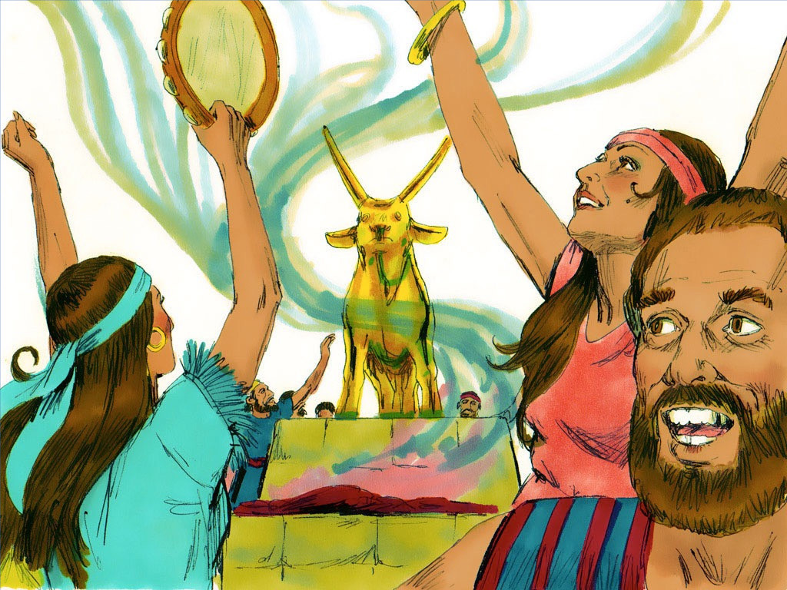
Notes:
2-3

Slide 17
Notes:
2-3

Slide 20
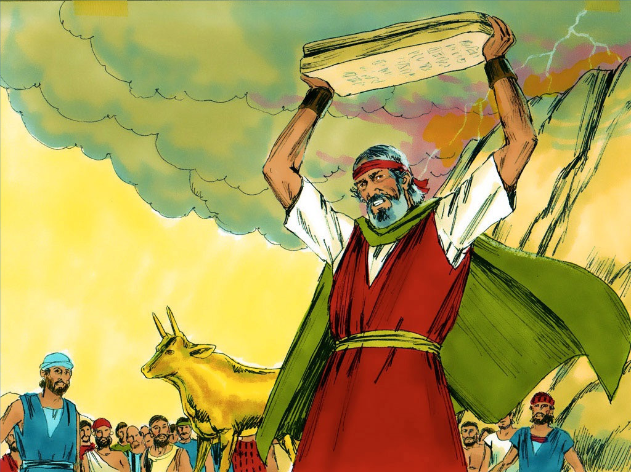
Notes:
2-4

Slide 21
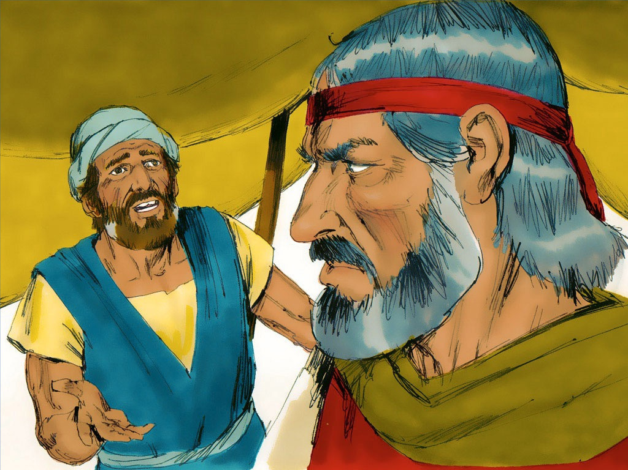
Notes:
2-5

Slide 26
